Slide 1

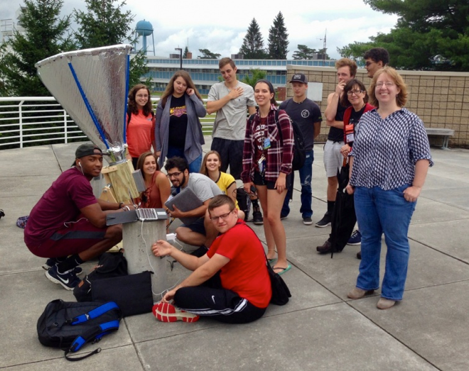

See the Big Picture – via
Milky Way Radio Astronomy
Glen Langston (NSF), Kevin Bandura, Pranav Sanghavi, Evan Smith (WVU), Sue Ann Heatherly, Sophie St. Georges (GBO), Tad Herman (WCSDNY), Joe Wise, Robert Baker (Wildwood), David Schultz (Park Ridge), John Makous (Providence), Eric Goff (Loudoun), Howard Chun, John Clark

Slide 2

Student Outcomes
  Show that everyone can discover the Milky Way in their own backyard.
  Students learn Scientific Process
  Students learn self-organization, group leadership
  Students design their own experiments
glangsto@nsf.gov
Notes:
NSF is focused on fundamental research --- that is transformative and pushes the boundaries of the current knowledge.

Slide 3
Introduction:
glangsto@nsf.gov
Radio and Optical Astronomer
NSF Galactic Astronomy Grants Program
Lead role in Outreach and Citizen Science
  Previous live AAS video demo: https://www.gb.nrao.edu/~glangsto/aas2020/Langston2020AasTelescopeWebinar.mp4
glangsto@nsf.gov
Notes:
All of Astronomy Grants program $ 44 Million, of that Galactic Astronomy $8.5 Million per year.
Radio Spectrum for Astronomy has a worth of $13 Billion

Slide 4
Outcome of Presentation
  Share student’s many Hands-On Milky Way projects.
  What goal? Help students appreciate their place in the Universe.
  How? Show that everyone can discover the Milky Way in their own backyard.
  Who? Investigators working with Teachers.
glangsto@nsf.gov
Notes:
NSF is focused on fundamental research --- that is transformative and pushes the boundaries of the current knowledge.

Slide 5
Goals of this Presentation
  Convince you that anyone can build a radio telescope to see the Milky Way.
  Show that High Schools can work together Nationwide.
  Solicit proposals from you to Expand the High School network.
  Solicit Key Science projects from you for the telescope network.
glangsto@nsf.gov
Notes:
NSF is focused on fundamental research --- that is transformative and pushes the boundaries of the current knowledge.

Slide 6
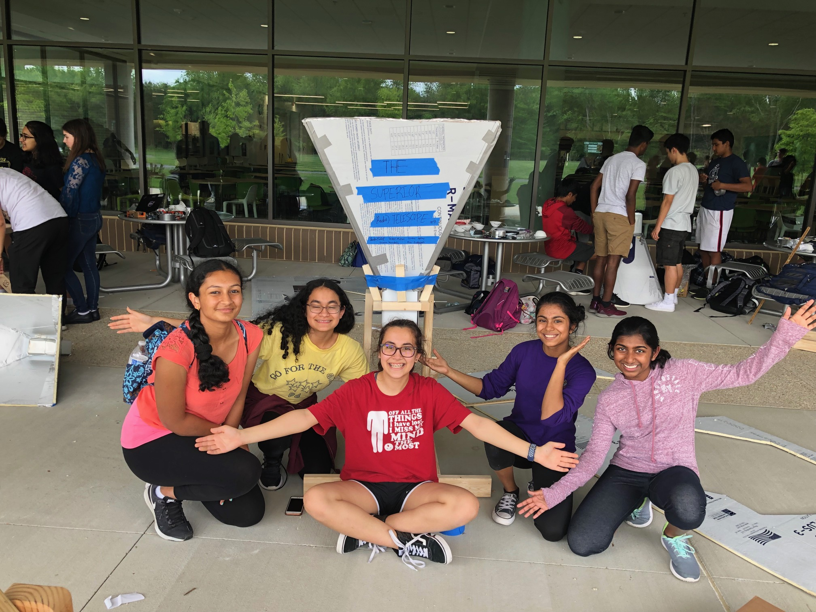
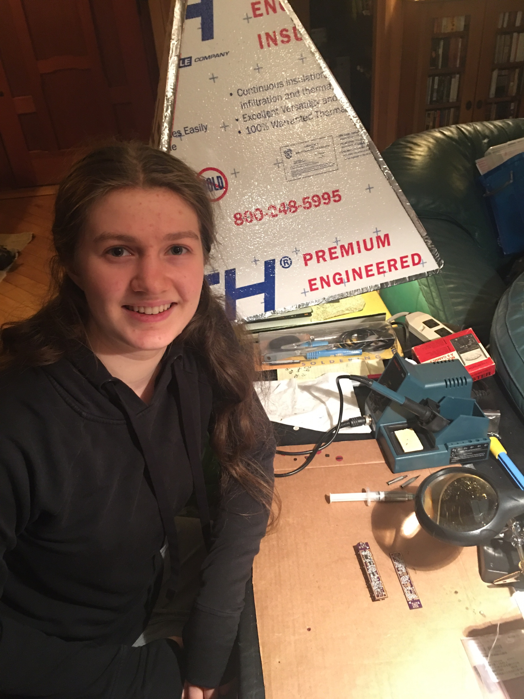
Students in Action
  Building Telescopes
  9th Grade Students with their telescope at Loudoun Academy in VA
  Student with amplifiers she built for the telescope in Los Angels, CA
glangsto@nsf.gov
Notes:
All of Astronomy Grants program $ 44 Million, of that Galactic Astronomy $8.5 Million per year.
Radio Spectrum for Astronomy has a worth of $13 Billion

Slide 7
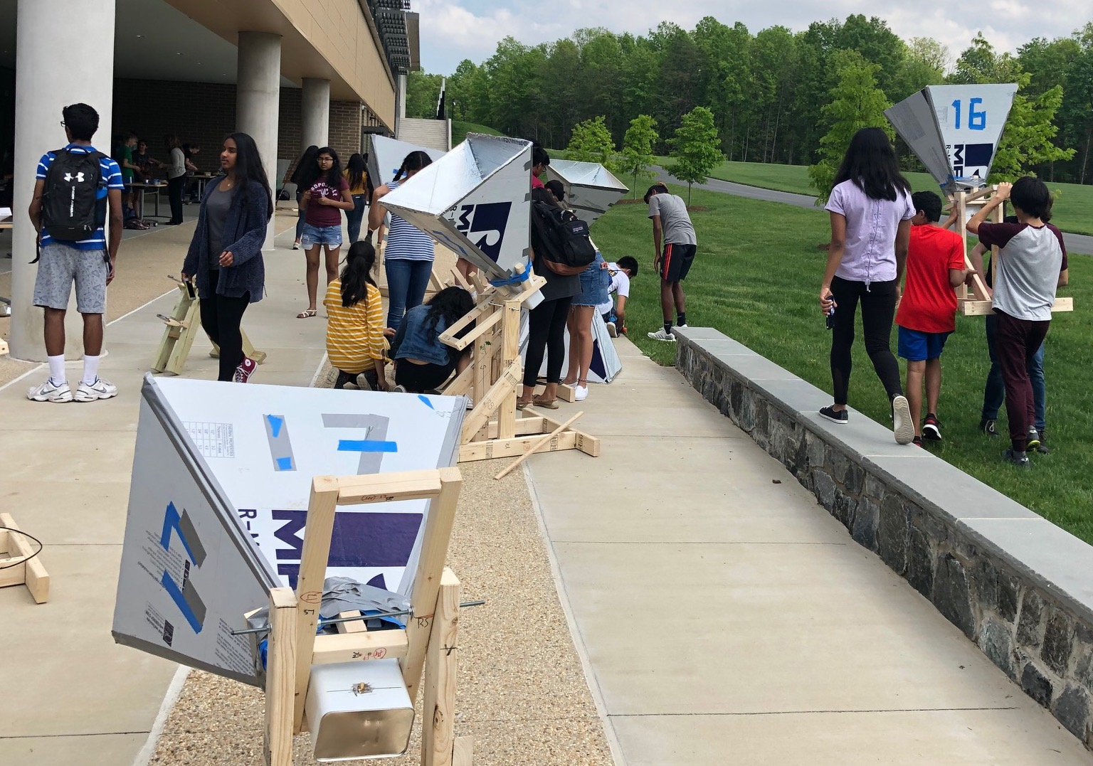
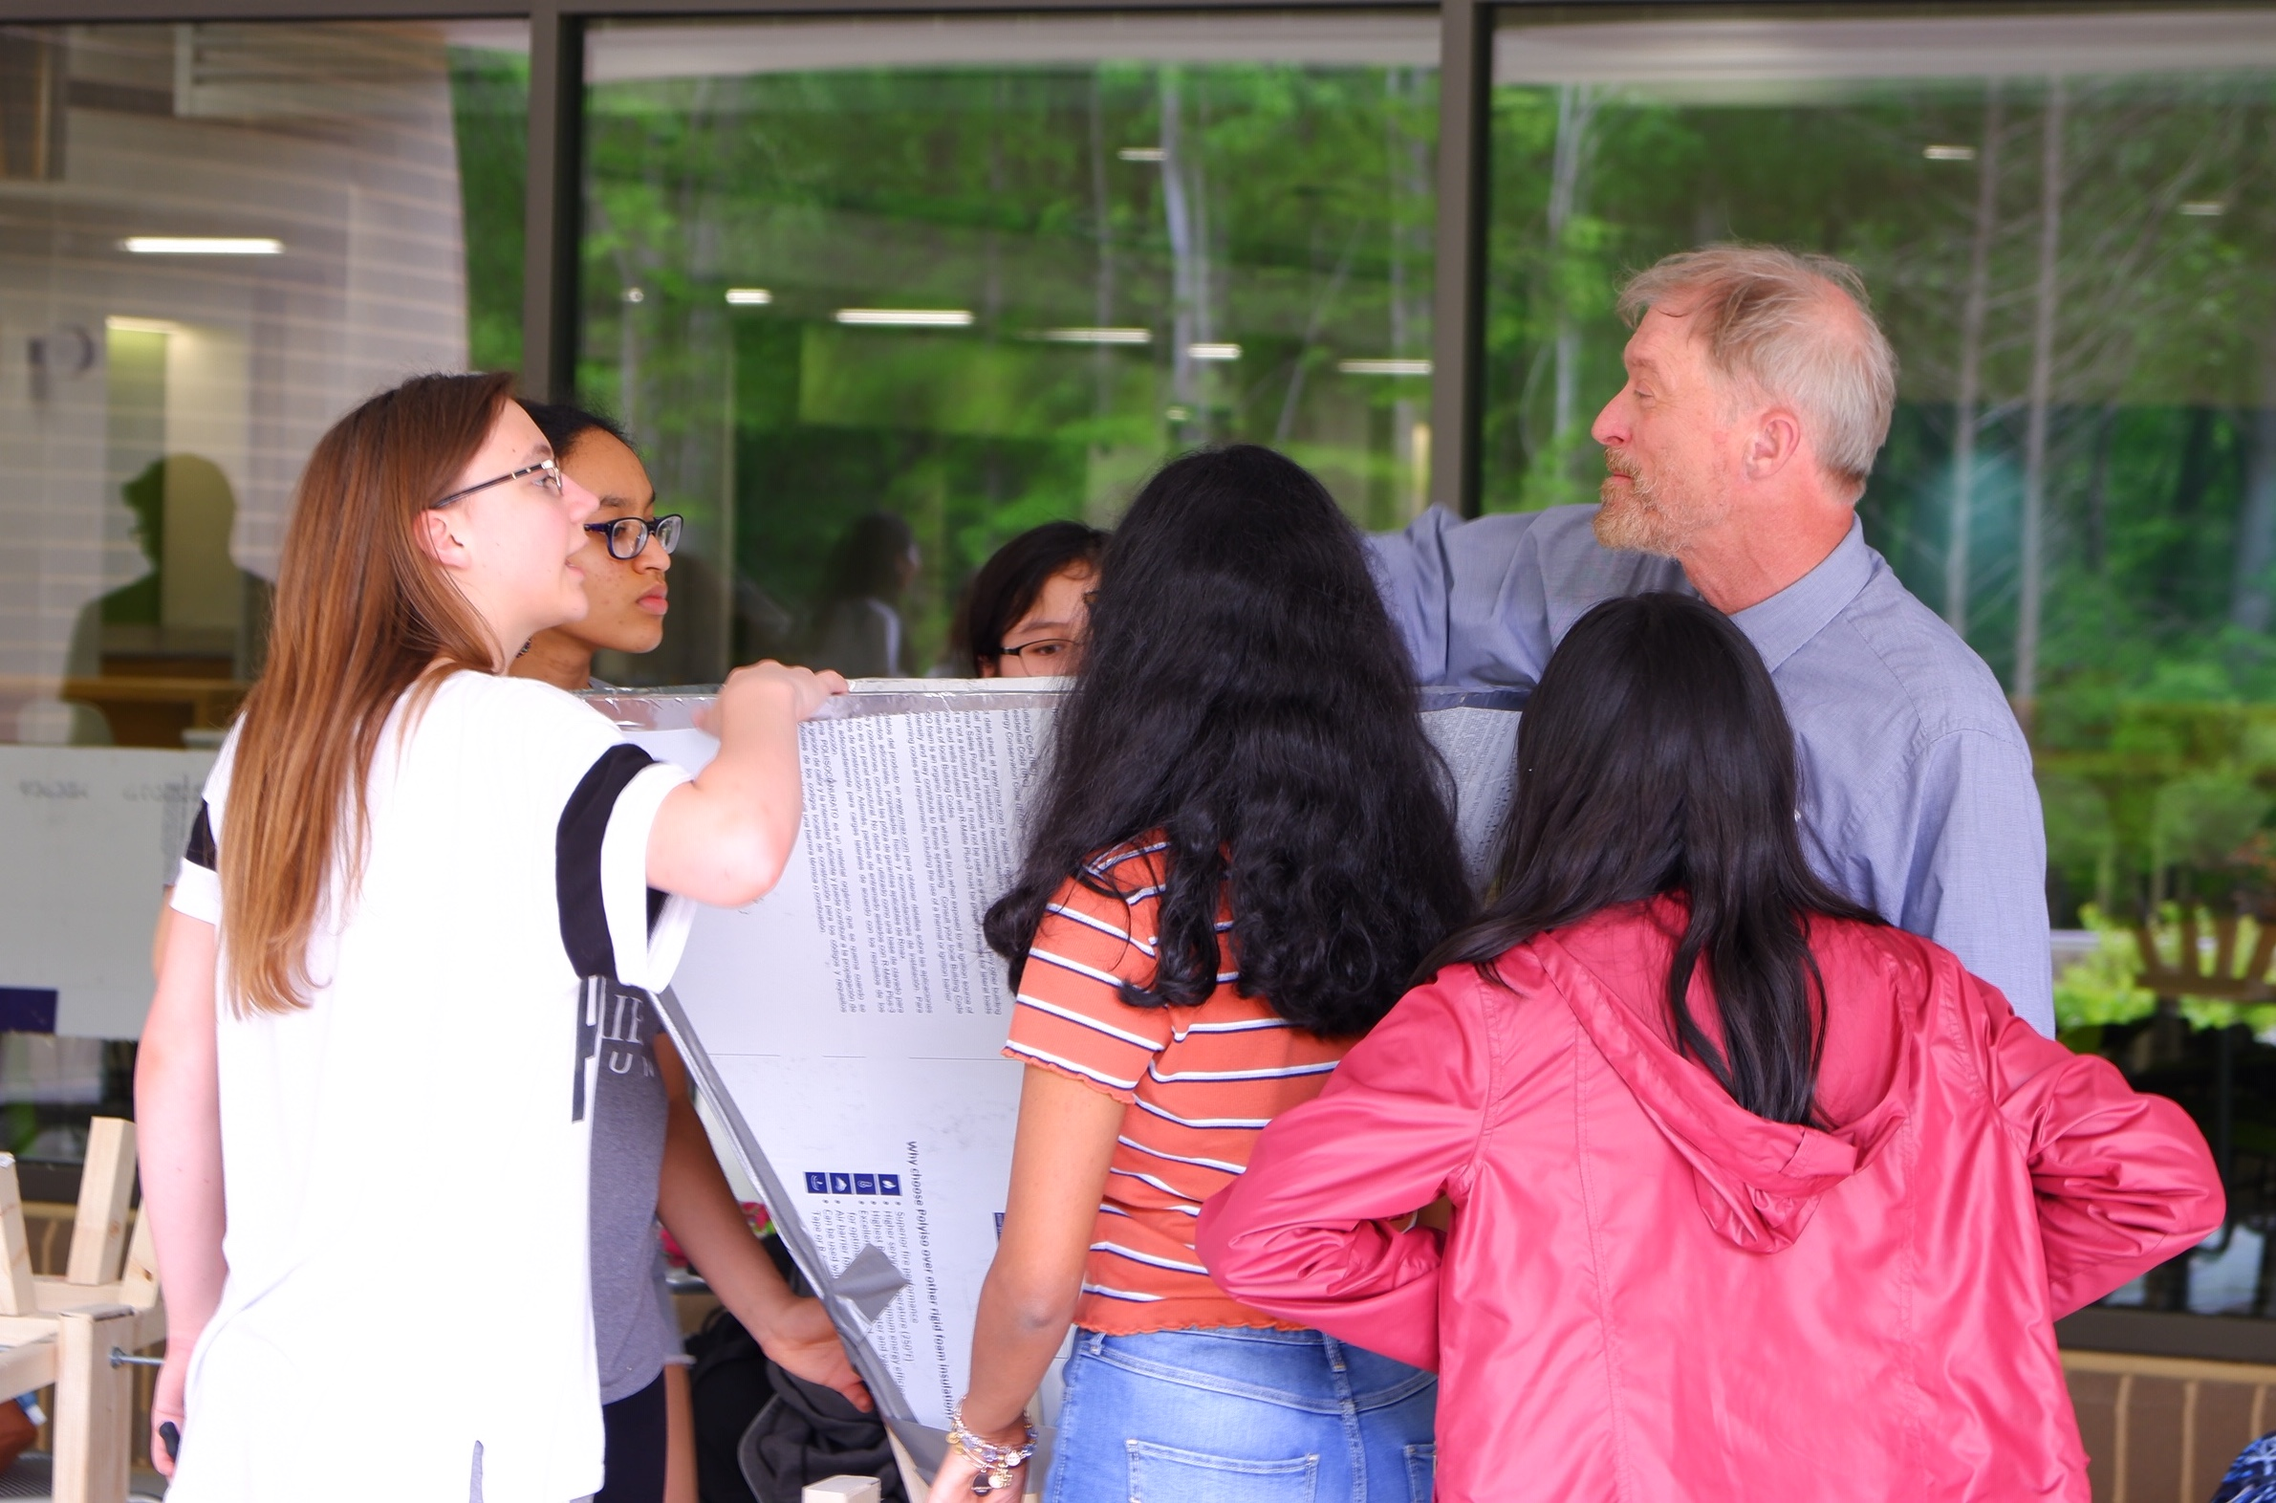
More Students in Action
  Building lots of Telescopes
  Group projects for 9th grade students teach teamwork, engineering, software and science simultaneously
  This was class project was organized by Eric Goff, with help from Kevin Bandura and Pranav Sanghavi
glangsto@nsf.gov
Notes:
All of Astronomy Grants program $ 44 Million, of that Galactic Astronomy $8.5 Million per year.
Radio Spectrum for Astronomy has a worth of $13 Billion

Slide 8
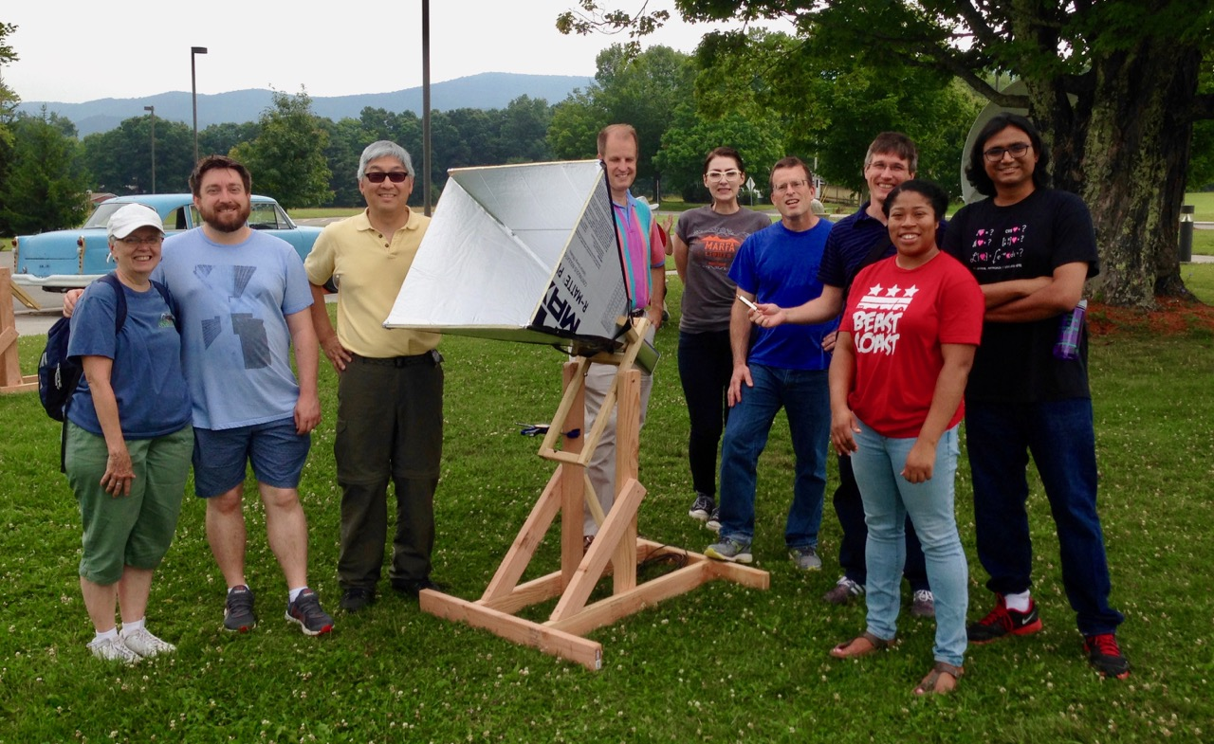
West Virginia University
https://wvurail.org/dspira/
  Hosts High School Teachers to develop curriculum
  Construction Guides - variety of telescope designs
  Each teacher built and operated a telescope
Kevin Bandura (WVU) building telescopes with high school teachers

Slide 9
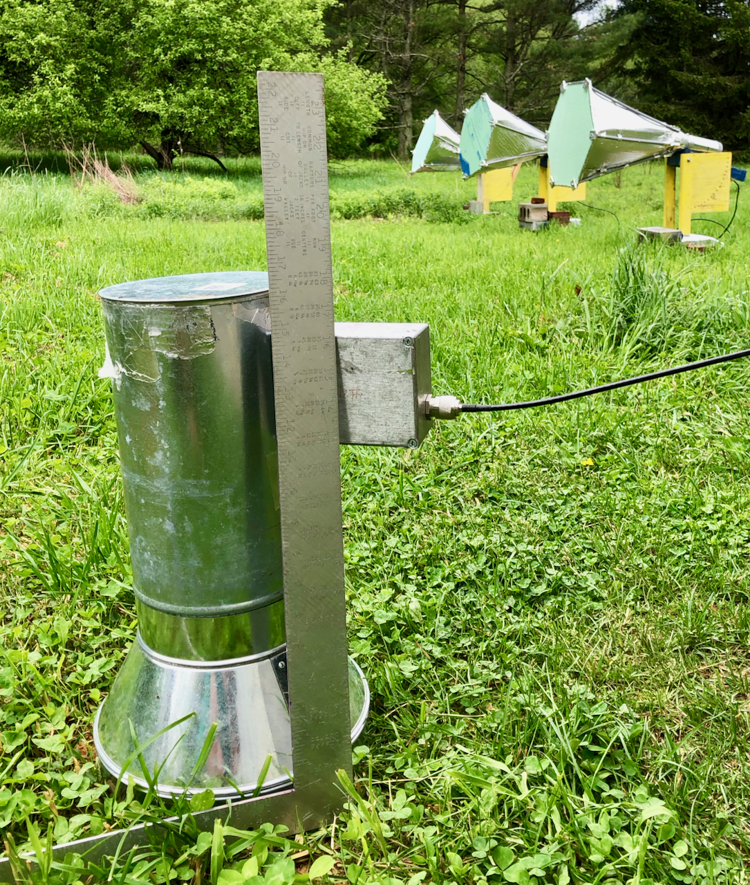
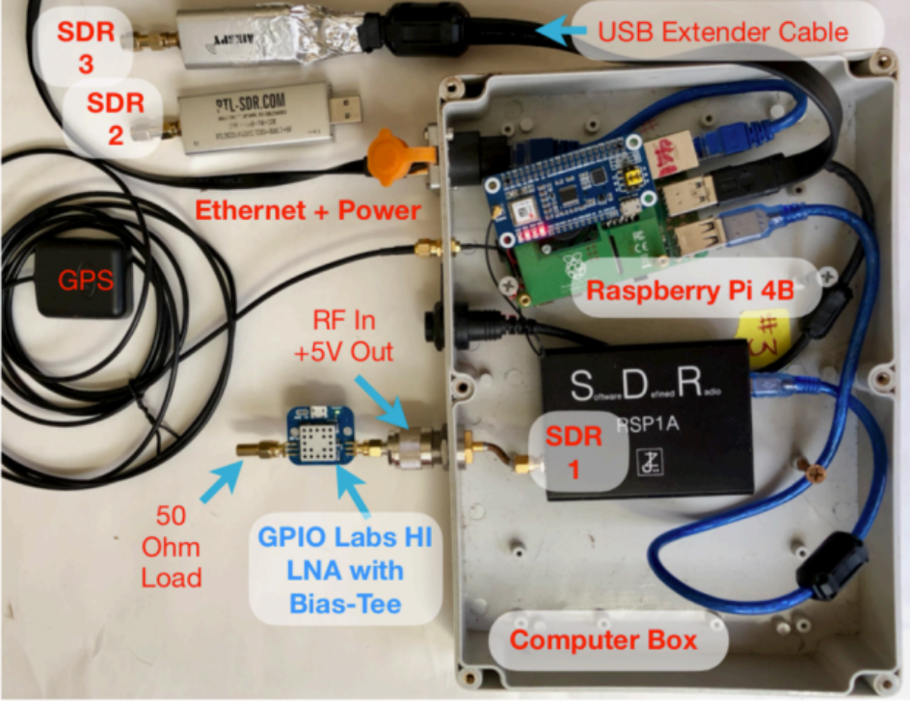
LightWork Memos
Telescope Components
Left: Radio Telescope Resonant Cavity in Front of 3 Radio Telescopes. The resonant cavity design is critical to high sensitivity. Right: Commercial computer components have sufficient sensitivity for easy study of our galaxy. All electronics need for the telescope are in the figure at right.
http://bit.ly/LightWorkMemos

Slide 10
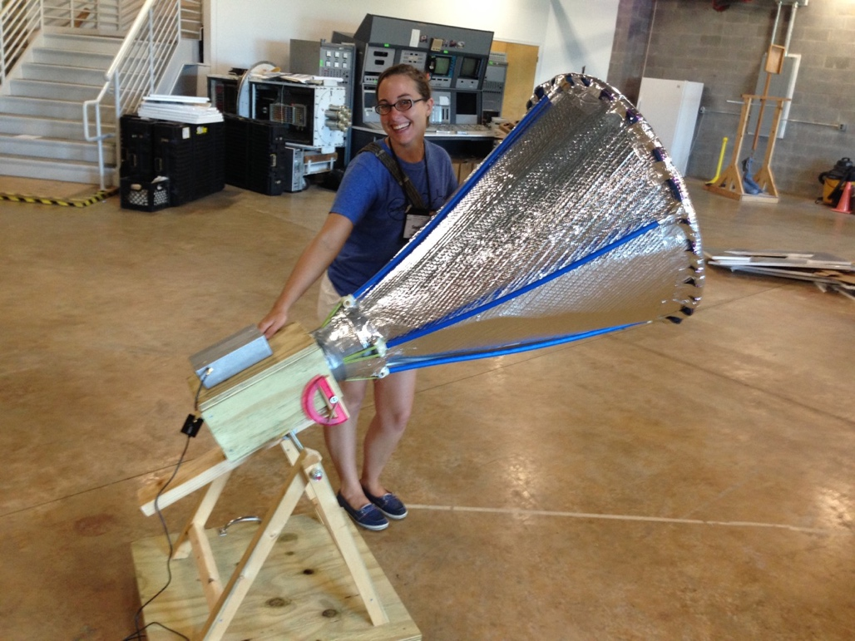
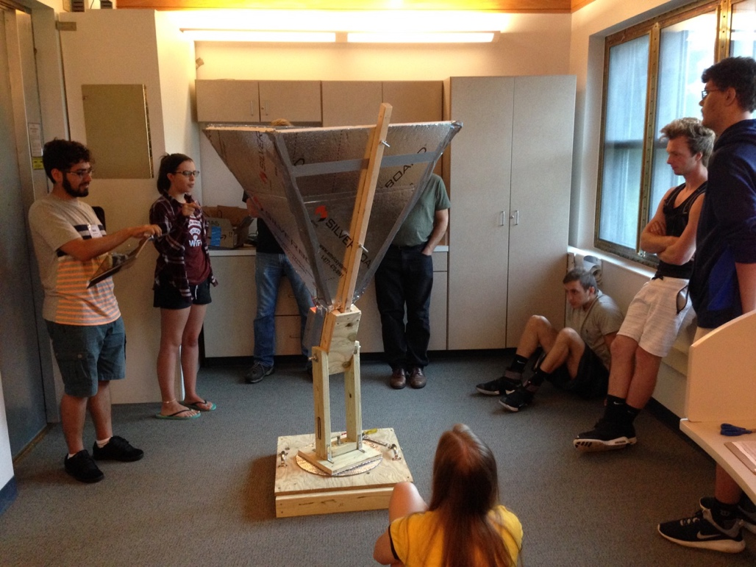
Horn Telescopes can be made of many types of materials
Left: Bubble Wrap horn. Right: Reflective foam horn
Bases are a complicated issue, as the horns must be left outside for long periods.
The students present their horn design and construction experience.

Slide 11
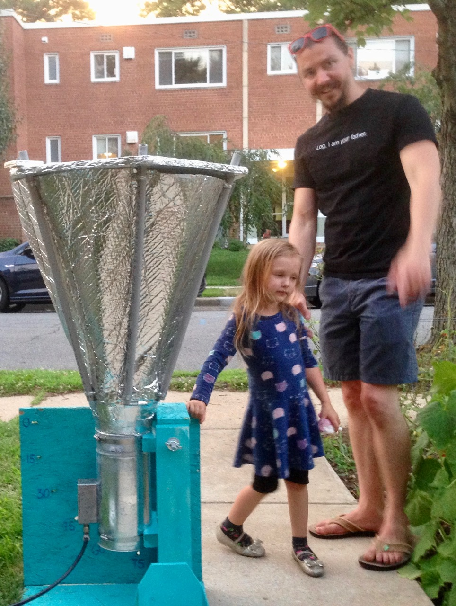
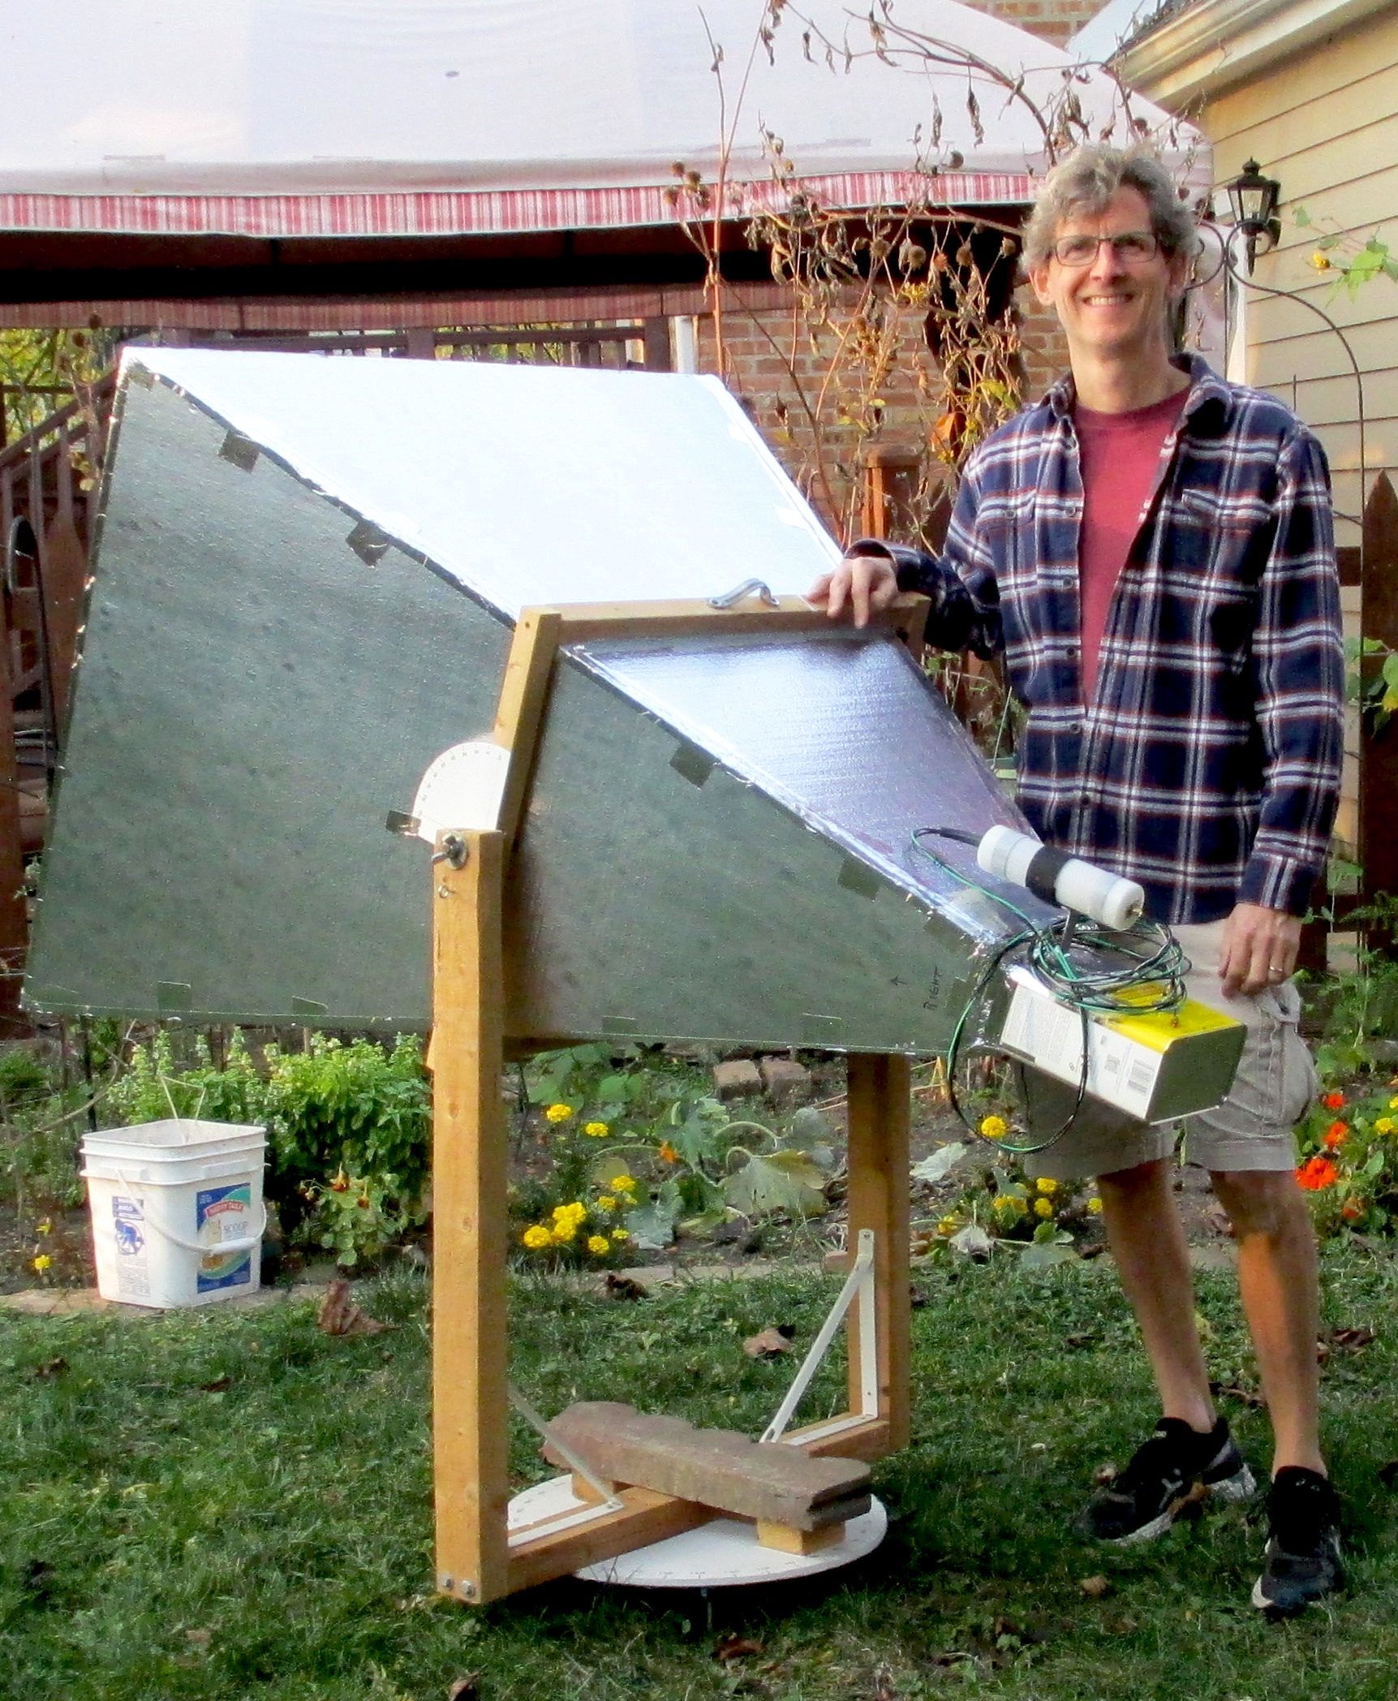
High School Telescopes Can Have Unique Features
  David Schultz at Park Ridge HS, Chicago

Slide 12
Recap:
  Many high school teachers and students have built and operated Radio Telescopes
  See: Digital Signal Processing in Radio Astronomy - Lessons Portal
  https://wvurail.org/dspira/
glangsto@nsf.gov
Notes:
NSF is focused on fundamental research --- that is transformative and pushes the boundaries of the current knowledge.

Slide 13
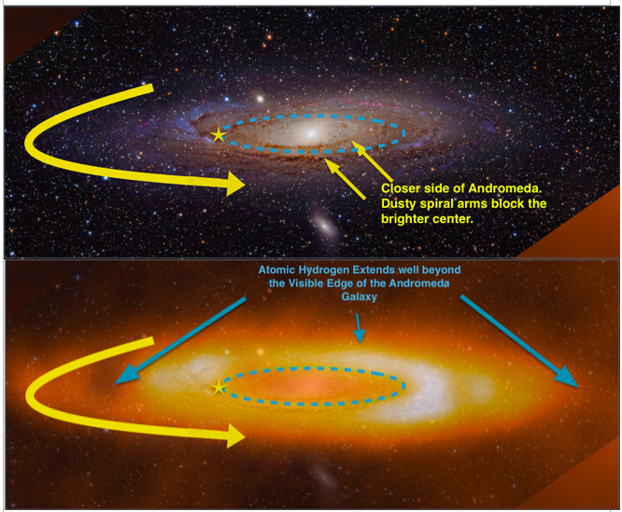
glangsto@nsf.gov

Slide 14
Aficionado Software
Observations and Calibration
Gnuradio-Based Observing Interface. Runs on a Raspberry Pi 4. Free Software!

Slide 15
Aficionado Software
Observations and Calibration
Hot and Cold load Calibration with astronomical accuracy!

Slide 16
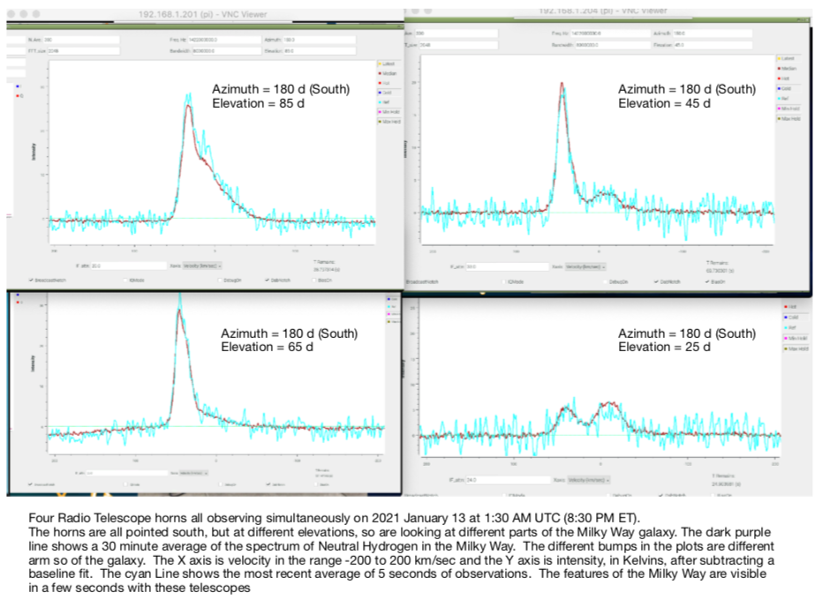
Almost “Live” Demos
Our intention was to have live observations during this presentation.
John Makous, Providence HS, North Caroline sent this observation, made
At noon today.
Will Try to Go Live…

Slide 17
Recap:
  Your Telescopes can observe the Milky Way while you are busy inventing Experiments
  Experiments:
            Find the Milky Way, Observe a band of Sky and the North Pole
            Map the Milky Way
            Detect Cosmic Ray Flashes
            Discover a Fast Radio Burst or Magnitar (eg. SGR 1935+2154)
            Discover Extra-terrestrials communicating by Radio Flashes
            Discover Extra-terrestrials communicating by Cosmic Rays
glangsto@nsf.gov
Notes:
NSF is focused on fundamental research --- that is transformative and pushes the boundaries of the current knowledge.

Slide 18
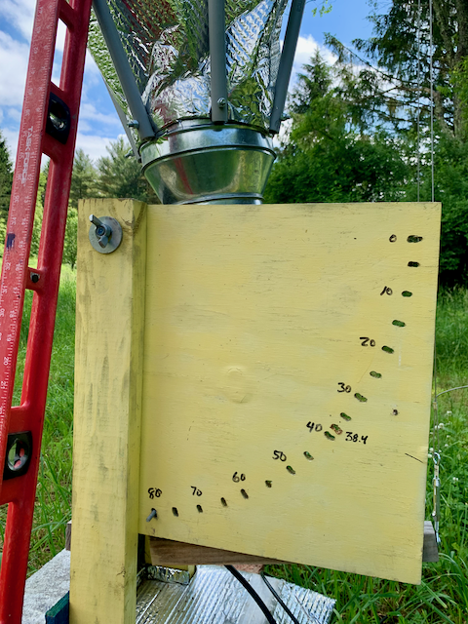
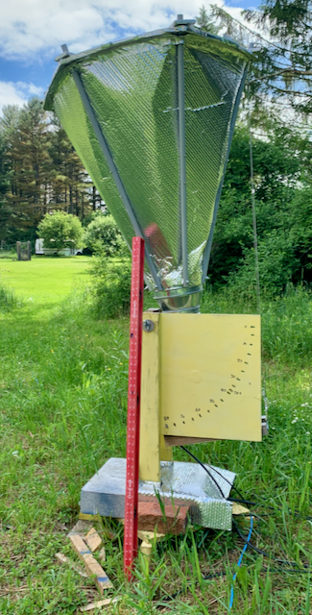
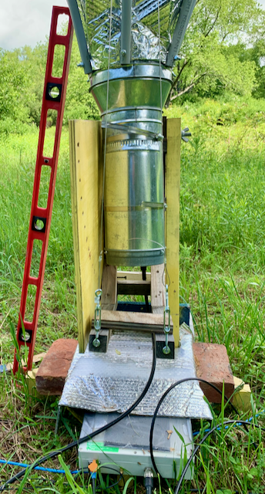
Transit Telescopes
  Observe for 24 hours with telescope at an elevation.
glangsto@nsf.gov
Notes:
NSF is focused on fundamental research --- that is transformative and pushes the boundaries of the current knowledge.

Slide 19
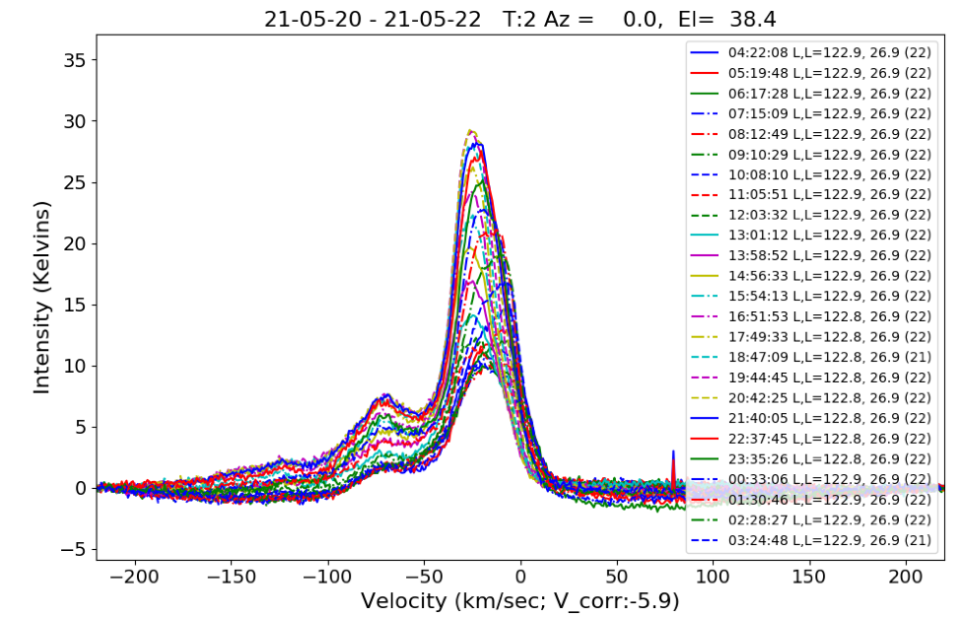
Transit Telescopes
  Observe for 24 hours at North Pole.
  Small pointing offsets cause surprising shifts in intensity!
glangsto@nsf.gov
Notes:
NSF is focused on fundamental research --- that is transformative and pushes the boundaries of the current knowledge.

Slide 20
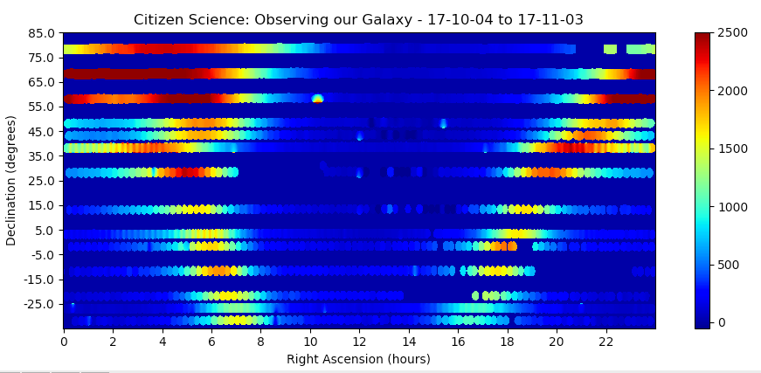
A week Drifts by…
The data files must fully and accurately describe the observations. Calibration observations are also needed periodically.

Slide 21
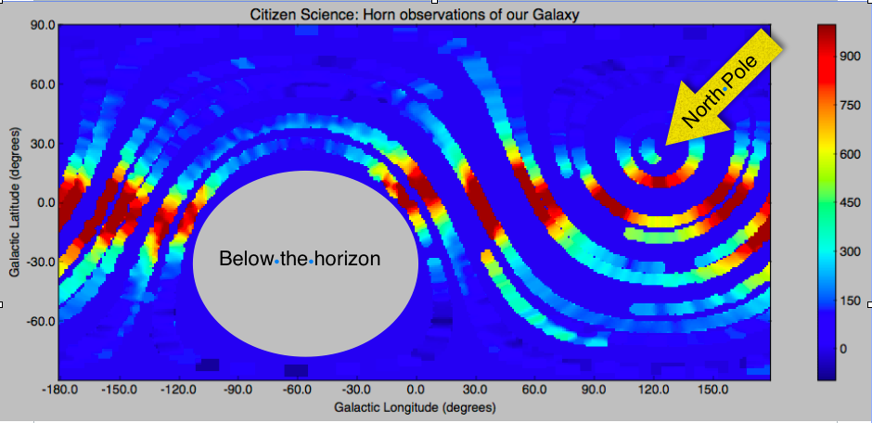
Aficionado Map of our Galaxy
Integrated Neutral Hydrogen (K km/sec)
glangsto@nsf.gov

Slide 22
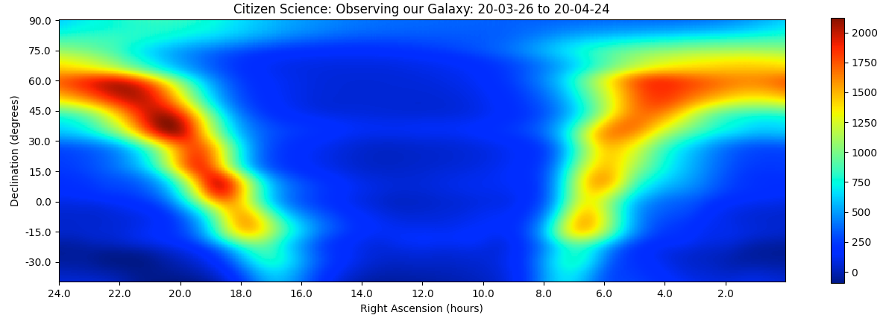
Another month Drifts by…
Improved calibration and better pointing needed to produce a more accurate map.

Slide 23
  Share the Big Picture: The vast scale of the Milky Way in time and space Miraculously Makes Life Possible!
Real Goal

