Slide 1
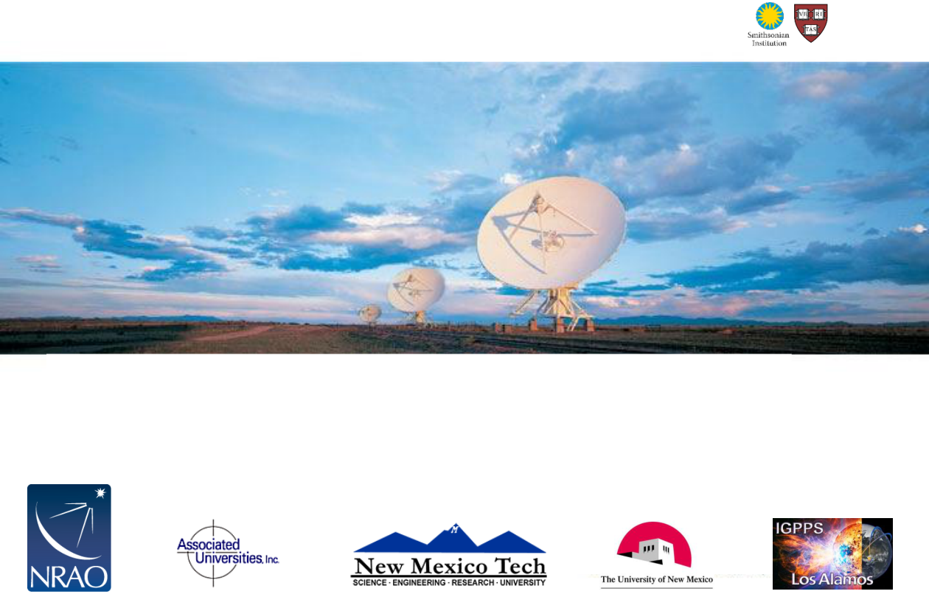
Imaging and Deconvolution
David J. Wilner (Harvard-Smithsonian Center for Astrophysics)
Fourteenth Synthesis Imaging Workshop
2014 May 13– 20
Notes:
Source edition: assets/lessons/lectures/radio-astronomy/imaging-and-deconvolution-wilner-2014.pdf, page 1. Original author and figure credits remain on the slide. Text is editable; illustrations retain their source artwork.

Slide 2

References
•
Thompson, A.R., Moran, J.M., Swensen, G.W.
2004
“Interferometry and Synthesis in Radio Astronomy”, 2
nd
edition (Wiley-VCH)
•
previous Synthesis Imaging Workshop proceedings
–
Perley, R.A., Schwab, F.R., Bridle, A.H. eds. 1989 ASP Conf. Series 6
“Synthesis Imaging in Radio Astronomy” (San Francisco: ASP)
•
Ch. 6 Imaging (Sramek & Schwab) and Ch. 8 Deconvolution (Cornwell)
–
www.aoc.nrao.edu/events/synthesis
•
lectures by Cornwell 2002 and Bhatnagar 2004, 2006
•
IRAM Interferometry School proceedings
–
www.iram.fr/IRAMFR/IS/IS2008/archive.html
•
Ch. 13 Imaging Principles and Ch. 16 Imaging in Practice (Guilloteau)
•
lectures by Pety 2004-2012
•
many other lectures and pedagogical presentations are available
–
ALMA primer, ATNF, CARMA, ASIAA, e-MERLIN, …
Fourteenth Synthesis Imaging Workshop
Notes:
Source edition: assets/lessons/lectures/radio-astronomy/imaging-and-deconvolution-wilner-2014.pdf, page 2. Original author and figure credits remain on the slide. Text is editable; illustrations retain their source artwork.

Slide 3
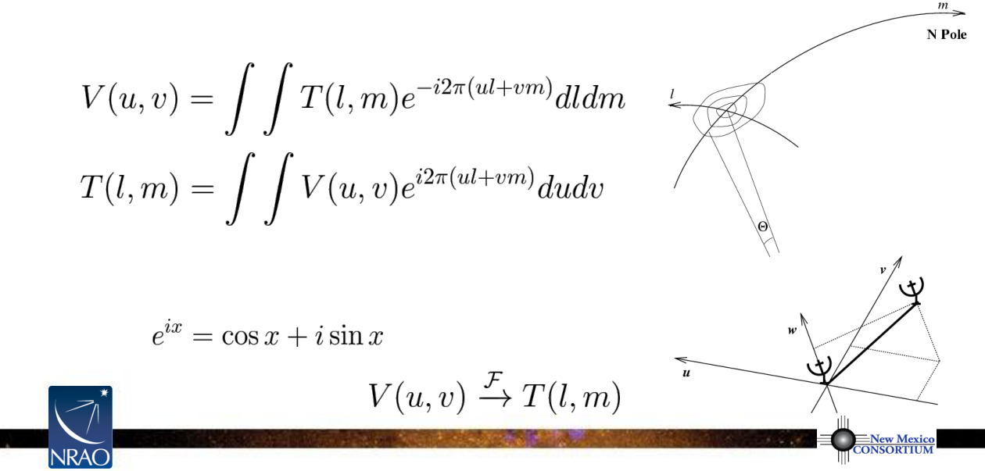
Visibility and Sky Brightness
•
V(u,v), the complex visibility function, is the 2D Fourier transform of T(l,m), the
sky brightness distribution (for incoherent source, small field of view, far field, etc.)
[for derivation from van Cittert-Zernike theorem, see TMS Ch. 14]
•
mathematically
T(l,m
)
u,v
are E-W, N-S spatial frequencies [wavelengths]
l,m
are E-W, N-S angles in the tangent plane [radians]
(recall )
Fourteenth Synthesis Imaging Workshop
Notes:
Source edition: assets/lessons/lectures/radio-astronomy/imaging-and-deconvolution-wilner-2014.pdf, page 3. Original author and figure credits remain on the slide. Text is editable; illustrations retain their source artwork.

Slide 4
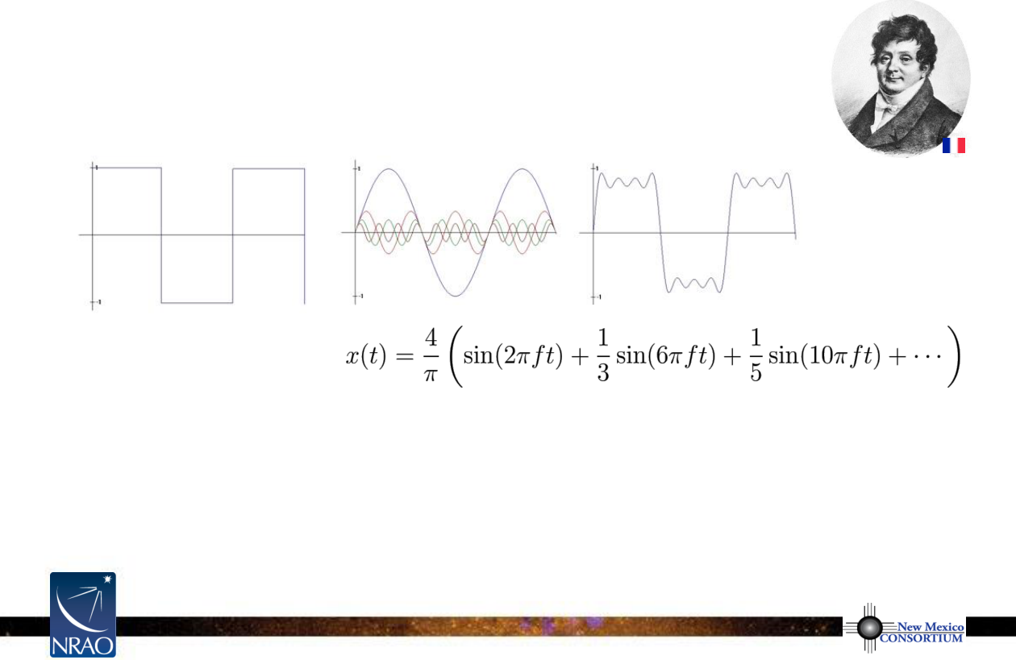
The Fourier Transform
•
Fourier theory states and any well behaved signal (including
images) can be expressed as the sum of sinusoids
Jean Baptiste
Joseph Fourier
1768-1830
signal
4 sinusoids
sum
•
the Fourier transform is the mathematical tool that decomposes a signal
into its sinusoidal components
•
the Fourier transform contains
all
of the information of the original signal
Notes:
Source edition: assets/lessons/lectures/radio-astronomy/imaging-and-deconvolution-wilner-2014.pdf, page 4. Original author and figure credits remain on the slide. Text is editable; illustrations retain their source artwork.

Slide 5
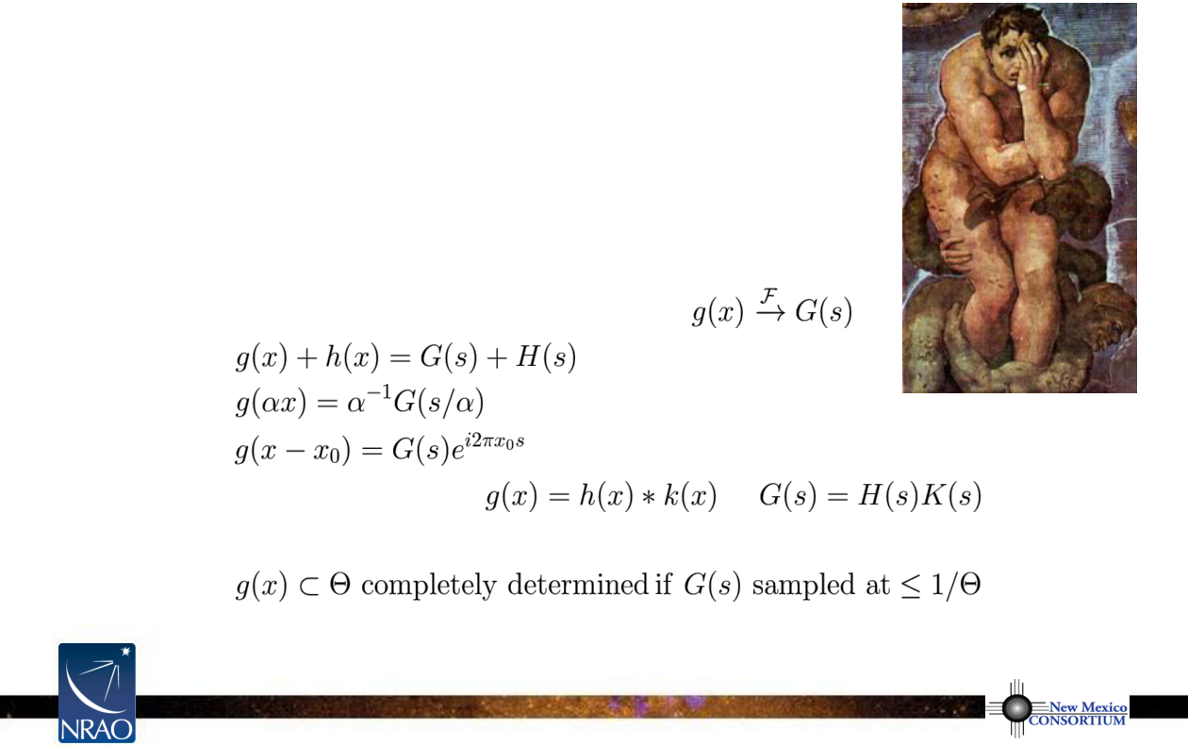
The Fourier Domain
•
acquire some comfort with the Fourier domain
•
in older texts, functions and their Fourier transforms
occupy
upper
and
lower
domains, as if “functions circulated
at ground level and their transforms in the underworld”
(Bracewell 1965)
•
some properties of the Fourier transform
adding
scaling
shifting
convolution/multiplication
Nyquist-Shannon sampling theorem
Notes:
Source edition: assets/lessons/lectures/radio-astronomy/imaging-and-deconvolution-wilner-2014.pdf, page 5. Original author and figure credits remain on the slide. Text is editable; illustrations retain their source artwork.

Slide 6
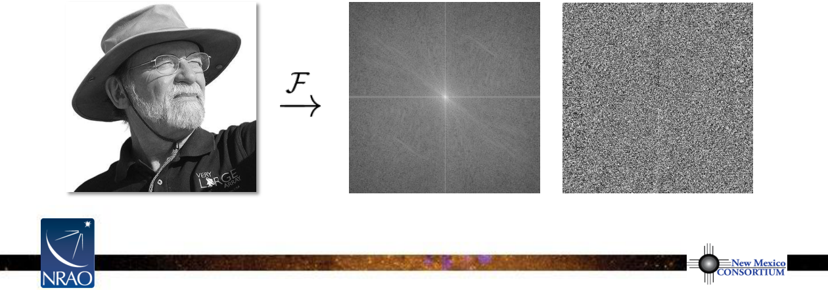
Visibilities
•
each
V(u,v)
contains information
on
T(l,m)
everywhere
,
not just at a given
(l,m)
coordinate or within a particular subregion
•
each
V(u,v)
is a complex quantity
–
expressed as
(real, imaginary)
or
(amplitude, phase)
T(l,m)
V(u,v) amplitude
V(u,v) phase
Notes:
Source edition: assets/lessons/lectures/radio-astronomy/imaging-and-deconvolution-wilner-2014.pdf, page 6. Original author and figure credits remain on the slide. Text is editable; illustrations retain their source artwork.

Slide 7
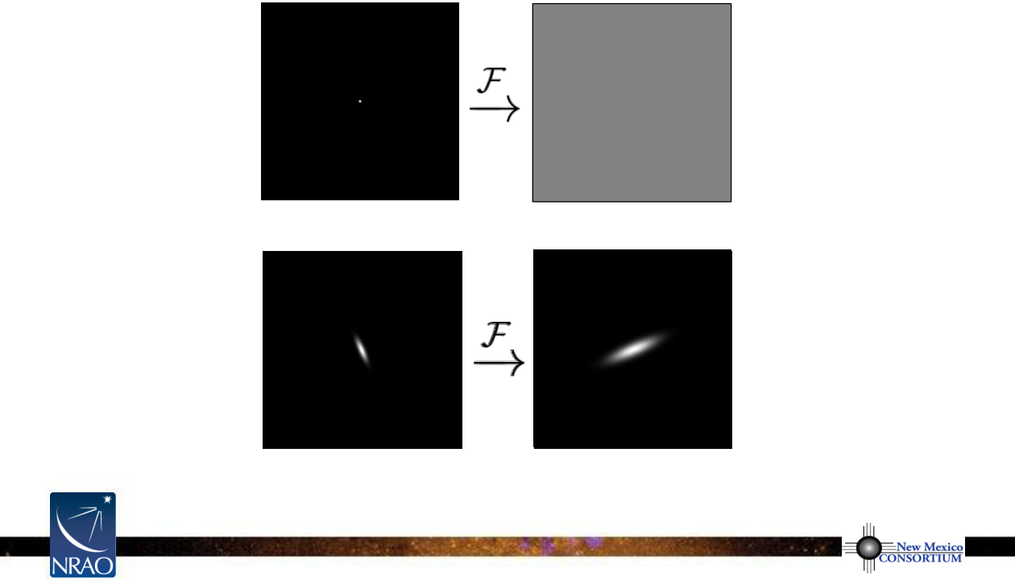
Example 2D Fourier Transforms
T(l,m)
V(u,v) amplitude
δ
function
constant
elliptical
elliptical
Gaussian
Gaussian
narrow features transform into wide features (and vice-versa)
Notes:
Source edition: assets/lessons/lectures/radio-astronomy/imaging-and-deconvolution-wilner-2014.pdf, page 7. Original author and figure credits remain on the slide. Text is editable; illustrations retain their source artwork.

Slide 8
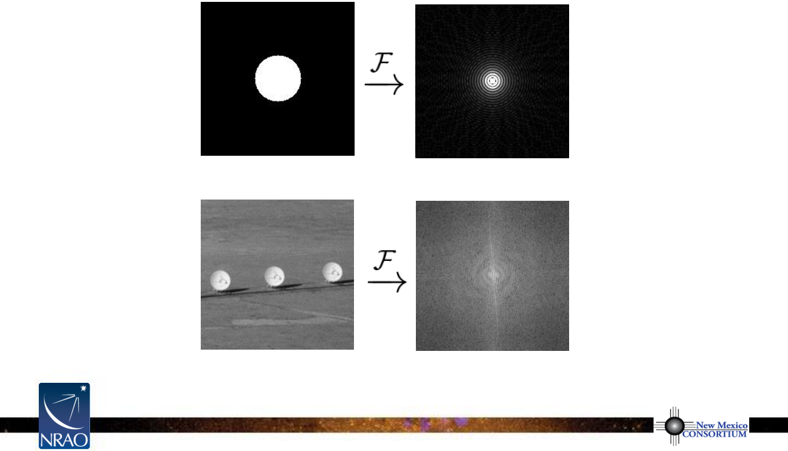
Example 2D Fourier Transforms
T(l,m)
V(u,v) amplitude
uniform
Bessel
disk
function
sharp edges result in many high spatial frequencies
Notes:
Source edition: assets/lessons/lectures/radio-astronomy/imaging-and-deconvolution-wilner-2014.pdf, page 8. Original author and figure credits remain on the slide. Text is editable; illustrations retain their source artwork.

Slide 9
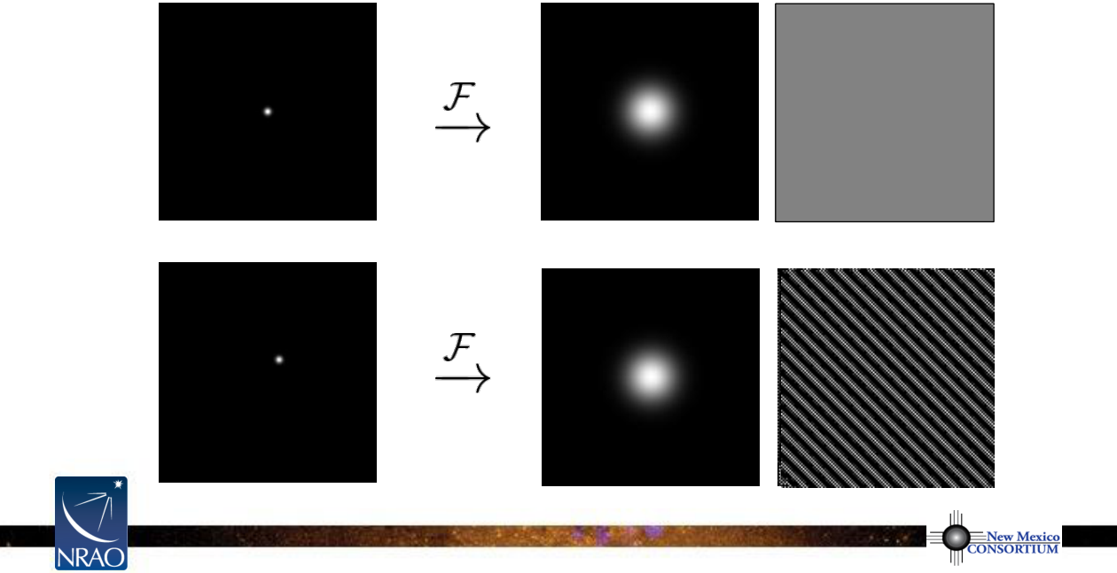
Amplitude and Phase
•
amplitude tells “how much” of a certain spatial frequency
•
phase tells “where” this spatial frequency component is located
T(l,m)
V(u,v) amplitude
V(u,v) phase
Notes:
Source edition: assets/lessons/lectures/radio-astronomy/imaging-and-deconvolution-wilner-2014.pdf, page 9. Original author and figure credits remain on the slide. Text is editable; illustrations retain their source artwork.

Slide 10
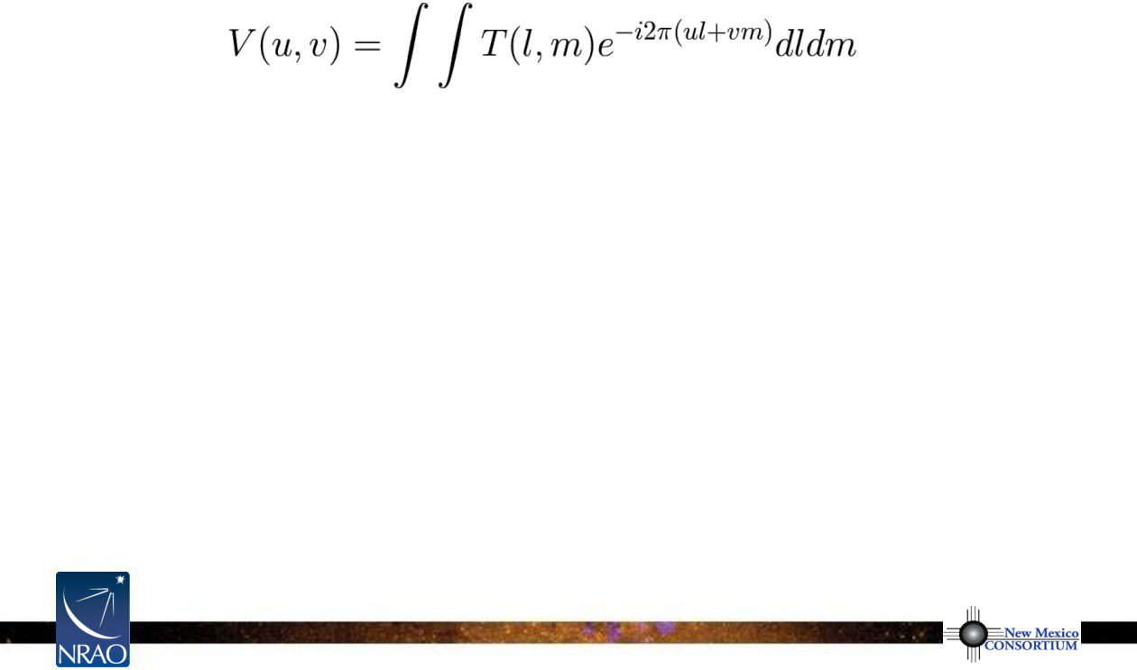
The Visibility Concept
•
visibility as a function of baseline coordinates
(u,v)
is the Fourier transform
of the sky brightness distribution as a function of the sky coordinates
(l,m)
•
V(u=0,v=0)
is the integral of
T(l,m)dldm
= total flux density
•
since
T(l,m)
is real,
V(-u,-v) = V
*
(u,v)
–
V(u,v)
is Hermitian
–
get two visibilities for one measurement
Notes:
Source edition: assets/lessons/lectures/radio-astronomy/imaging-and-deconvolution-wilner-2014.pdf, page 10. Original author and figure credits remain on the slide. Text is editable; illustrations retain their source artwork.

Slide 11
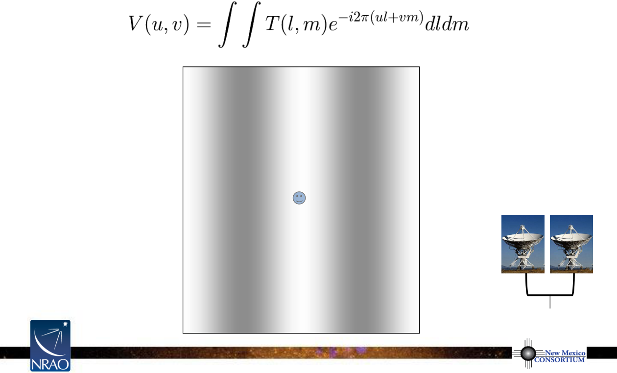
The Visibility Concept
Notes:
Source edition: assets/lessons/lectures/radio-astronomy/imaging-and-deconvolution-wilner-2014.pdf, page 11. Original author and figure credits remain on the slide. Text is editable; illustrations retain their source artwork.

Slide 12
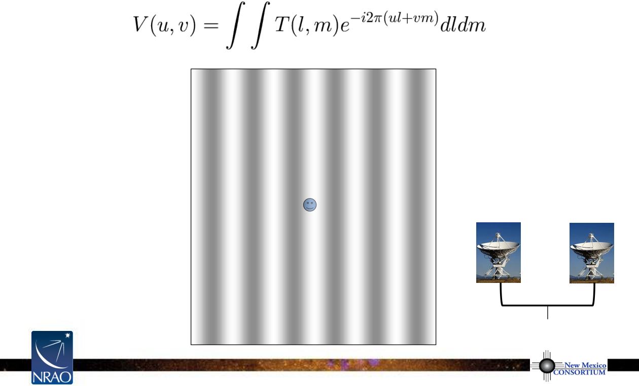
The Visibility Concept
Notes:
Source edition: assets/lessons/lectures/radio-astronomy/imaging-and-deconvolution-wilner-2014.pdf, page 12. Original author and figure credits remain on the slide. Text is editable; illustrations retain their source artwork.

Slide 13
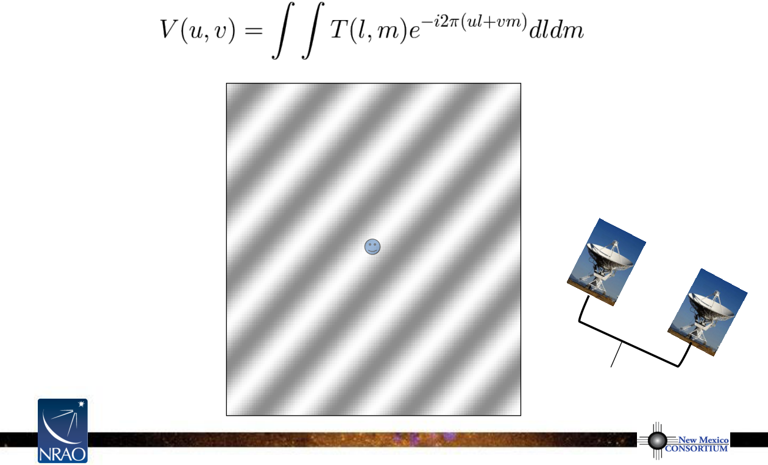
The Visibility Concept
Notes:
Source edition: assets/lessons/lectures/radio-astronomy/imaging-and-deconvolution-wilner-2014.pdf, page 13. Original author and figure credits remain on the slide. Text is editable; illustrations retain their source artwork.

Slide 14
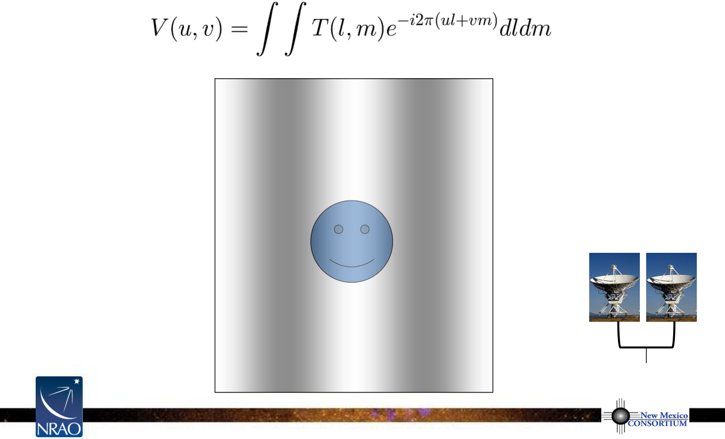
The Visibility Concept
Notes:
Source edition: assets/lessons/lectures/radio-astronomy/imaging-and-deconvolution-wilner-2014.pdf, page 14. Original author and figure credits remain on the slide. Text is editable; illustrations retain their source artwork.

Slide 15
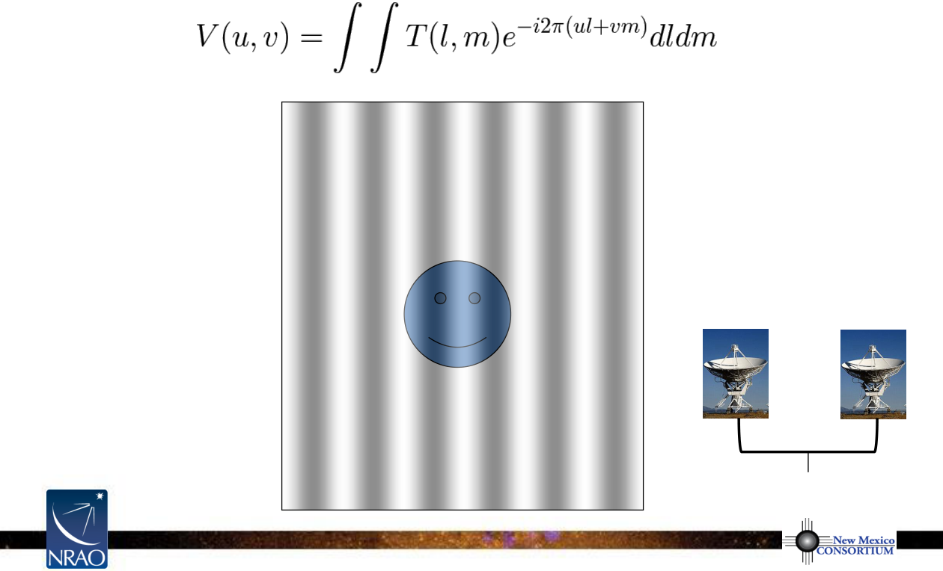
The Visibility Concept
Notes:
Source edition: assets/lessons/lectures/radio-astronomy/imaging-and-deconvolution-wilner-2014.pdf, page 15. Original author and figure credits remain on the slide. Text is editable; illustrations retain their source artwork.

Slide 16
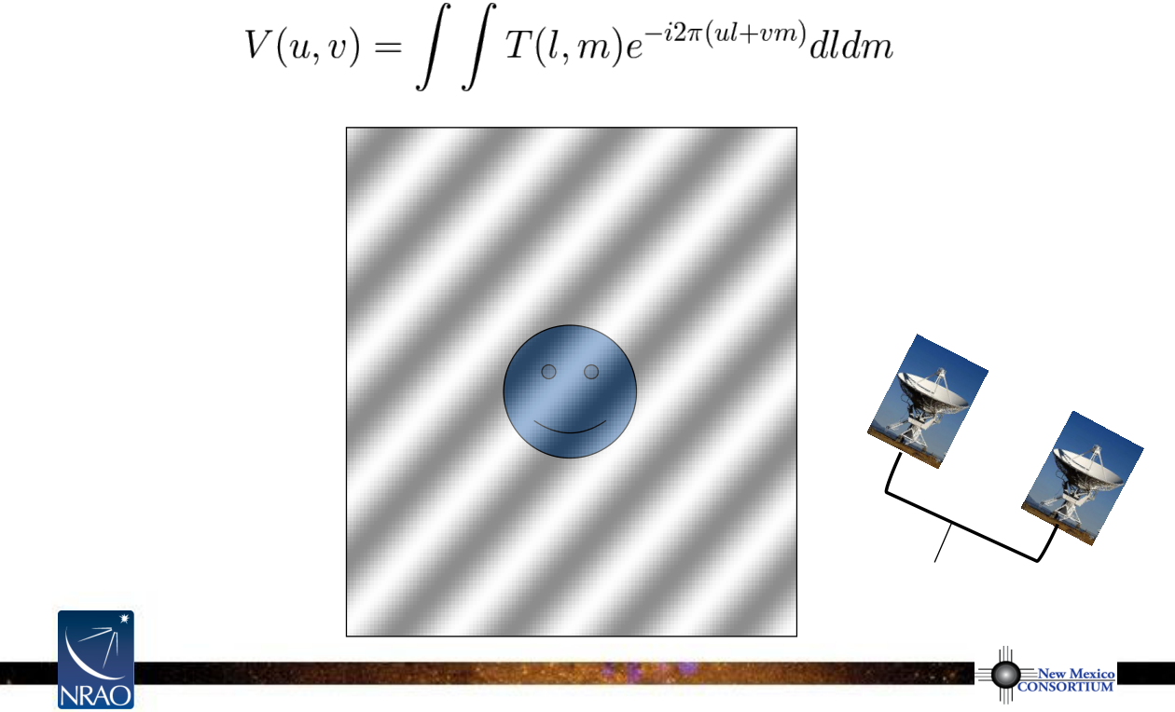
The Visibility Concept
Notes:
Source edition: assets/lessons/lectures/radio-astronomy/imaging-and-deconvolution-wilner-2014.pdf, page 16. Original author and figure credits remain on the slide. Text is editable; illustrations retain their source artwork.

Slide 17
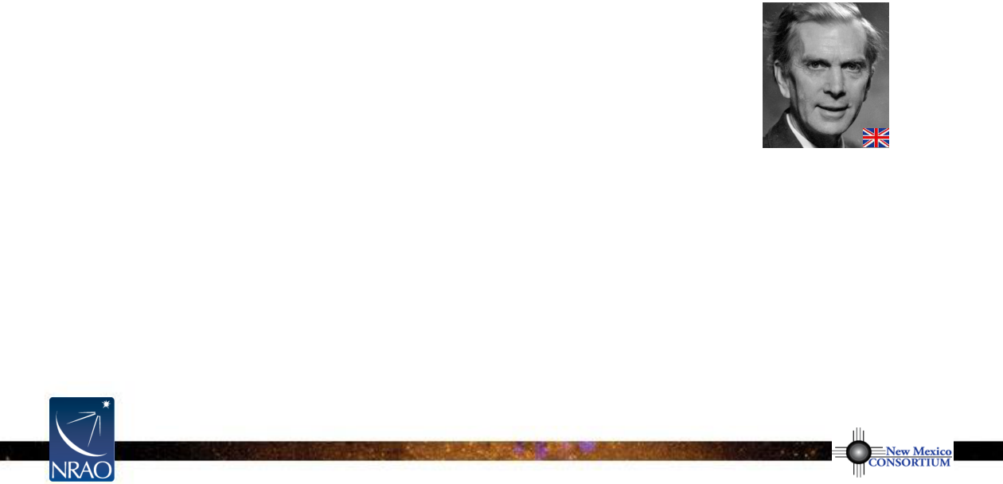
Aperture Synthesis Basics
•
idea: sample
V(u,v)
at enough
(u,v)
points using distributed small aperture
antennas to synthesize a large aperture antenna of size
(u
max
,v
max
)
•
one pair of antennas = one baseline
= two
(u,v)
samples at a time
•
N antennas = N(N-1) samples at a time
•
use Earth rotation to fill in
(u,v)
plane over time
(Sir Martin Ryle, 1974 Nobel Prize in Physics)
Sir Martin Ryle
•
reconfigure physical layout of N antennas for more samples
1918-1984
•
observe at multiple wavelengths for
(u,v)
plane coverage, for source
spectra amenable to simple characterization (“multi-frequency synthesis”)
•
if source is variable, then be careful
Notes:
Source edition: assets/lessons/lectures/radio-astronomy/imaging-and-deconvolution-wilner-2014.pdf, page 17. Original author and figure credits remain on the slide. Text is editable; illustrations retain their source artwork.

Slide 18
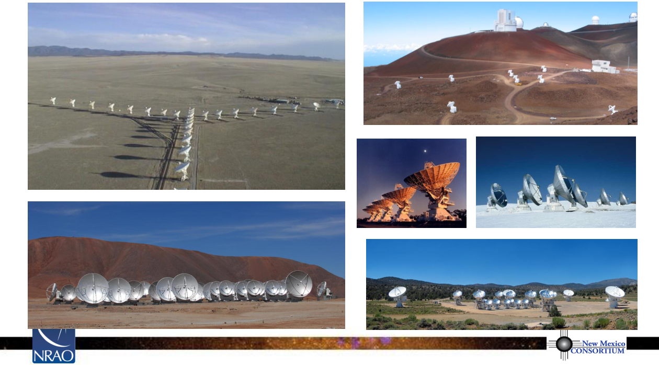
Examples of Aperture Synthesis Telescopes (for Millimeter Wavelengths)
Jansky VLA
SMA
ATCA
IRAM PdBI
ALMA
CARMA
Notes:
Source edition: assets/lessons/lectures/radio-astronomy/imaging-and-deconvolution-wilner-2014.pdf, page 18. Original author and figure credits remain on the slide. Text is editable; illustrations retain their source artwork.

Slide 19
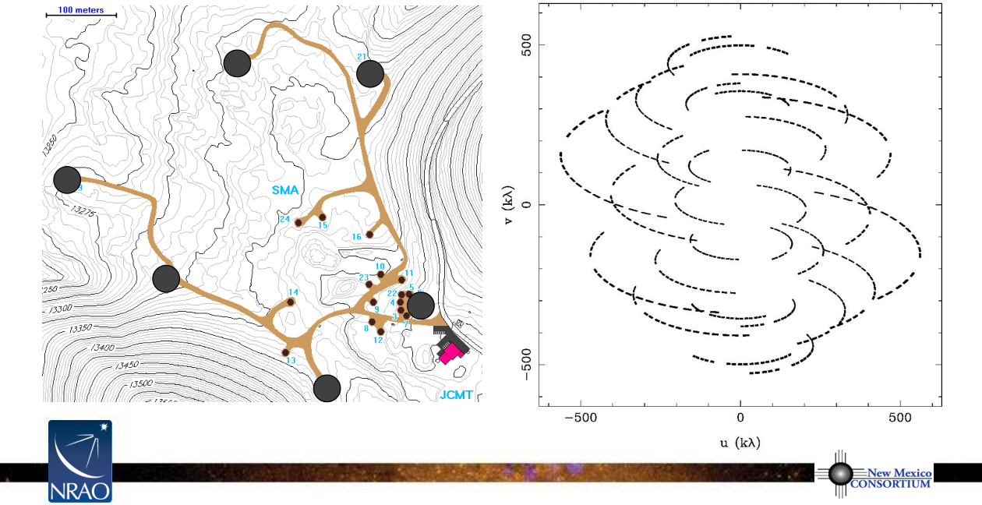
An Example of (u,v) plane Sampling
VEX configuration of 6 SMA antennas,
ν
= 345 GHz, dec = +22 deg
Notes:
Source edition: assets/lessons/lectures/radio-astronomy/imaging-and-deconvolution-wilner-2014.pdf, page 19. Original author and figure credits remain on the slide. Text is editable; illustrations retain their source artwork.

Slide 20
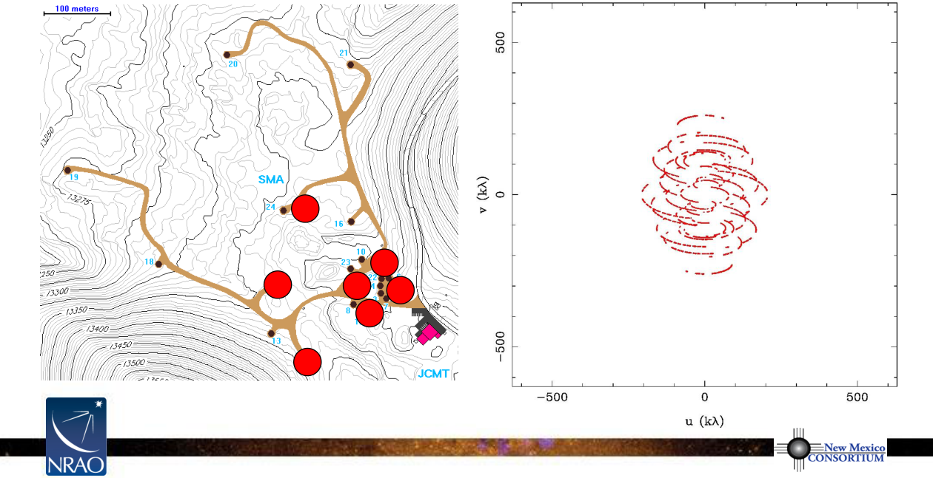
An Example of (u,v) plane Sampling
EXT configurations of 7 SMA antennas,
ν
= 345 GHz, dec = +22 deg
Notes:
Source edition: assets/lessons/lectures/radio-astronomy/imaging-and-deconvolution-wilner-2014.pdf, page 20. Original author and figure credits remain on the slide. Text is editable; illustrations retain their source artwork.

Slide 21
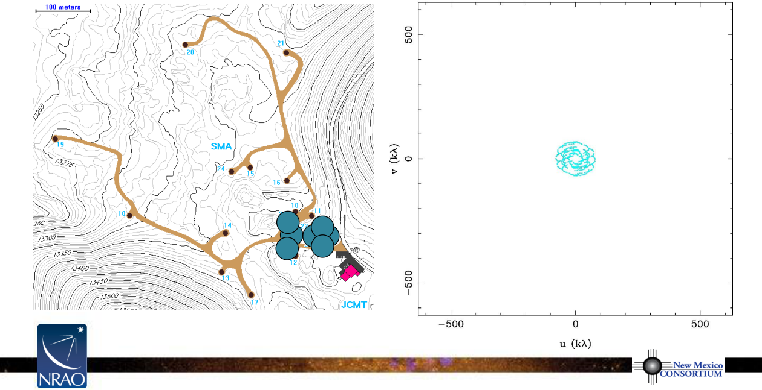
An Example of (u,v) plane Sampling
COM configurations of 7 SMA antennas,
ν
= 345 GHz, dec = +22 deg
Notes:
Source edition: assets/lessons/lectures/radio-astronomy/imaging-and-deconvolution-wilner-2014.pdf, page 21. Original author and figure credits remain on the slide. Text is editable; illustrations retain their source artwork.

Slide 22
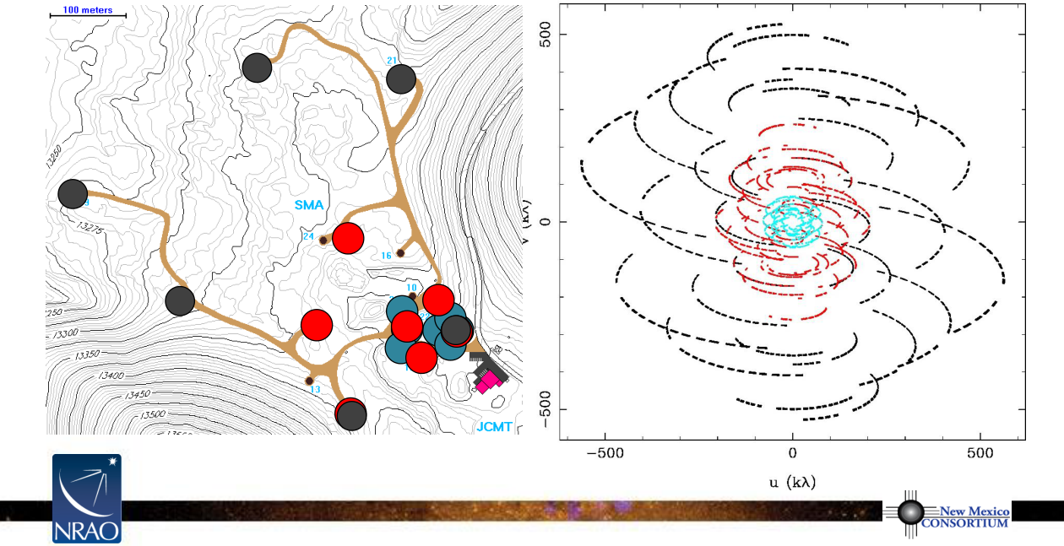
An Example of (u,v) plane Sampling
3 configurations of SMA antennas,
ν
= 345 GHz, dec = +22 deg
Notes:
Source edition: assets/lessons/lectures/radio-astronomy/imaging-and-deconvolution-wilner-2014.pdf, page 22. Original author and figure credits remain on the slide. Text is editable; illustrations retain their source artwork.

Slide 23
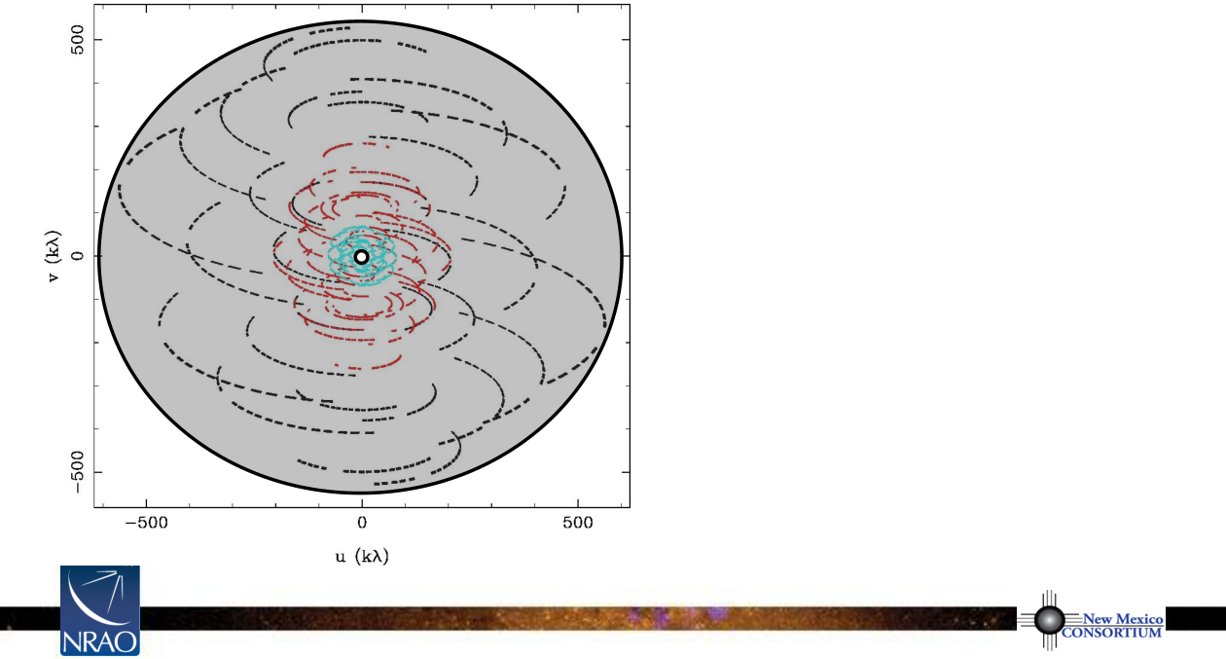
Implications of (u,v) plane Sampling
samples of
V(u,v)
are limited by number of antennas and by Earth-sky geometry
•
outer boundary
–
no information on smaller scales
–
resolution limit
•
inner hole
–
no information on larger scales
–
extended structures invisible
•
irregular coverage between boundaries
–
sampling theorem violated
–
information missing
Notes:
Source edition: assets/lessons/lectures/radio-astronomy/imaging-and-deconvolution-wilner-2014.pdf, page 23. Original author and figure credits remain on the slide. Text is editable; illustrations retain their source artwork.

Slide 24
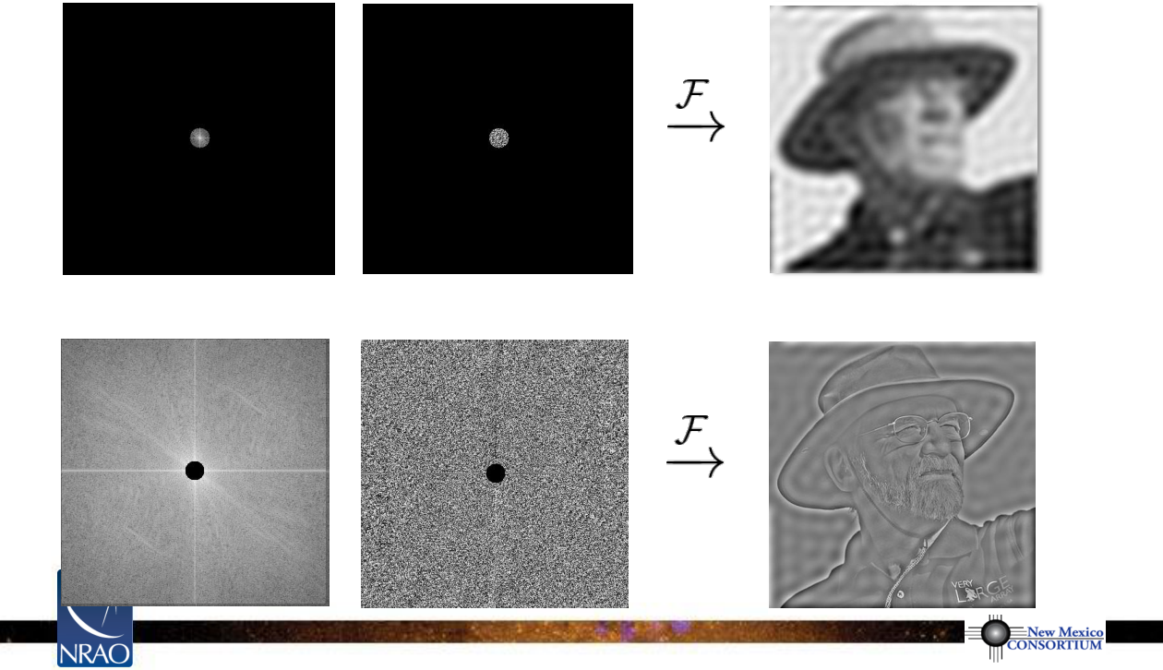
Inner and Outer (u,v) Boundaries
V(u,v) amplitude
V(u,v) phase
T(l,m)
V(u,v) amplitude
V(u,v) phase
T(l,m)
Notes:
Source edition: assets/lessons/lectures/radio-astronomy/imaging-and-deconvolution-wilner-2014.pdf, page 24. Original author and figure credits remain on the slide. Text is editable; illustrations retain their source artwork.

Slide 25
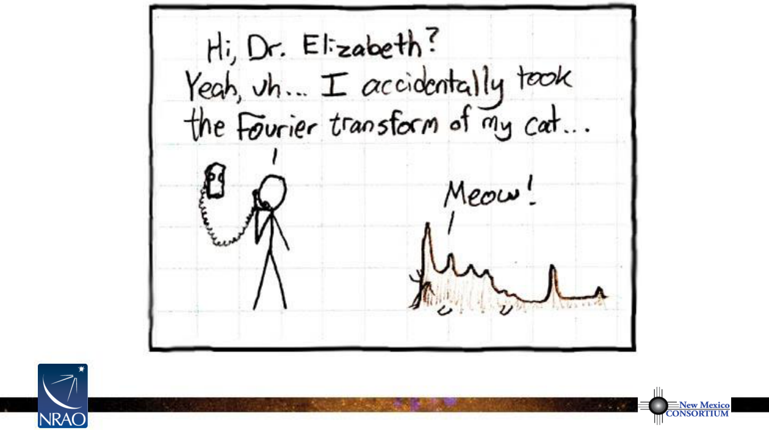
xkcd.com/26/
Notes:
Source edition: assets/lessons/lectures/radio-astronomy/imaging-and-deconvolution-wilner-2014.pdf, page 25. Original author and figure credits remain on the slide. Text is editable; illustrations retain their source artwork.

Slide 26
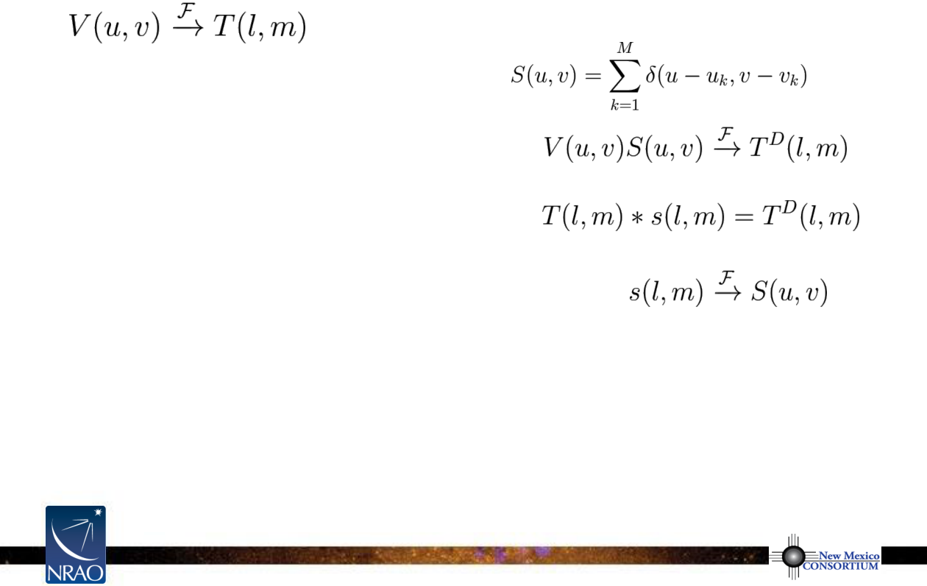
Formal Description of Imaging
•
sample Fourier domain at discrete points
•
Fourier transform sampled visibility function
•
apply the convolution theorem
where the Fourier transform of the sampling pattern is
the “point spread function”
the Fourier transform of the sampled visibilities yields the true
sky brightness convolved with the point spread function
radio jargon: the “dirty image” is the true image convolved with the “dirty beam”
Notes:
Source edition: assets/lessons/lectures/radio-astronomy/imaging-and-deconvolution-wilner-2014.pdf, page 26. Original author and figure credits remain on the slide. Text is editable; illustrations retain their source artwork.

Slide 27
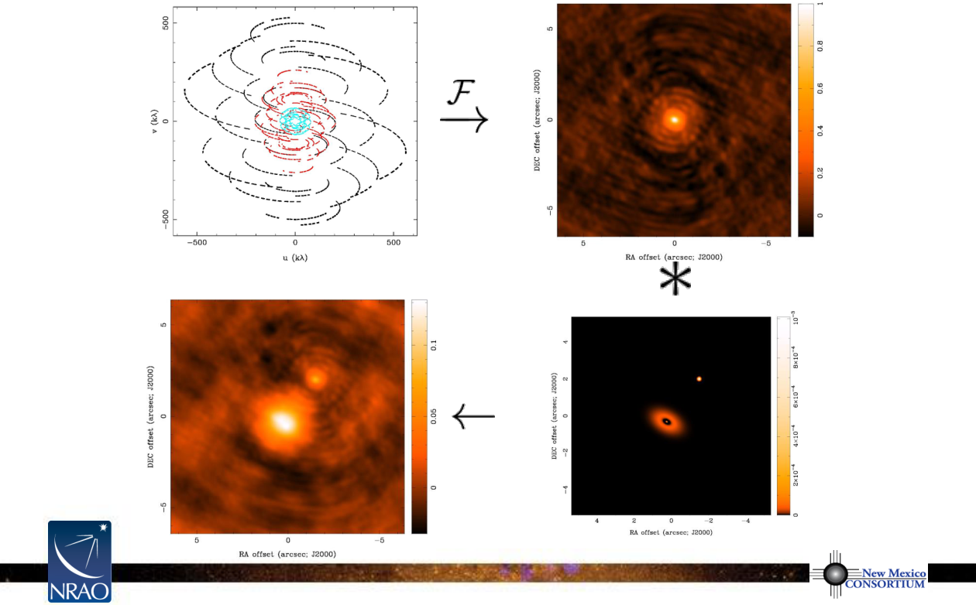
Dirty Beam and Dirty Image
S(u,v
)
s(l,m)
“dirty beam”
T
D
(l,m)
T(l,m)
“dirty image”
Notes:
Source edition: assets/lessons/lectures/radio-astronomy/imaging-and-deconvolution-wilner-2014.pdf, page 27. Original author and figure credits remain on the slide. Text is editable; illustrations retain their source artwork.

Slide 28
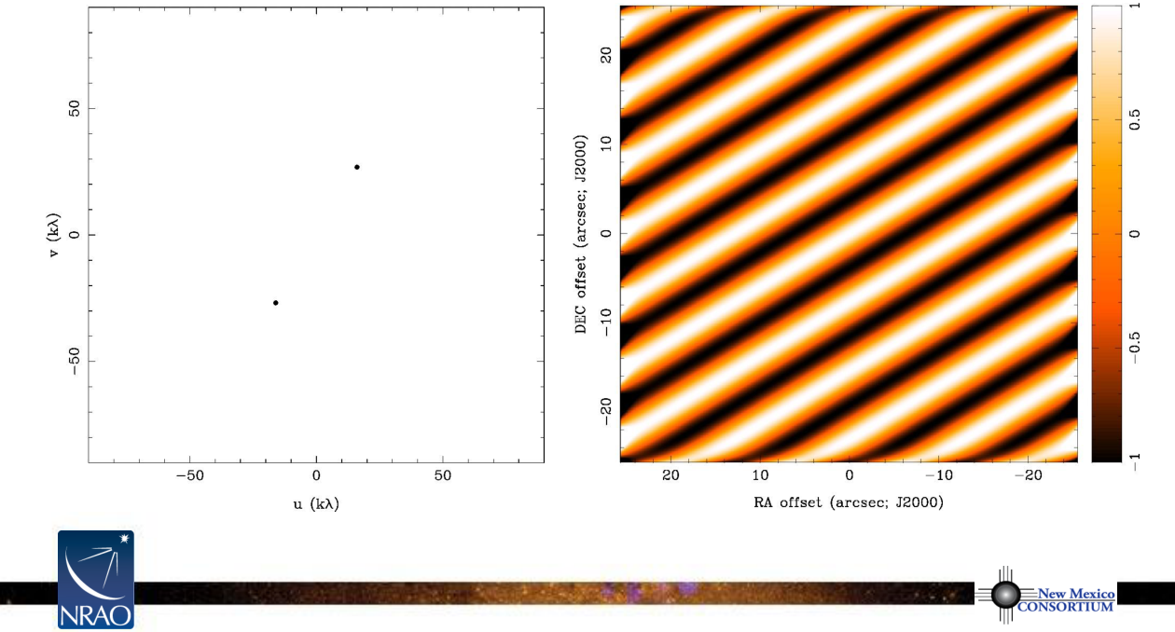
Dirty Beam Shape and N Antennas
2 Antennas, 1 Sample
Notes:
Source edition: assets/lessons/lectures/radio-astronomy/imaging-and-deconvolution-wilner-2014.pdf, page 28. Original author and figure credits remain on the slide. Text is editable; illustrations retain their source artwork.

Slide 29
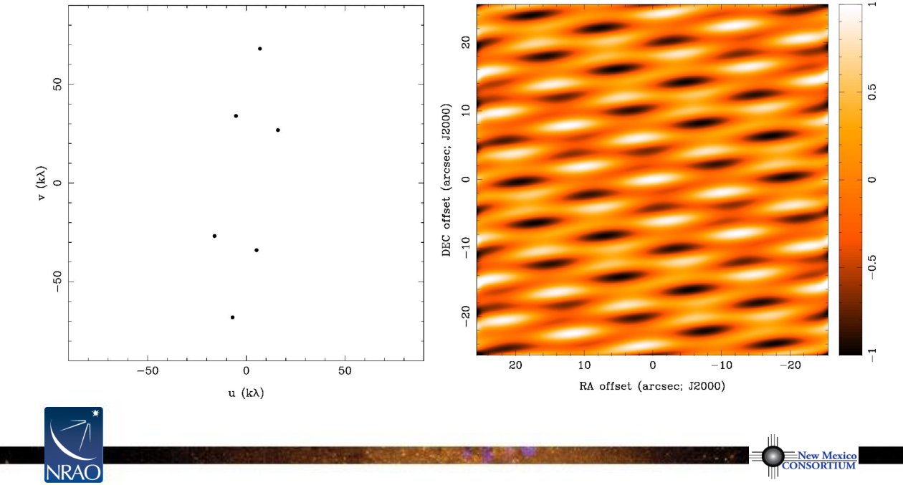
Dirty Beam Shape and N Antennas
3 Antennas, 1 Sample
Notes:
Source edition: assets/lessons/lectures/radio-astronomy/imaging-and-deconvolution-wilner-2014.pdf, page 29. Original author and figure credits remain on the slide. Text is editable; illustrations retain their source artwork.

Slide 30
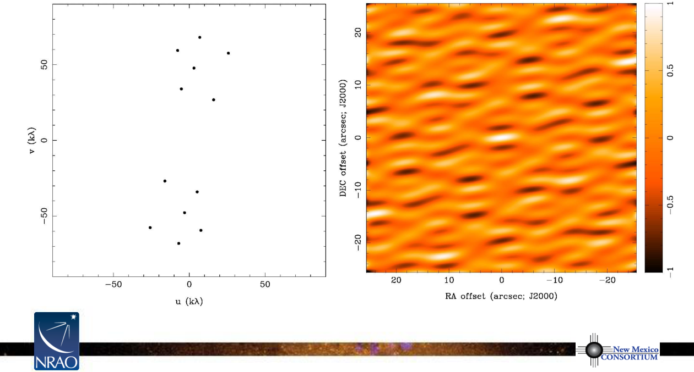
Dirty Beam Shape and N Antennas
4 Antennas, 1 Sample
Notes:
Source edition: assets/lessons/lectures/radio-astronomy/imaging-and-deconvolution-wilner-2014.pdf, page 30. Original author and figure credits remain on the slide. Text is editable; illustrations retain their source artwork.

Slide 31

Dirty Beam Shape and N Antennas
5 Antennas, 1 Sample
Notes:
Source edition: assets/lessons/lectures/radio-astronomy/imaging-and-deconvolution-wilner-2014.pdf, page 31. Original author and figure credits remain on the slide. Text is editable; illustrations retain their source artwork.

Slide 32
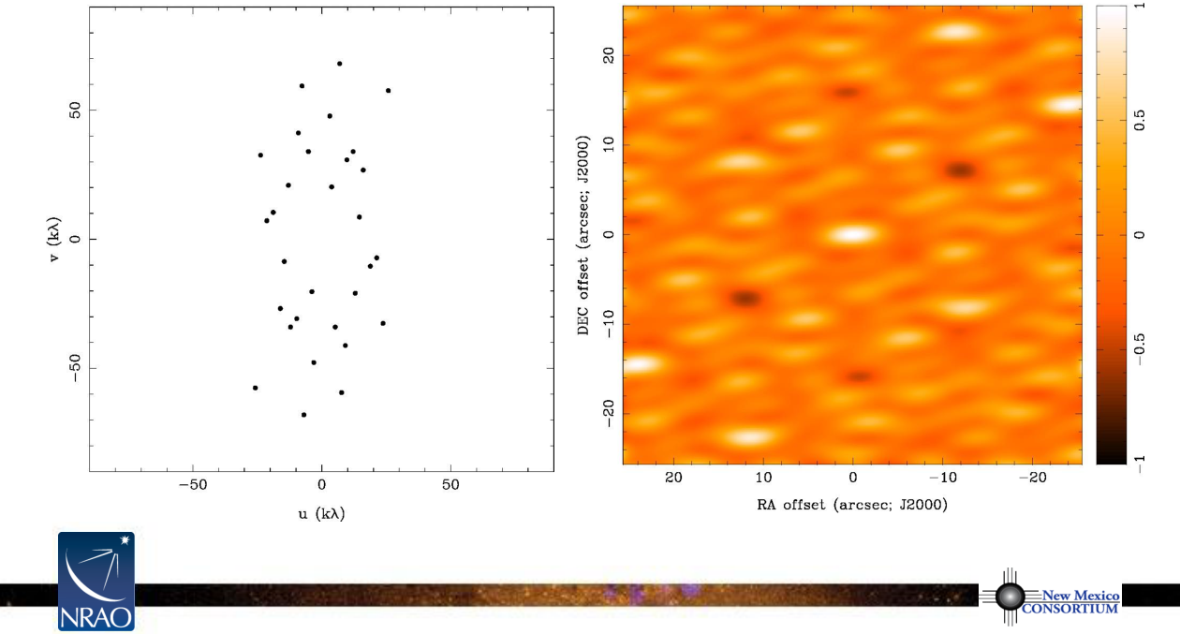
Dirty Beam Shape and N Antennas
6 Antennas, 1 Sample
Notes:
Source edition: assets/lessons/lectures/radio-astronomy/imaging-and-deconvolution-wilner-2014.pdf, page 32. Original author and figure credits remain on the slide. Text is editable; illustrations retain their source artwork.

Slide 33

Dirty Beam Shape and N Antennas
7 Antennas, 1 Sample
Notes:
Source edition: assets/lessons/lectures/radio-astronomy/imaging-and-deconvolution-wilner-2014.pdf, page 33. Original author and figure credits remain on the slide. Text is editable; illustrations retain their source artwork.

Slide 34
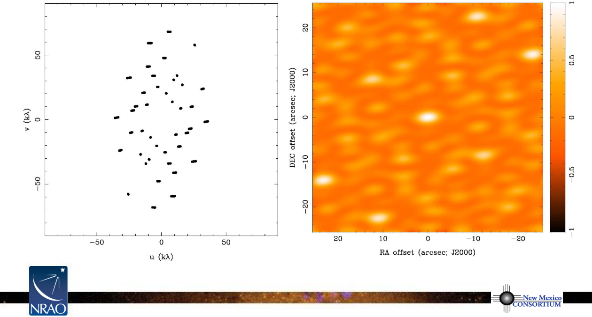
Dirty Beam Shape and N Antennas
7 Antennas, 10 min
Notes:
Source edition: assets/lessons/lectures/radio-astronomy/imaging-and-deconvolution-wilner-2014.pdf, page 34. Original author and figure credits remain on the slide. Text is editable; illustrations retain their source artwork.

Slide 35

Dirty Beam Shape and N Antennas
7 Antennas, 2 x 10 min
Notes:
Source edition: assets/lessons/lectures/radio-astronomy/imaging-and-deconvolution-wilner-2014.pdf, page 35. Original author and figure credits remain on the slide. Text is editable; illustrations retain their source artwork.

Slide 36
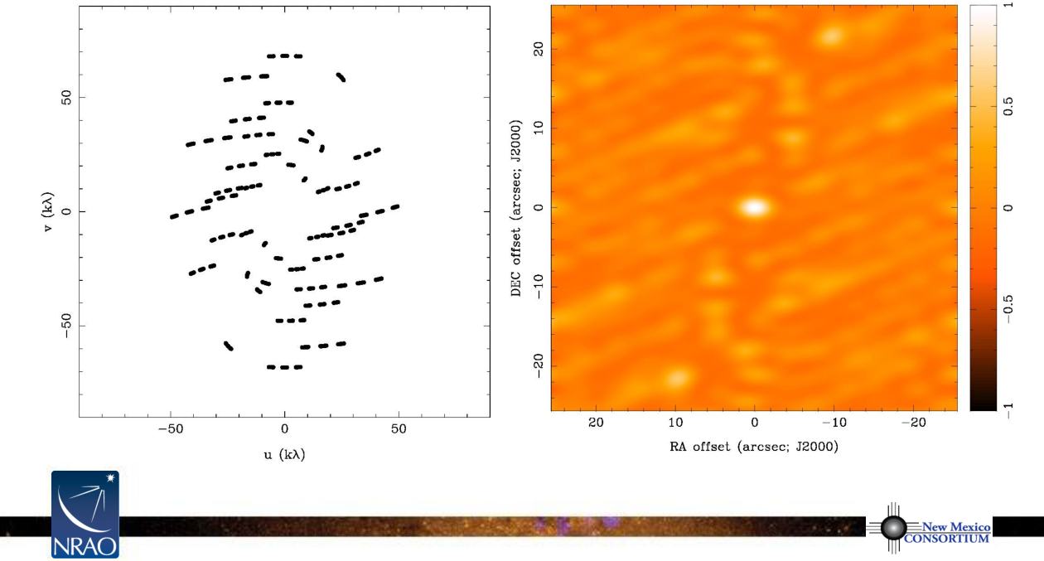
Dirty Beam Shape and N Antennas
7 Antennas, 1 hour
Notes:
Source edition: assets/lessons/lectures/radio-astronomy/imaging-and-deconvolution-wilner-2014.pdf, page 36. Original author and figure credits remain on the slide. Text is editable; illustrations retain their source artwork.

Slide 37
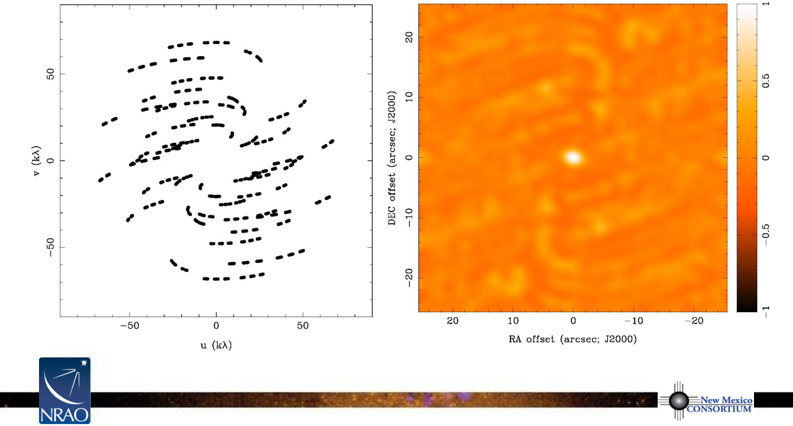
Dirty Beam Shape and N Antennas
7 Antennas, 3 hours
Notes:
Source edition: assets/lessons/lectures/radio-astronomy/imaging-and-deconvolution-wilner-2014.pdf, page 37. Original author and figure credits remain on the slide. Text is editable; illustrations retain their source artwork.

Slide 38

Dirty Beam Shape and N Antennas
7 Antennas, 8 hours
Notes:
Source edition: assets/lessons/lectures/radio-astronomy/imaging-and-deconvolution-wilner-2014.pdf, page 38. Original author and figure credits remain on the slide. Text is editable; illustrations retain their source artwork.

Slide 39
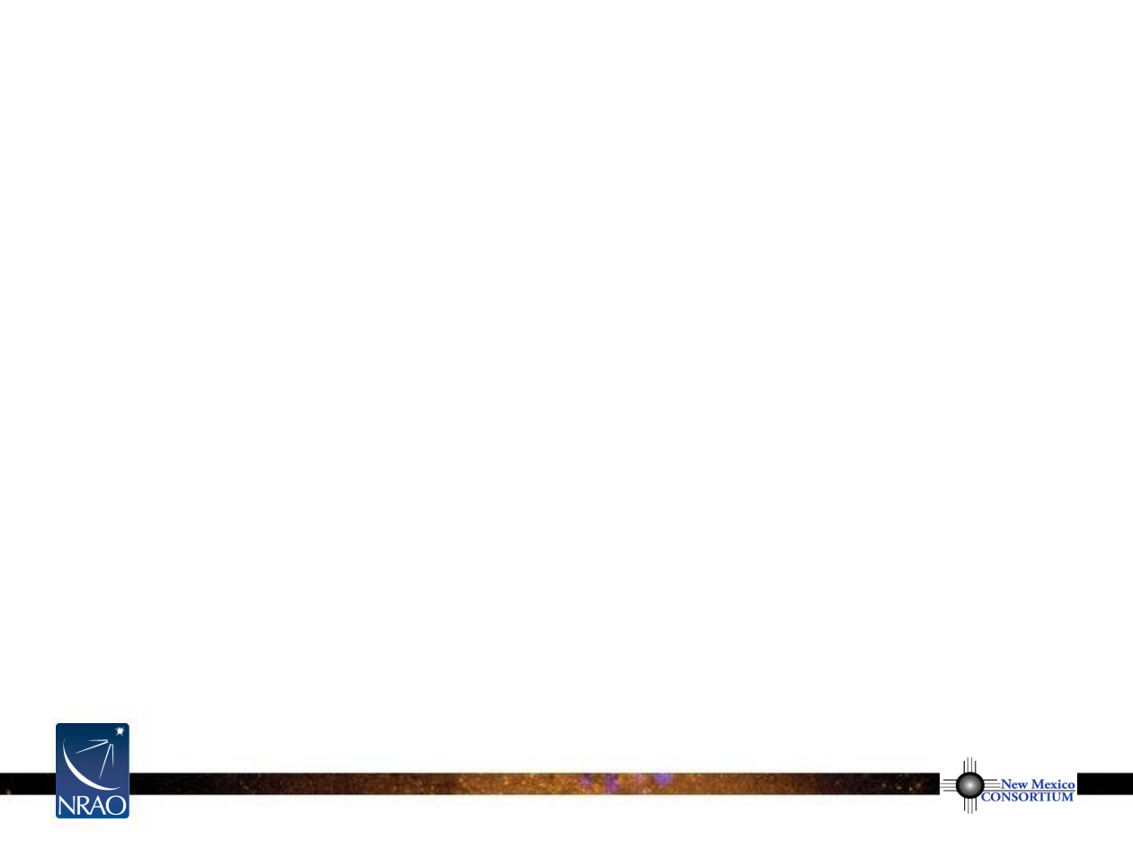
Calibrated Visibilities: What’s Next?
•
analyze directly
V(u,v)
samples by model fitting
–
good for simple structures, e.g. point sources, symmetric disks
–
sometimes for statistical descriptions of sky brightness
–
visibilities have very well defined noise properties
•
recover an
image
from the observed incomplete and noisy
samples of its Fourier transform for analysis
–
Fourier transform
V(u,v)
to get
T
D
(l,m)
–
difficult to do science with the dirty image
T
D
(l,m)
–
deconvolve
s(l,m)
from
T
D
(l,m)
to determine a model of
T(l,m)
–
work with the model of
T(l,m)
Notes:
Source edition: assets/lessons/lectures/radio-astronomy/imaging-and-deconvolution-wilner-2014.pdf, page 39. Original author and figure credits remain on the slide. Text is editable; illustrations retain their source artwork.

Slide 40
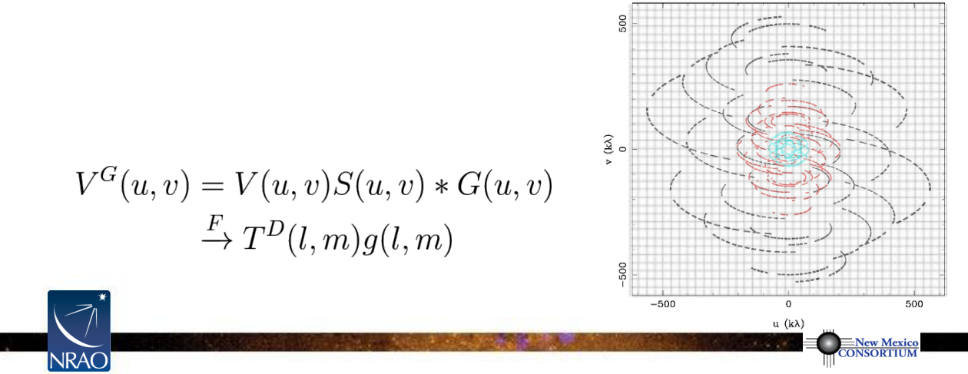
Some Details of the Dirty Image
•
“Fourier transform”
–
Fast Fourier Transform (FFT) algorithm is much faster than simple
Fourier summation,
O
(NlogN) for 2
N
x 2
N
image
–
FFT requires data on a regularly spaced grid
–
aperture synthesis does not provide
V(u,v)
on a regularly spaced grid, so…
•
“gridding” used to resample
V(u,v)
for FFT
–
customary to use a convolution method
–
special (“spheroidal”) functions
that minimize smoothing and aliasing
Notes:
Source edition: assets/lessons/lectures/radio-astronomy/imaging-and-deconvolution-wilner-2014.pdf, page 40. Original author and figure credits remain on the slide. Text is editable; illustrations retain their source artwork.

Slide 41
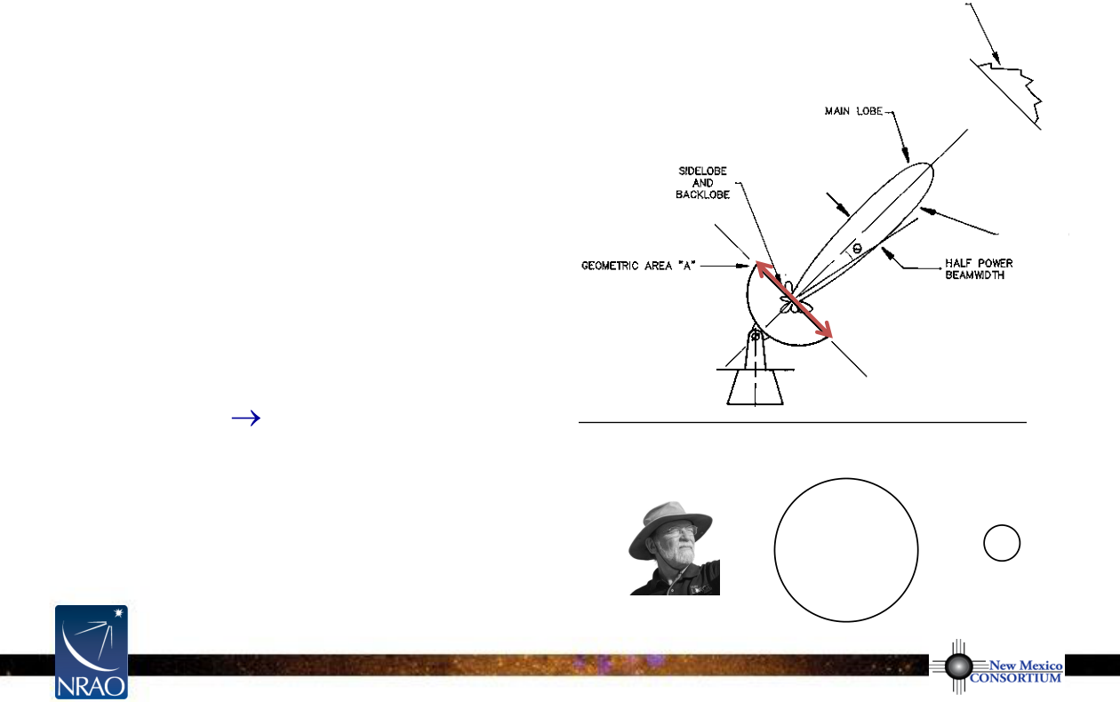
Antenna Primary Beam Response
T(l,m)
•
antenna response
A(l,m)
is not
uniform across the entire sky
–
main lobe = “primary beam”
fwhm ~
λ
/D
–
response beyond primary beam
can be important (“sidelobes”)
A(l,m)
•
antenna beam modifies the sky
D
brightness distribution
–
T(l,m)
T(l,m)A(l,m)
–
can correct with division by
A(l,m)
in the image plane
–
large source extents require
SMA 6 m
multiple pointings of antennas
345 GHz
ALMA 12 m
= mosaicking
690 GHz
Notes:
Source edition: assets/lessons/lectures/radio-astronomy/imaging-and-deconvolution-wilner-2014.pdf, page 41. Original author and figure credits remain on the slide. Text is editable; illustrations retain their source artwork.

Slide 42
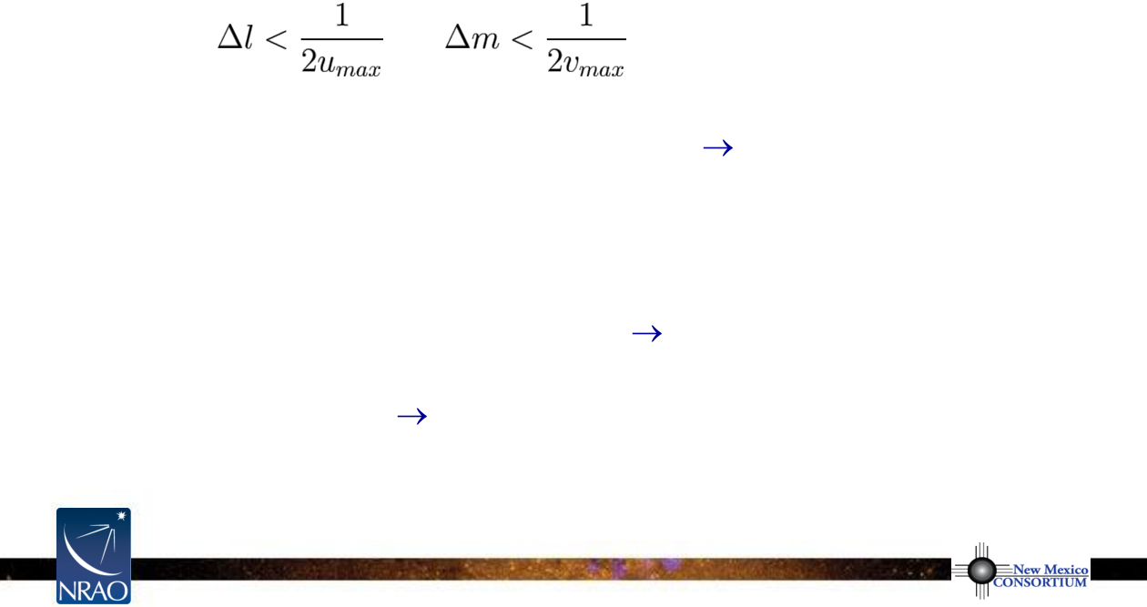
Imaging Decisions: Pixel Size, Image Size
•
pixel size
–
satisfy sampling theorem for longest baselines
–
in practice, 3 to 5 pixels across main lobe of dirty beam to aid deconvolution
–
e.g. at 870
μ
m with baselines to 500 meters
pixel size < 0.1 arcsec
–
CASA “cell” size
•
image size
–
natural choice is often the full extent of the primary beam
A(l,m)
–
e.g. SMA
at 870
μ
m, 6 meter antennas
image size 2 x 35 arcsec
–
if there are bright sources in the sidelobes of A(l,m), then the FFT will alias
them into the image
make a larger image (or equivalent)
–
CASA “imsize”
Notes:
Source edition: assets/lessons/lectures/radio-astronomy/imaging-and-deconvolution-wilner-2014.pdf, page 42. Original author and figure credits remain on the slide. Text is editable; illustrations retain their source artwork.

Slide 43
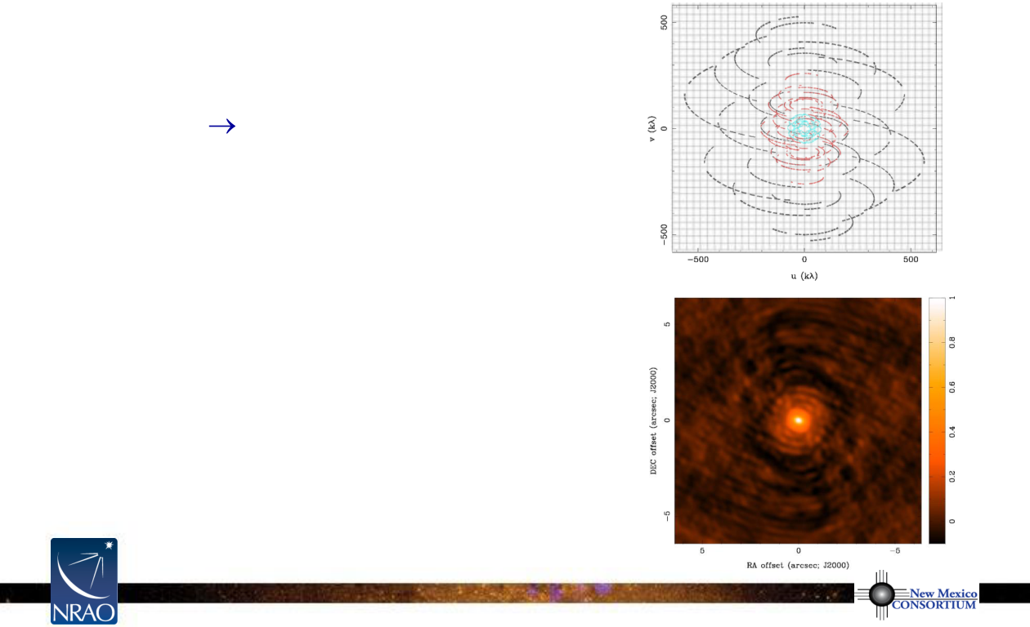
Imaging Decisions: Visibility Weighting
•
introduce weighting function
W(u,v)
–
modifies sampling function
–
S(u,v)
S(u,v)W(u,v)
–
changes
s(l,m)
, the dirty beam shape
•
natural weight
–
W(u,v)
= 1/
σ
2
in occupied
(u.v)
cells,
where
σ
2
is the noise variance, and
W(u,v)
= 0 everywhere else
–
maximizes point source sensitivity
–
lowest rms in image
–
generally gives more weight to short
baselines (low spatial frequencies), so
angular resolution is degraded
Notes:
Source edition: assets/lessons/lectures/radio-astronomy/imaging-and-deconvolution-wilner-2014.pdf, page 43. Original author and figure credits remain on the slide. Text is editable; illustrations retain their source artwork.

Slide 44
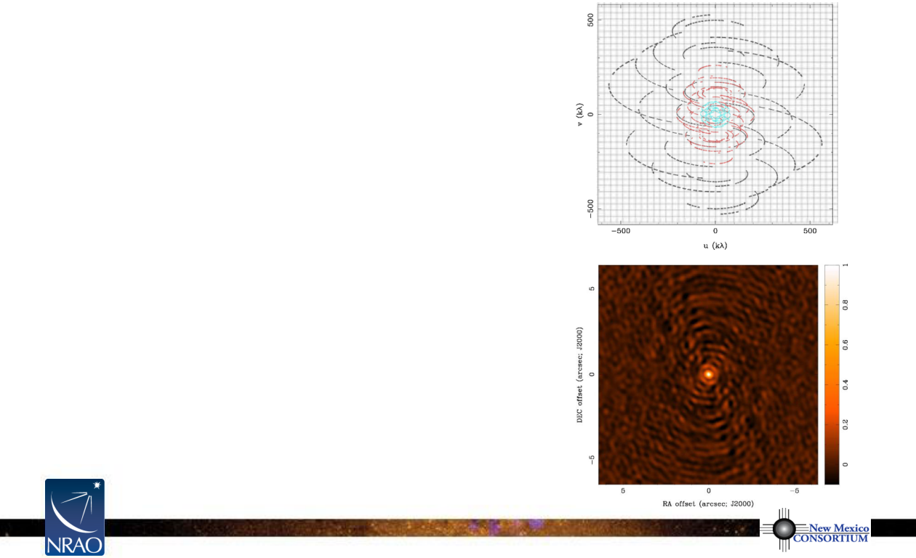
Dirty Beam Shape and Weighting
•
uniform weight
–
W(u,v)
is inversely proportional to
local density of
(u,v)
points
–
sum of weights in a
(u,v)
cell = const
(and 0 for empty cells)
–
fills
(u,v)
plane more uniformly and
dirty beam sidelobes are lower
–
gives more weight to long baselines
(high spatial frequencies), so angular
resolution is enhanced
–
downweights some data, so point
source sensitivity is degraded
–
can be trouble with sparse sampling:
cells with few data points have same
weight as cells with many data points
Notes:
Source edition: assets/lessons/lectures/radio-astronomy/imaging-and-deconvolution-wilner-2014.pdf, page 44. Original author and figure credits remain on the slide. Text is editable; illustrations retain their source artwork.

Slide 45
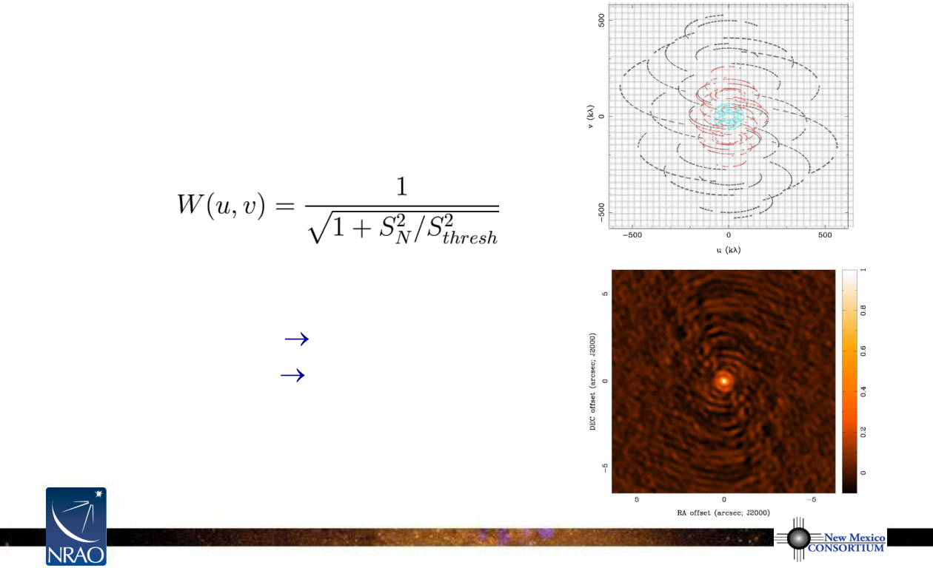
Dirty Beam Shape and Weighting
•
robust (Briggs) weight
–
variant of uniform that avoids giving
too much weight to
(u.v)
cells with
low natural weight
–
software implementations differ
–
e.g.
S
N
is natural weight of cell
S
thresh
is a threshold
high threshold
natural weight
low threshold
uniform weight
•
an adjustable parameter allows for
continuous variation between maximum
point source sensitivity and resolution
Notes:
Source edition: assets/lessons/lectures/radio-astronomy/imaging-and-deconvolution-wilner-2014.pdf, page 45. Original author and figure credits remain on the slide. Text is editable; illustrations retain their source artwork.

Slide 46
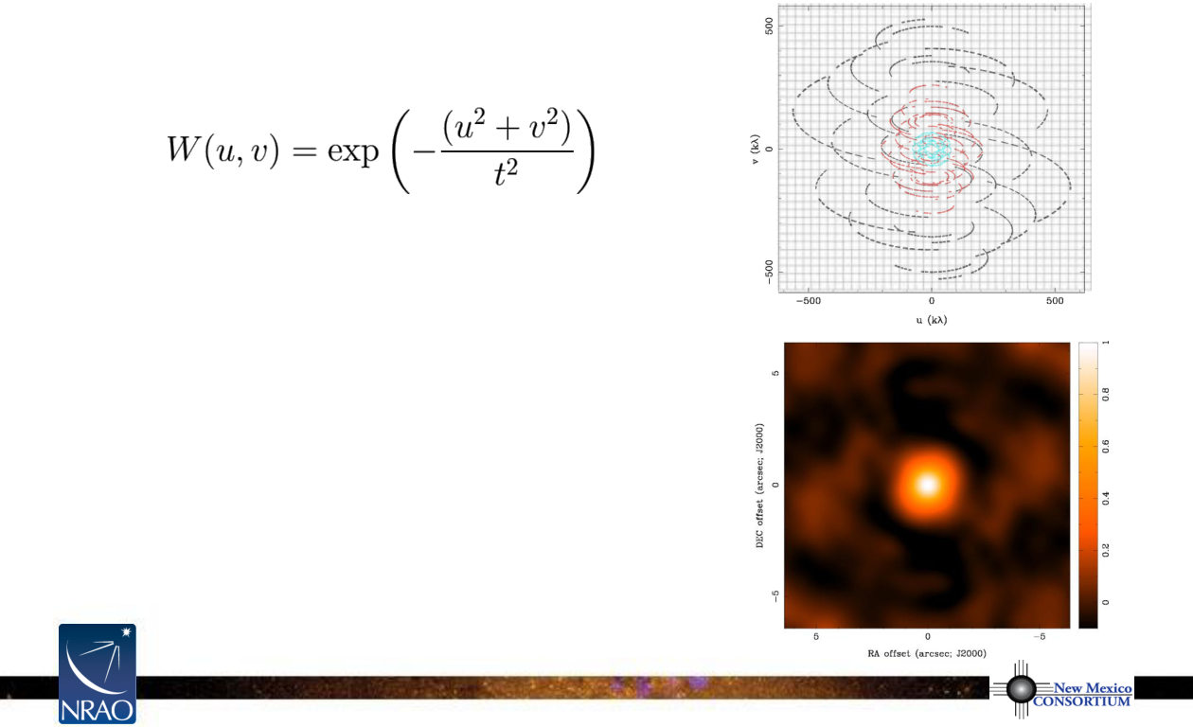
Dirty Beam Shape and Weighting
•
tapering
–
apodize
(u,v)
sampling by a Gaussian
t
= adjustable tapering parameter
–
like smoothing in the image plane
(convolution by a Gaussian)
–
gives more weight to short baselines,
degrades angular resolution
–
downweights some data, so point
source source sensivitity degraded
–
may improve sensitivity to extended
structure sampled by short baselines
–
limits to usefulness
Notes:
Source edition: assets/lessons/lectures/radio-astronomy/imaging-and-deconvolution-wilner-2014.pdf, page 46. Original author and figure credits remain on the slide. Text is editable; illustrations retain their source artwork.

Slide 47
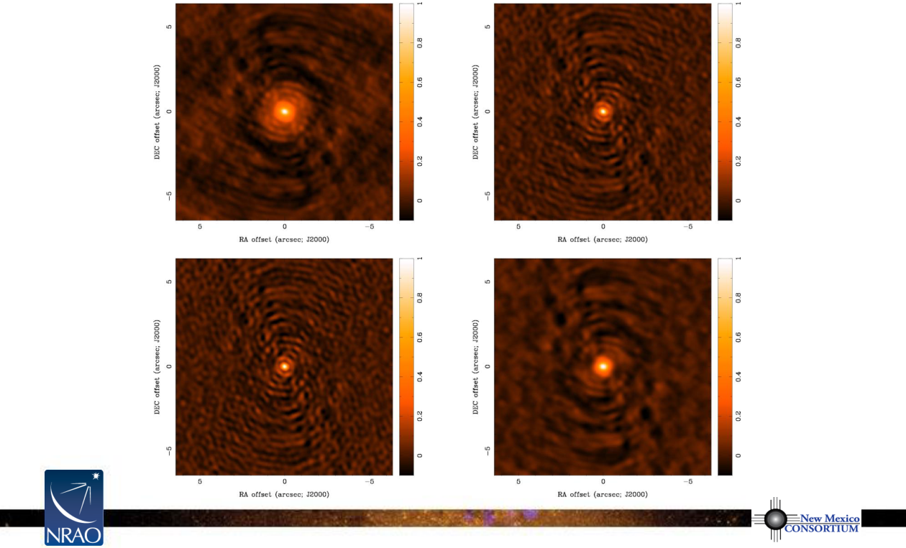
Weighting and Tapering: Image Noise
natural
robust=0
0.59x0.50
0.40x0.34
rms
=1.0
rms=1.3
robust=0
uniform
+ taper to
0.35x0.30
0.59x0.50
rms=2.1
rms=1.2
Notes:
Source edition: assets/lessons/lectures/radio-astronomy/imaging-and-deconvolution-wilner-2014.pdf, page 47. Original author and figure credits remain on the slide. Text is editable; illustrations retain their source artwork.

Slide 48
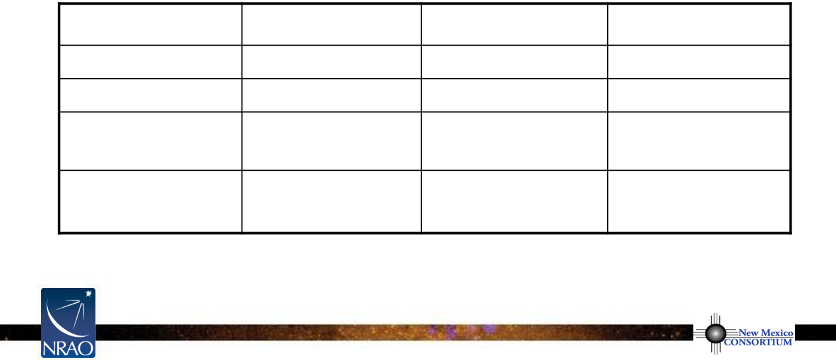
Weighting and Tapering: Summary
•
imaging parameters provide a lot of freedom
•
appropriate choices depend on science goals
Robust/Uniform
Natural
Taper
resolution
higher
medium
lower
sidelobes
lower
higher
depends
point source
lower
maximum
lower
sensitivity
extended source
lower
medium
higher
sensitivity
Notes:
Source edition: assets/lessons/lectures/radio-astronomy/imaging-and-deconvolution-wilner-2014.pdf, page 48. Original author and figure credits remain on the slide. Text is editable; illustrations retain their source artwork.

Slide 49
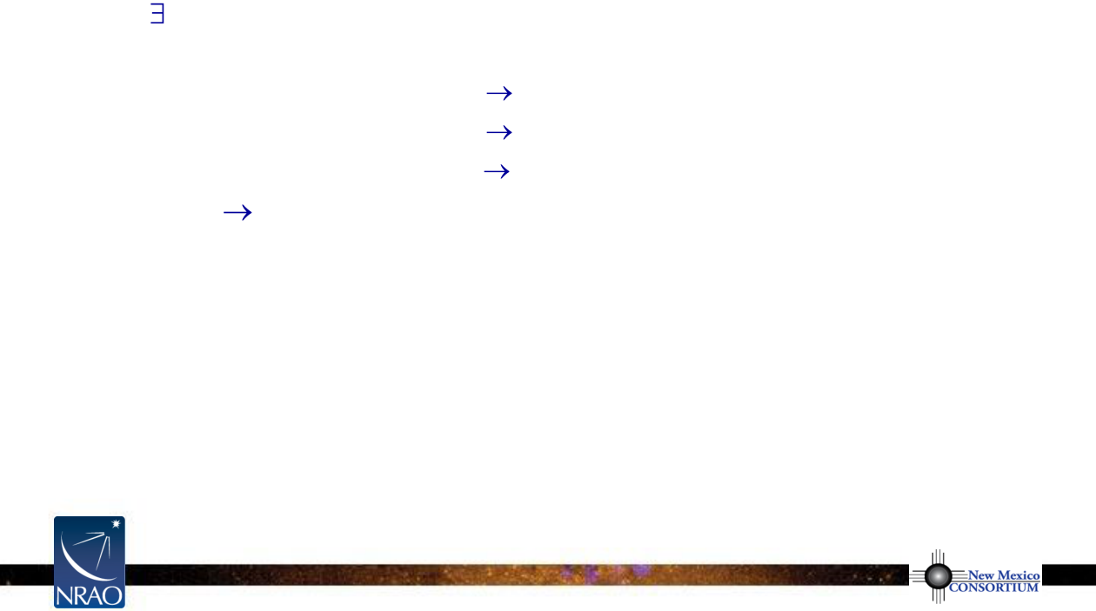
Beyond the Dirty Image: Deconvolution
•
to keep you awake at night
–
an infinite number of
T(l,m)
compatible with sampled
V(u,v)
,
with “invisible” distributions
R(l,m)
where
s(l,m)
*
R(l,m)
= 0
•
no data beyond u
max
,v
max
unresolved structure
•
no data within u
min
,v
min
limit on largest size scale
•
holes in between
synthesized beam sidelobes
–
noise
undetected/corrupted structure in
T(l,m)
–
no unique prescription for extracting optimum estimate of
T(l,m)
•
deconvolution
–
uses non-linear techniques to interpolate/extrapolate samples of
V(u,v)
into unsampled regions of the
(u,v)
plane
–
aims to find a sensible model of
T(l,m)
compatible with data
–
requires
a priori
assumptions about
T(l,m)
to pick plausible “invisible”
distributions to fill unmeasured parts of the Fourier plane
Notes:
Source edition: assets/lessons/lectures/radio-astronomy/imaging-and-deconvolution-wilner-2014.pdf, page 49. Original author and figure credits remain on the slide. Text is editable; illustrations retain their source artwork.

Slide 50
Deconvolution Algorithms
•
an active research area, e.g. compressive sensing methods
•
clean
: dominant deconvolution algorithm in radio astronomy
–
a priori
assumption:
T(l,m)
is a collection of point sources
–
fit and subtract the synthesized beam iteratively
–
original version by Högbom (1974) purely image based
–
variants developed for higher computational efficiency, model visibility
subtraction, to deal better with extended emission structure, etc.
•
maximum entropy: a rarely used alternative
–
a priori
assumption:
T(l,m)
is smooth and positive
–
define “smoothness” via a mathematical expression for entropy, e.g.
Gull and Skilling (1983), find smoothest image consistent with data
–
vast literature about the deep meaning of entropy as information content
Notes:
Source edition: assets/lessons/lectures/radio-astronomy/imaging-and-deconvolution-wilner-2014.pdf, page 50. Original author and figure credits remain on the slide. Text is editable; illustrations retain their source artwork.

Slide 51
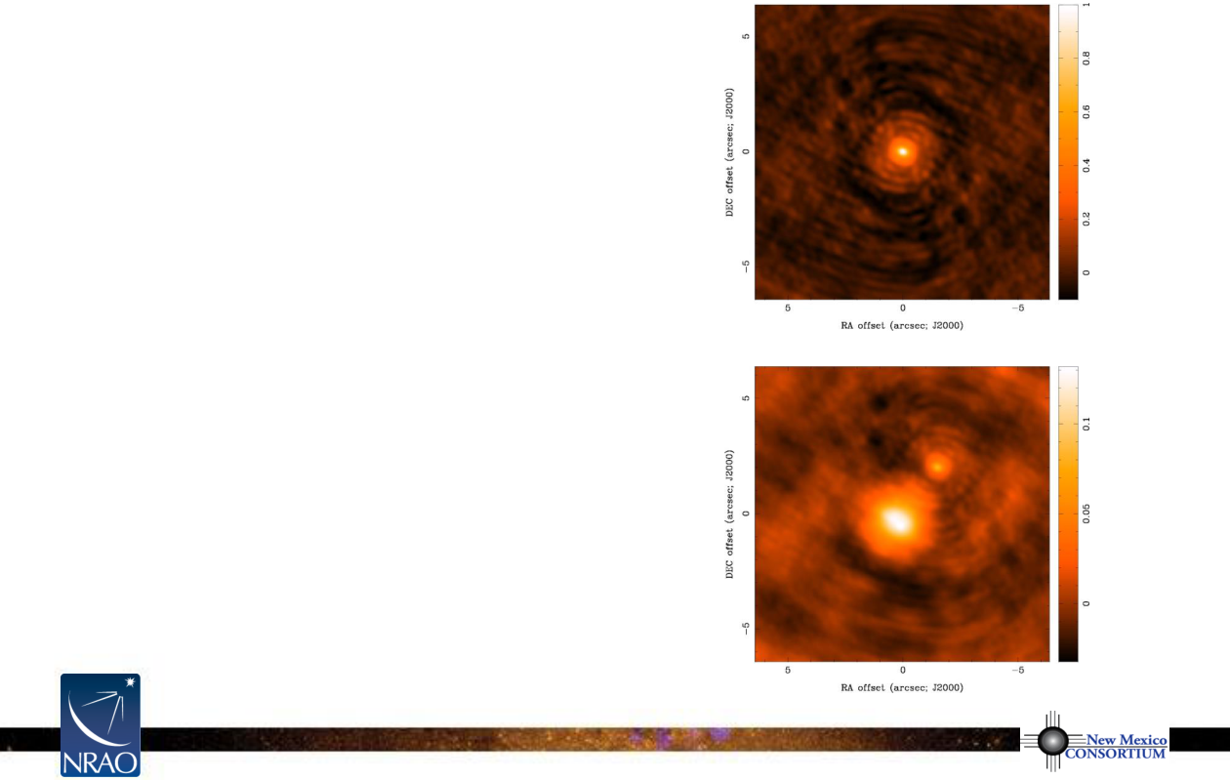
Basic clean Algorithm
•
initialize
a
residual map
to the dirty map
a
Clean Component
list
s(l,m)
1.
identify the highest peak in the
residual map as a point source
2.
subtract a fraction of this peak
from the
residual map
using a
scaled dirty beam,
s(l,m)
x gain
3.
add this point source location
and amplitude to the
Clean
T
D
(l,m)
Component
list
4.
goto step 1 (an iteration) unless
stopping criterion reached
Notes:
Source edition: assets/lessons/lectures/radio-astronomy/imaging-and-deconvolution-wilner-2014.pdf, page 51. Original author and figure credits remain on the slide. Text is editable; illustrations retain their source artwork.

Slide 52
Basic clean Algorithm (continued)
•
stopping criteria?
–
residual map
maximum < threshold = multiple of rms (if noise limited)
–
residual
map
maximum < threshold = fraction of dirty map maximum
(if dynamic range limited)
–
maximum number of
Clean Components
reached (no justification)
•
loop gain?
–
good results for g=0.1 to 0.3
–
lower values can work better for smoother emission, g=0.05
•
easy to include
a priori
information about where in dirty map to search
for
Clean Components
(using “boxes” or “masks”)
–
very useful but potentially dangerous
•
Schwarz (1978) showed that the clean algorithm is equivalent to a least
squares fit of sinusoids to visibilities in the case of no noise
Notes:
Source edition: assets/lessons/lectures/radio-astronomy/imaging-and-deconvolution-wilner-2014.pdf, page 52. Original author and figure credits remain on the slide. Text is editable; illustrations retain their source artwork.

Slide 53
Basic clean Algorithm (continued)
•
last step: make “restored” image
–
make a model image with all point source
Clean Components
–
convolve point sources with an elliptical Gaussian, fit to the main lobe of
the dirty beam (“clean beam”); avoids super-resolution of model
–
add
residual map
of noise and source structure below the threshold
•
resulting restored image is an estimate of the true sky brightness
T(l,m)
•
units of the restored image are (mostly) Jy per clean beam area
= intensity (or brightness temperature)
•
for most weighting schemes, there is information in the image from baselines
that sample high spatial frequencies within the clean beam fwhm, so modest
super-resolution may be OK
•
the restored image does not actually fit the observed visibilities
Notes:
Source edition: assets/lessons/lectures/radio-astronomy/imaging-and-deconvolution-wilner-2014.pdf, page 53. Original author and figure credits remain on the slide. Text is editable; illustrations retain their source artwork.

Slide 54
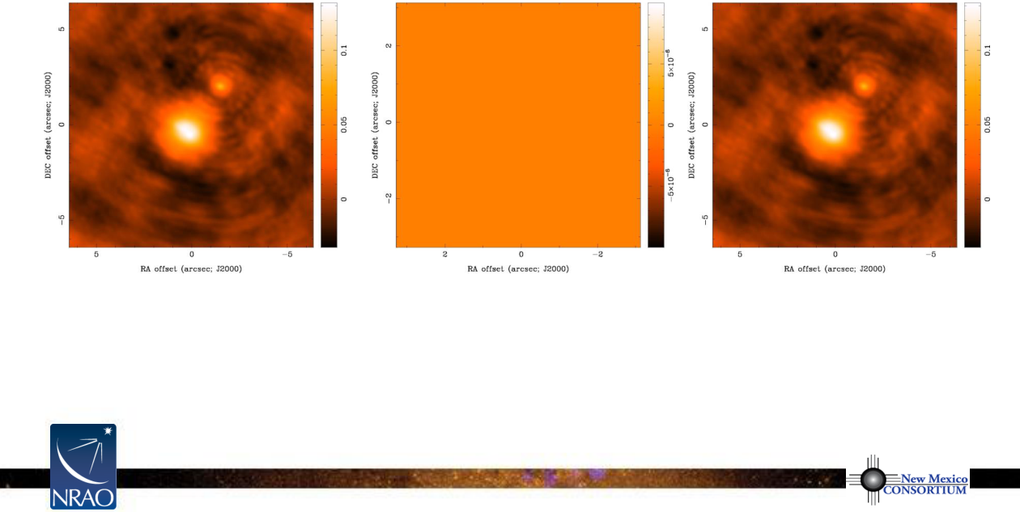
clean Example
T
D
(l,m)
0 Clean Components
residual map
Notes:
Source edition: assets/lessons/lectures/radio-astronomy/imaging-and-deconvolution-wilner-2014.pdf, page 54. Original author and figure credits remain on the slide. Text is editable; illustrations retain their source artwork.

Slide 55
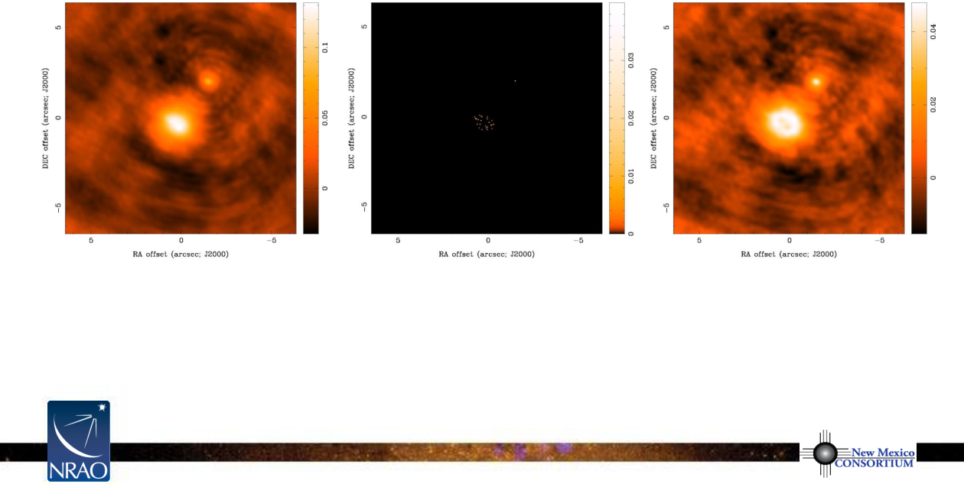
clean Example
T
D
(l,m)
30 Clean Components
residual map
Notes:
Source edition: assets/lessons/lectures/radio-astronomy/imaging-and-deconvolution-wilner-2014.pdf, page 55. Original author and figure credits remain on the slide. Text is editable; illustrations retain their source artwork.

Slide 56
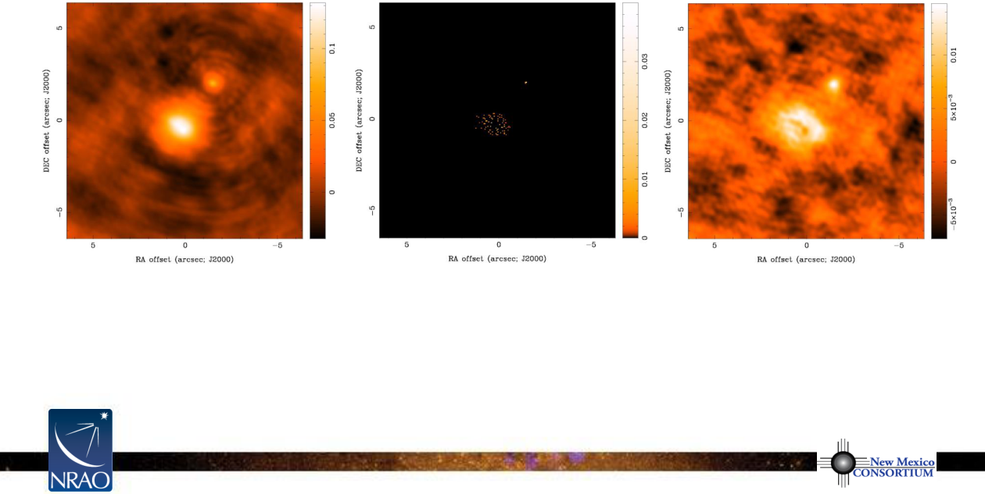
clean Example
T
D
(l,m)
100 Clean Components
residual map
Notes:
Source edition: assets/lessons/lectures/radio-astronomy/imaging-and-deconvolution-wilner-2014.pdf, page 56. Original author and figure credits remain on the slide. Text is editable; illustrations retain their source artwork.

Slide 57
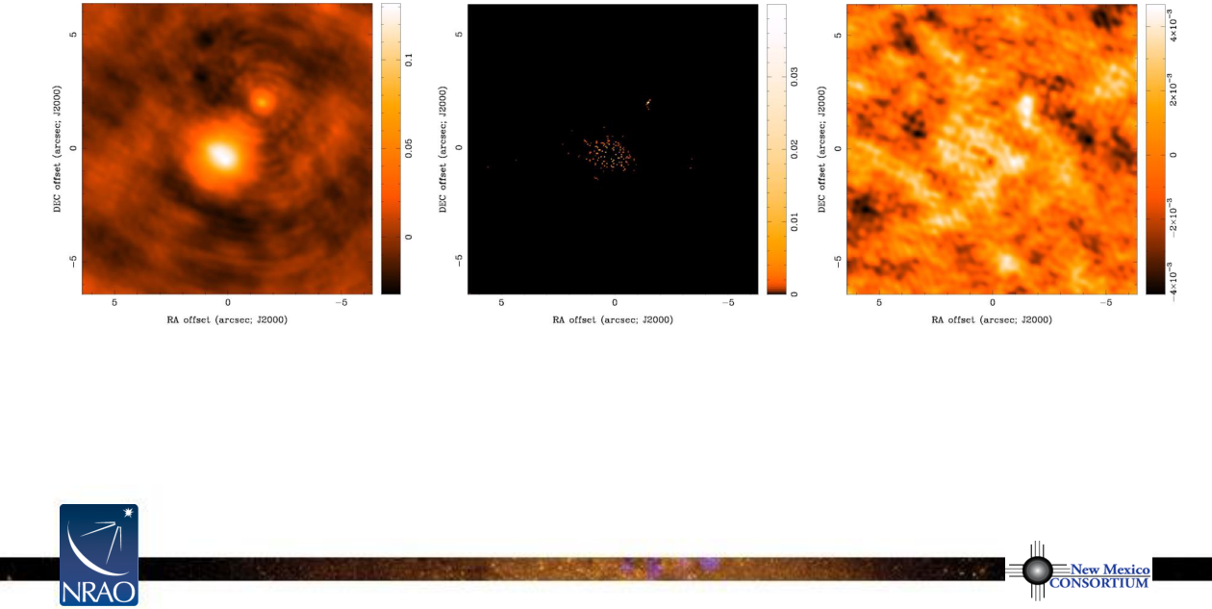
clean Example
T
D
(l,m)
300 Clean Components
residual map
Notes:
Source edition: assets/lessons/lectures/radio-astronomy/imaging-and-deconvolution-wilner-2014.pdf, page 57. Original author and figure credits remain on the slide. Text is editable; illustrations retain their source artwork.

Slide 58

clean Example
T
D
(l,m)
583 Clean Components
residual map
Notes:
Source edition: assets/lessons/lectures/radio-astronomy/imaging-and-deconvolution-wilner-2014.pdf, page 58. Original author and figure credits remain on the slide. Text is editable; illustrations retain their source artwork.

Slide 59
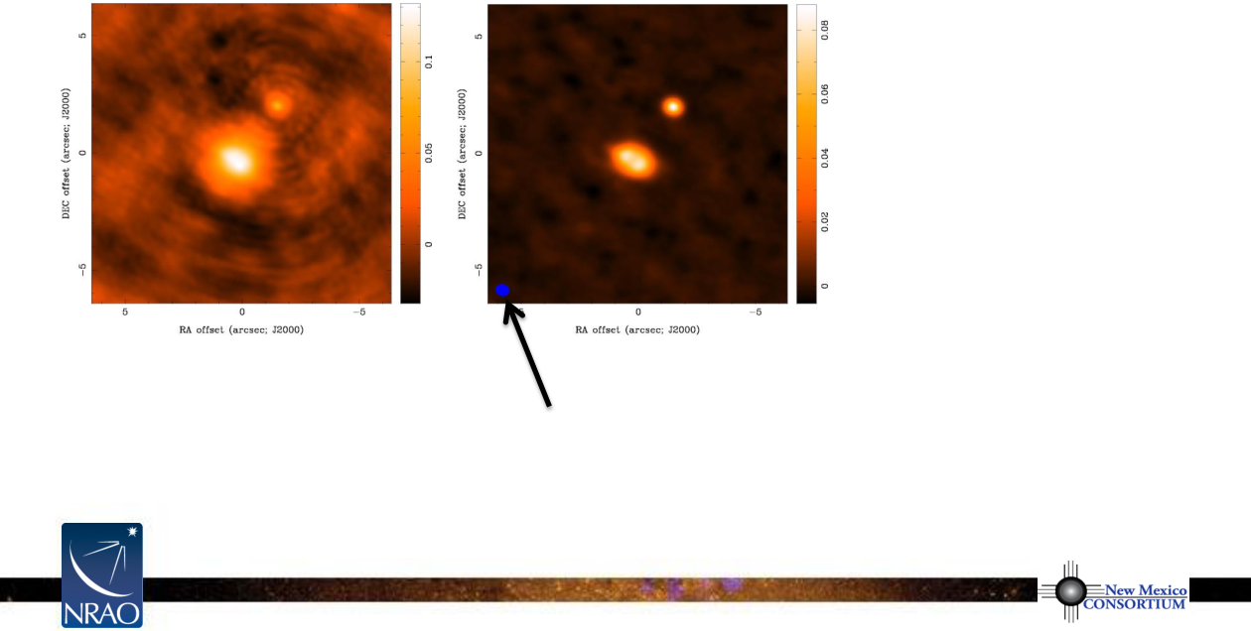
clean Example
T
D
(l,m)
restored image
ellipse = clean beam fwhm
final image depends on
imaging parameters (pixel size, visibility weighting scheme, gridding)
and deconvolution (algorithm, iterations, masks, stopping criteria)
Notes:
Source edition: assets/lessons/lectures/radio-astronomy/imaging-and-deconvolution-wilner-2014.pdf, page 59. Original author and figure credits remain on the slide. Text is editable; illustrations retain their source artwork.

Slide 60
CASA clean filename extensions
•
<
imagename
>.image
–
final clean image (or dirty image if niter=0)
•
<
imagename
>.psf
–
point spread function (= dirty beam)
•
<
imagename
>.model
–
image of clean components
•
<
imagename
>.residual
–
residual after subtracting clean components
(use to decide whether or not to continue clean)
•
<
imagename
>.flux
–
relative sensitivity on the sky
–
pbcor = True divides .image by .flux
Notes:
Source edition: assets/lessons/lectures/radio-astronomy/imaging-and-deconvolution-wilner-2014.pdf, page 60. Original author and figure credits remain on the slide. Text is editable; illustrations retain their source artwork.

Slide 61

Results from Different Weighting Schemes
natural
robust=0
0.59x0.50
0.40x0.34
uniform
natural
+ taper to
0.35x0.30
1.5x1.5
Notes:
Source edition: assets/lessons/lectures/radio-astronomy/imaging-and-deconvolution-wilner-2014.pdf, page 61. Original author and figure credits remain on the slide. Text is editable; illustrations retain their source artwork.

Slide 62

Tune Resolution/Sensitivity to suit Science
•
example: SMA 870
μ
m images of protoplanetary disk dust continuum
emission with resolved inner cavities (Andrews et al. 2009, ApJ, 700, 1502)
Notes:
Source edition: assets/lessons/lectures/radio-astronomy/imaging-and-deconvolution-wilner-2014.pdf, page 62. Original author and figure credits remain on the slide. Text is editable; illustrations retain their source artwork.

Slide 63
Scale Sensitive Deconvolution Algorithms
•
basic clean (or Maximum Entropy) is scale-free and treats each pixel as an
independent degree of freedom: no concept of source size
•
adjacent pixels in an image are not independent
•
an extended source covering 1000 pixels might be characterized by just
a few parameters, not 1000 paramters (e.g. an elliptical Gaussian with 6
parameters: x, y, amp, major fwhm, minor fwhm, position angle)
•
scale sensitive deconvolution algorithms try to employ fewer degrees of
freedom to model plausible sky brightness distributions
•
MS Clean (Multi-Scale Clean)
•
Adaptive Scale Pixel (Asp) Clean
•
yields promising results on extended emission
Notes:
Source edition: assets/lessons/lectures/radio-astronomy/imaging-and-deconvolution-wilner-2014.pdf, page 63. Original author and figure credits remain on the slide. Text is editable; illustrations retain their source artwork.

Slide 64

“Invisible” Large Scale Structure
•
missing short spacings can be problematic for large scale structure
•
to estimate? simulate observations, or check simple expressions for a
Gaussian or unform disk (appendix of Wilner & Welch 1994, ApJ, 427, 898)
Homework Problem
•
Q: By what factor is the central brightness reduced as a function of source
size due to missing short spacings for a Gaussian characterized by fwhm
θ
1/2
?
•
A: a Gaussian source central brightness is reduced 50% when
where
B
min
is the shortest baseline [meters],
υ
is the frequency [GHz]
Notes:
Source edition: assets/lessons/lectures/radio-astronomy/imaging-and-deconvolution-wilner-2014.pdf, page 64. Original author and figure credits remain on the slide. Text is editable; illustrations retain their source artwork.

Slide 65

Missing Short Spacings: Demonstration
•
important structure may be missed in central hole of (u,v) coverage
•
Do the visibilities observed in our example discriminate between these two
models of the sky brightness distribution
T(l,m)
?
•
Yes… but only on baselines shorter than about 75 k
λ
Notes:
Source edition: assets/lessons/lectures/radio-astronomy/imaging-and-deconvolution-wilner-2014.pdf, page 65. Original author and figure credits remain on the slide. Text is editable; illustrations retain their source artwork.

Slide 66

Missing Short Spacings: Demonstration
T(l,m)
natural weight
> 75 k
λ
natural weight
Notes:
Source edition: assets/lessons/lectures/radio-astronomy/imaging-and-deconvolution-wilner-2014.pdf, page 66. Original author and figure credits remain on the slide. Text is editable; illustrations retain their source artwork.

Slide 67

Measures of Image Quality
•
dynamic range
–
ratio of peak brightness to rms noise in
a region void of emission
–
easy way to calculate a lower limit to the
error in brightness in a non-empty region
–
e.g. peak = 89 mJy/beam, rms = 0.9 mJy/beam
DR = 89/0.9 = 99
•
fidelity
–
difference between any produced image and the correct image
–
fidelity image = input model / difference
= model * beam / abs(model * beam – reconstruction)
= inverse of the relative error
–
need knowledge of the correct image to calculate
Notes:
Source edition: assets/lessons/lectures/radio-astronomy/imaging-and-deconvolution-wilner-2014.pdf, page 67. Original author and figure credits remain on the slide. Text is editable; illustrations retain their source artwork.

Slide 68

Techniques to Obtain Short Spacings
use a large single dish telescope
density of
(u,v)
points
(u
2
+ v
2
)
1/2
•
all
Fourier components from 0 to D sampled, where D is dish diameter
(weighting depends on illumination)
•
scan single dish across sky to make an image
T(l,m)
*
A(l,m)
where
A(l,m)
is the single dish response pattern
•
Fourier transform single dish image,
T(l,m)
*
A(l,m),
to get
V(u,v)a(u,v)
and then divide by
a(u,v)
to estimate
V(u,v)
for baselines < D
•
choose D large enough to overlap interferometer samples of
V(u,v)
and avoid using data where
a(u,v)
becomes small, e.g. VLA & GBT
Notes:
Source edition: assets/lessons/lectures/radio-astronomy/imaging-and-deconvolution-wilner-2014.pdf, page 68. Original author and figure credits remain on the slide. Text is editable; illustrations retain their source artwork.

Slide 69

Techniques to Obtain Short Spacings
use a separate array of smaller antennas
•
small antennas can observe short baselines inaccessible to larger ones
•
the larger antennas can be used as single dish telescopes to make images
with Fourier components not accessible to the smaller antennas
•
example: ALMA main array + ACA
main array
50 x 12m: 12m to 14+ km
ACA
12 x 7m: covers 7-12m
4 x 12m single dishes: 0-7m
Notes:
Source edition: assets/lessons/lectures/radio-astronomy/imaging-and-deconvolution-wilner-2014.pdf, page 69. Original author and figure credits remain on the slide. Text is editable; illustrations retain their source artwork.

Slide 70

Techniques to Obtain Short Spacings
mosaic with a homogeneous array
•
recover a range of spatial frequencies around the nominal baseline b using
knowledge of A(l,m), shortest spacings from single dishes (Ekers & Rots 1979)
•
V(u,v)
is a linear combination of baselines from b-D to b+D
•
depends on pointing direction
(l
0
,m
0
)
as well as on
(u,v)
•
Fourier transform with respect to pointing direction
(l
0
,m
0
)
Notes:
Source edition: assets/lessons/lectures/radio-astronomy/imaging-and-deconvolution-wilner-2014.pdf, page 70. Original author and figure credits remain on the slide. Text is editable; illustrations retain their source artwork.

Slide 71

Self Calibration
•
a priori
calibration using external calibrators is not perfect
–
interpolated from different time, different sky direction from source
•
basic idea of self calibration is to correct for antenna based phase and
amplitude errors
together
with imaging to create a source model
•
works because
–
at each time, measure N complex gains and N(N-1)/2 visibilities
–
source structure can be represented by a small number of parameters
–
a highly overconstrained problem if N large and source simple
•
in practice, an iterative, non-linear relaxation process
–
assume source model
solve for time dependent gains
form new
source model from corrected data using e.g. clean
solve for new gains
–
requires sufficient signal-to-noise at each solution interval
•
loses absolute phase from calibrators and therefore position information
•
dangerous with small N arrays, complex sources, marginal signal-to-noise
Notes:
Source edition: assets/lessons/lectures/radio-astronomy/imaging-and-deconvolution-wilner-2014.pdf, page 71. Original author and figure credits remain on the slide. Text is editable; illustrations retain their source artwork.

Slide 72

Concluding Remarks
•
interferometry samples Fourier components of sky brightness
•
make an image by Fourier transforming sampled visibilities
•
deconvolution attempts to correct for incomplete sampling
•
remember
–
there are an infinite number of images compatible with the visibilities
–
missing (or corrrupted) visibilities affect the entire image
•
astronomers must use judgement in the imaging and deconvolution process
•
it’s fun and worth the trouble
high angular resolution images!
many, many issues not covered in this talk: see References and upcoming talks
Notes:
Source edition: assets/lessons/lectures/radio-astronomy/imaging-and-deconvolution-wilner-2014.pdf, page 72. Original author and figure credits remain on the slide. Text is editable; illustrations retain their source artwork.

Slide 73
END
Notes:
Source edition: assets/lessons/lectures/radio-astronomy/imaging-and-deconvolution-wilner-2014.pdf, page 73. Original author and figure credits remain on the slide. Text is editable; illustrations retain their source artwork.

