Slide 1

Signal Processing for Radio Astronomy Applications

Slide 2
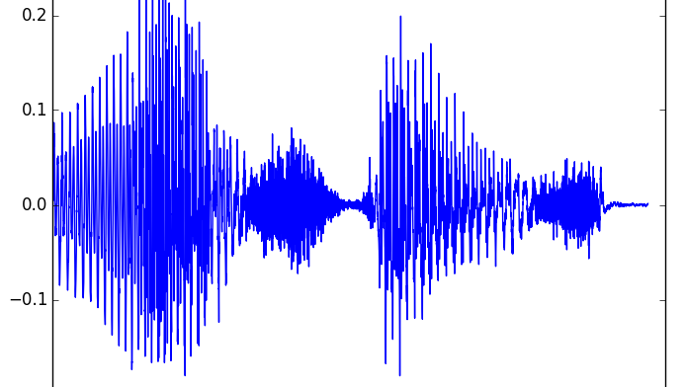
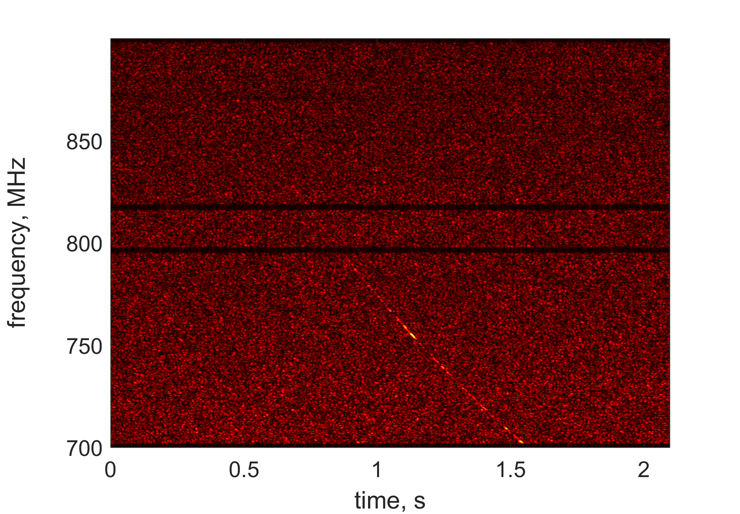
Signals
Signals = functions in 1D, 2D, 3D, etc.
Examples: audio signal, images, video signal
Dependence on time and frequency (or space and spatial frequencies)

Slide 3
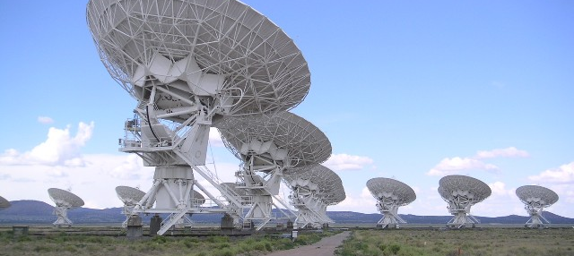
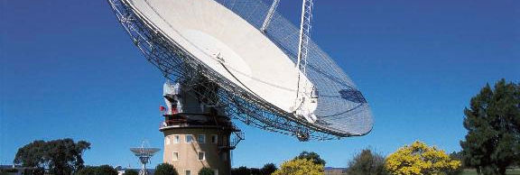
Systems
Cellular antenna
Camera
Tomographer (CT, MRI, etc.)
Optical telescope
Radio telescope
Radar
Any other receiver or antenna

Slide 4
Operations on Signals

Slide 5
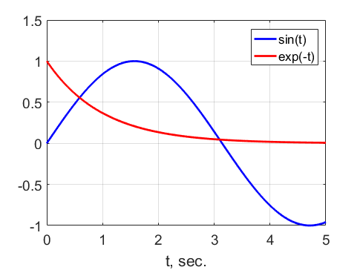
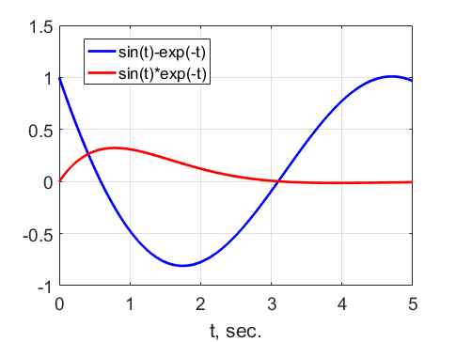
Adding / Subtracting / Multiplying

Slide 6
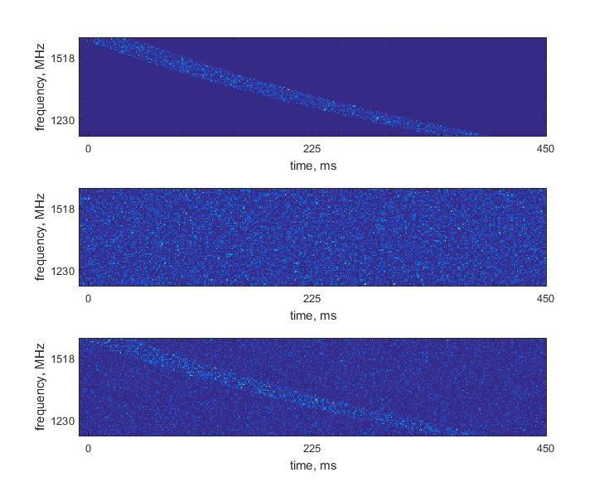
Signal processing for radio astronomy
Adding signals:
radio astronomy
Simulated Lorimer burst
DM = 375
S/N = 25

Slide 7
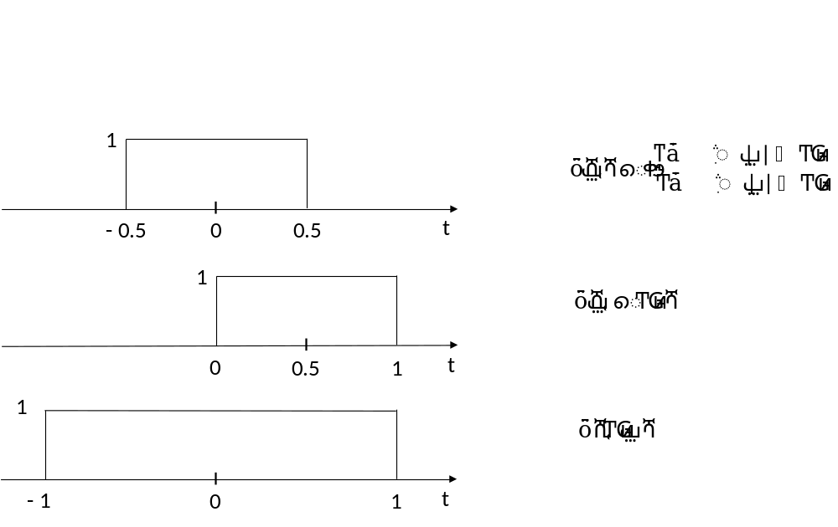
Time delay and scaling

Slide 8
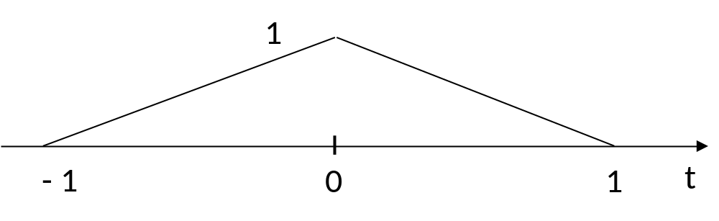
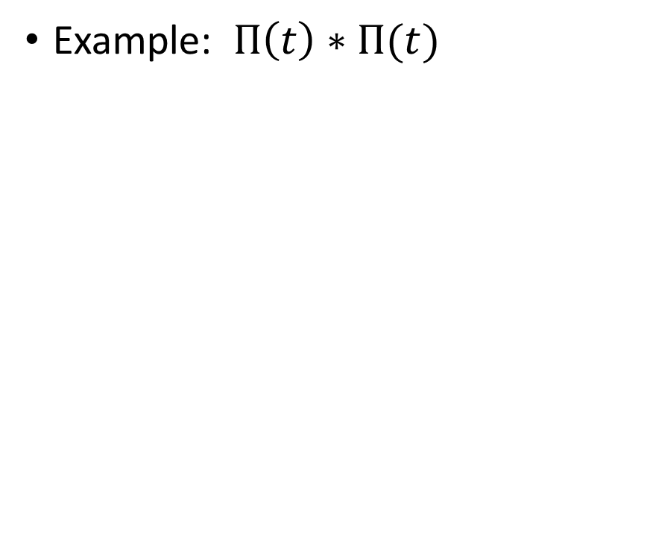
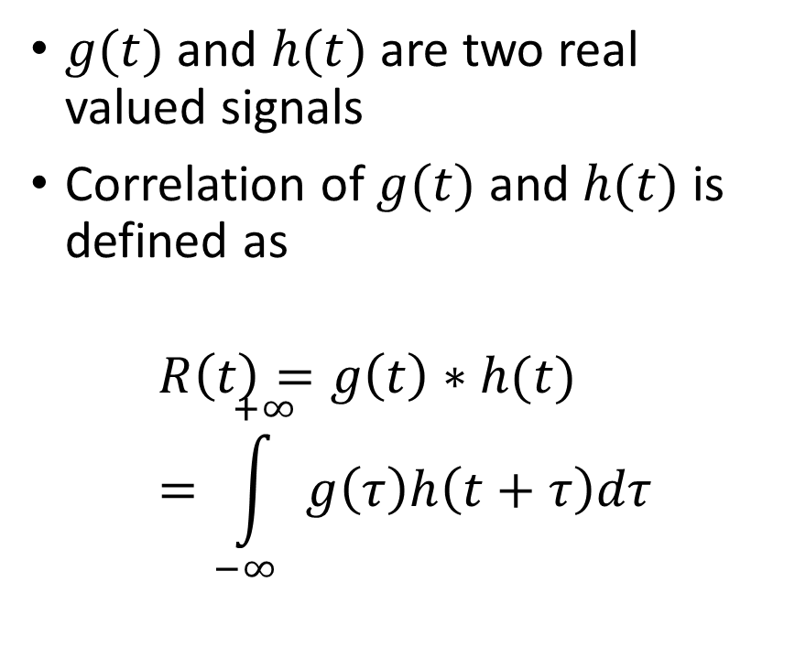
Correlation of signals
$g(t)$ and $h(t)$ are two real valued signals
Correlation of $g(t)$ and $h(t)$ is defined as
$$R\left(t\right)=g\left(t\right)∗h(t)=\int_{−∞}^{+∞}{g\left(τ\right)h\left(t+τ\right)dτ}$$
Example: $Π\left(t\right)∗Π(t)$

Slide 9

Why correlation?
It’s like matching patterns
Operators: shift, logical comparison
Assign one if two objects match (zero, otherwise), add all ones, find the maximum score. This is the best match.
The same idea is used to search for signals.
(0)
(2)
(0)
(0)
(0)
(6)

Slide 10
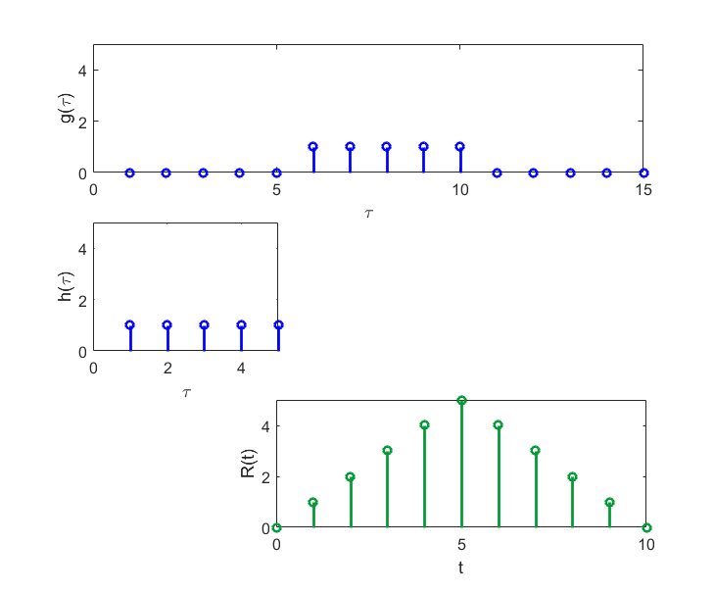
Illustration

Slide 11
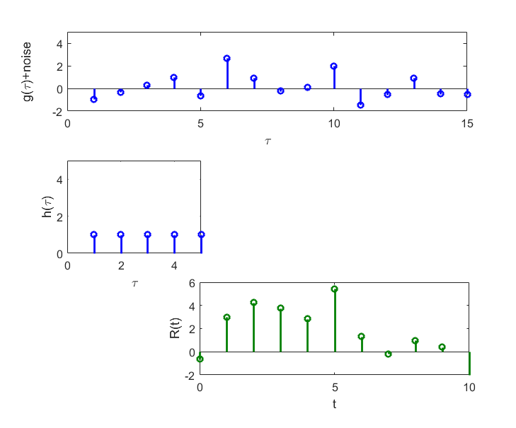
Noisy signal

Slide 12
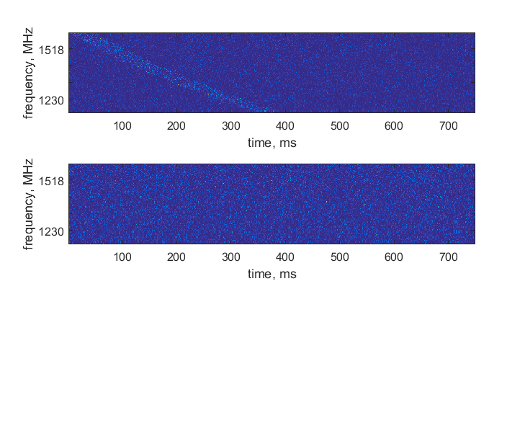
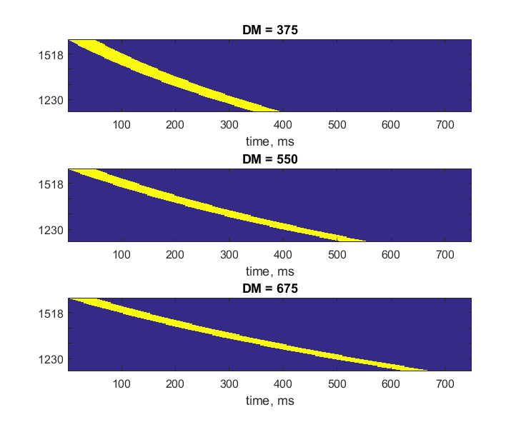
Matching signals in 2D
Signal + Noise | Noise only
1984.6 | 726.8
1013.0 | 740.3
896.8 | 755.8

