Slide 1
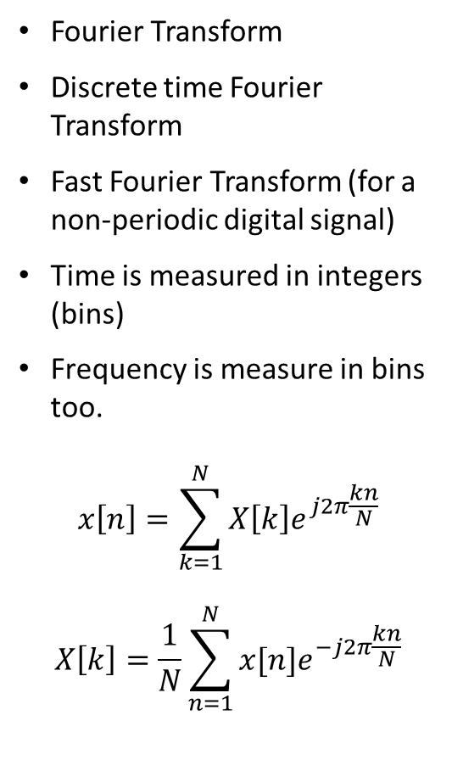
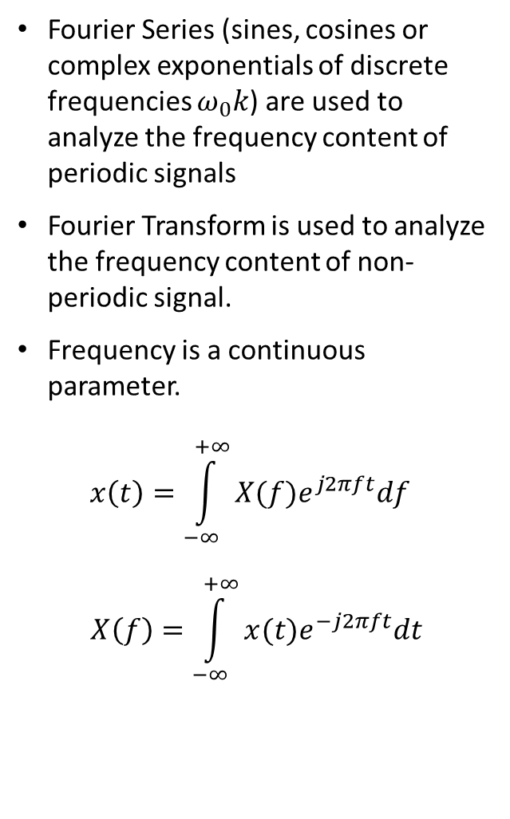
Frequency content of non-periodic signals
Fourier Series (sines, cosines or complex exponentials of discrete frequencies $ω_{0}k$) are used to analyze the frequency content of periodic signals
Fourier Transform is used to analyze the frequency content of non-periodic signal.
Frequency is a continuous parameter.
$$x\left(t\right)=\int_{−∞}^{+∞}{X(f)e^{j2πft}df}$$
$$X\left(f\right)=\int_{−∞}^{+∞}{x(t)e^{−j2πft}dt}$$
Fourier Transform
Discrete time Fourier Transform
Fast Fourier Transform (for a non-periodic digital signal)
Time is measured in integers (bins)
Frequency is measure in bins too.
$$x\left[n\right]=\sum_{k=1}^{N}{X\left[k\right]e^{j2π\frac{kn}{N}}}$$
$$X\left[k\right]=\frac{1}{N}\sum_{n=1}^{N}{x[n]e^{−j2π\frac{kn}{N}}}$$

Slide 2
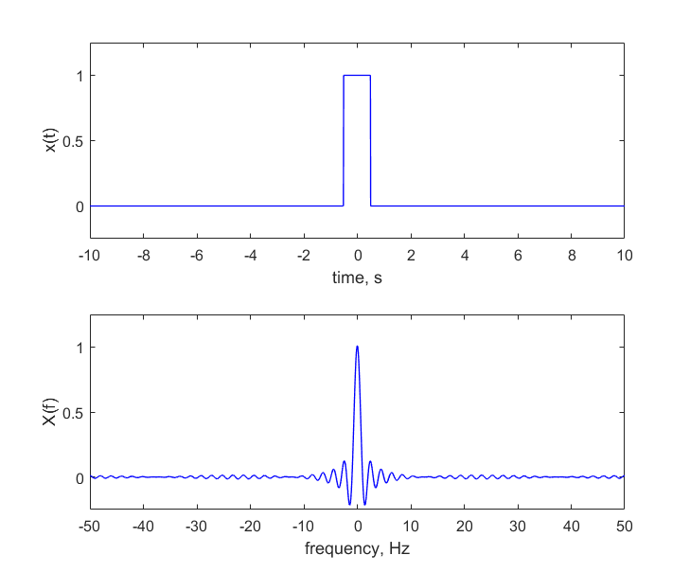

Common Fourier Transform Pairs: Rectangular Pulse
$$Π\left(t\right)=\left\{\begin{matrix}1, −0.5<t<0.5 \\ 0, otherwise\end{matrix}\right.$$
Fourier transform
$$X\left(f\right)=sinc\left(f\right)= \frac{sin⁡(πf)}{πf}$$

Slide 3
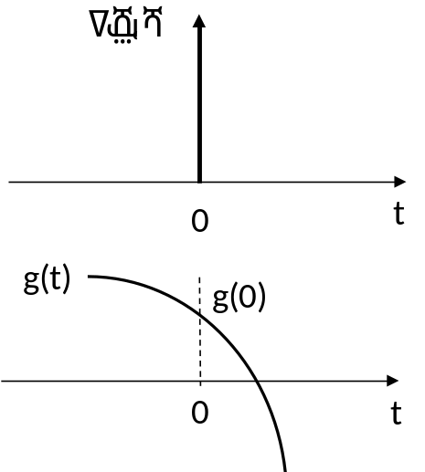
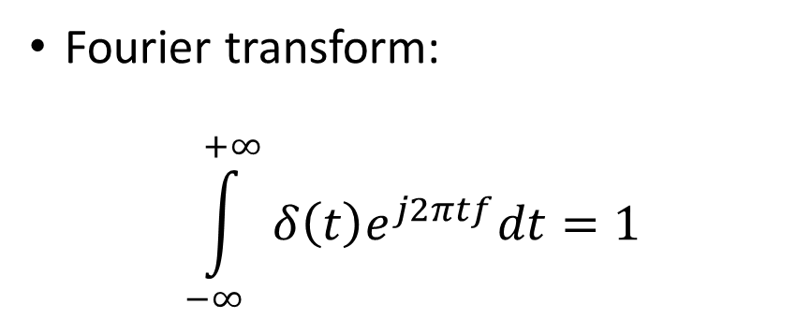
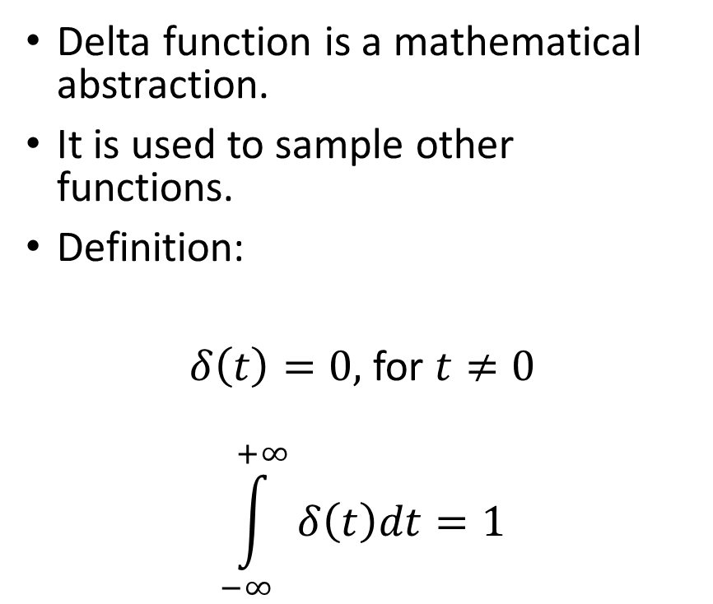
Delta function
Delta function is a mathematical abstraction.
It is used to sample other functions.
Definition:
$δ\left(t\right)=0,$ for $t≠0$
$$\int_{−∞}^{+∞}{δ\left(t\right)dt=1}$$
Fourier transform:
$$\int_{−∞}^{+∞}{δ\left(t\right)e^{j2πtf}dt=1}$$

Slide 4
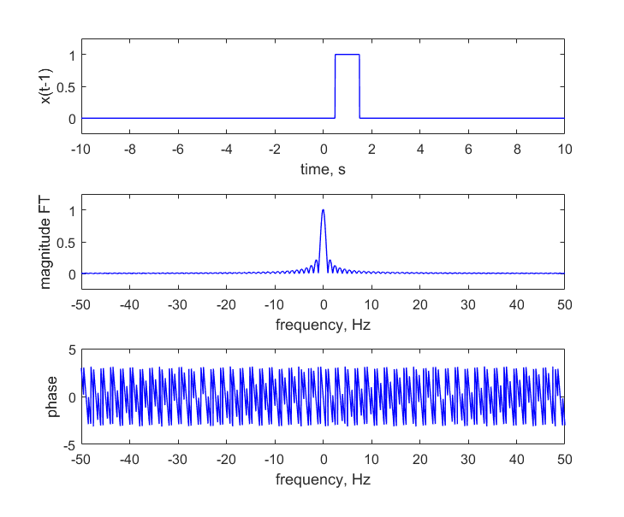

Time delay
Fourier pairs
$$Π(t)\underset{⇔}{FT}sinc(f)$$
$$Π(t−1)\underset{⇔}{FT}sinc(f)e^{−j2πf}$$
$$δ(t)\underset{⇔}{FT}1$$
$$δ(t−2)\underset{⇔}{FT}e^{−j2π2f}$$

Slide 5
Linearity of FT
Fourier transform of a sum of signals = sum of Fourier transforms
Example

Slide 6
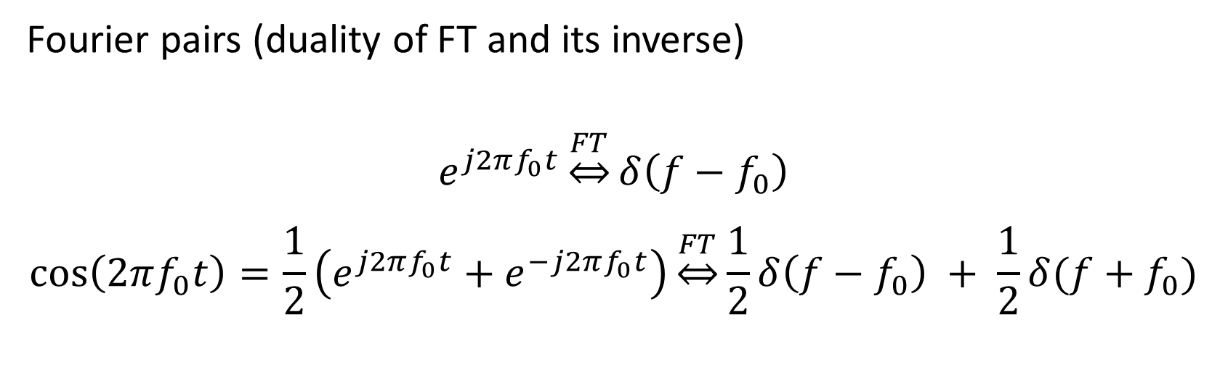
Complex Exponential and Cosine
Fourier pairs (duality of FT and its inverse)
$$e^{j2πf_{0}t}\underset{⇔}{FT}δ\left(f−f_{0}\right)$$
$$\cos\left(2πf_{0}t\right)=\frac{1}{2}\left(e^{j2πf_{0}t}+e^{−j2πf_{0}t}\right)\underset{⇔}{FT}\frac{1}{2}δ\left(f−f_{0}\right) + \frac{1}{2}δ(f+f_{0})$$

Slide 7

Fourier transform
Train of pulses: FT of a Dirac train and another Dirac train, but in frequency space.

Slide 8
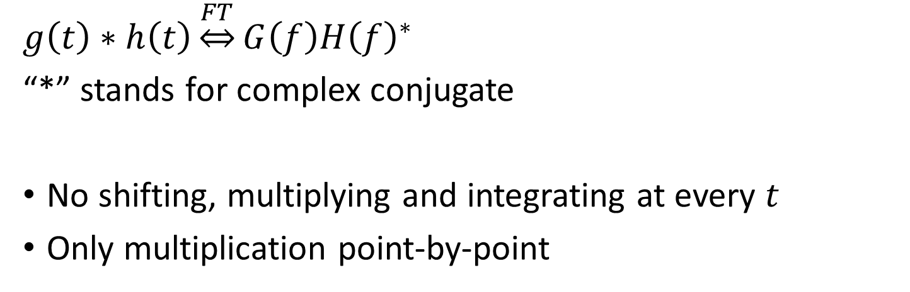
Correlation
$$g\left(t\right)∗h\left(t\right)\underset{⇔}{FT}G\left(f\right){H\left(f\right)}^{∗}$$
“*” stands for complex conjugate
No shifting, multiplying and integrating at every $t$
Only multiplication point-by-point

Slide 9
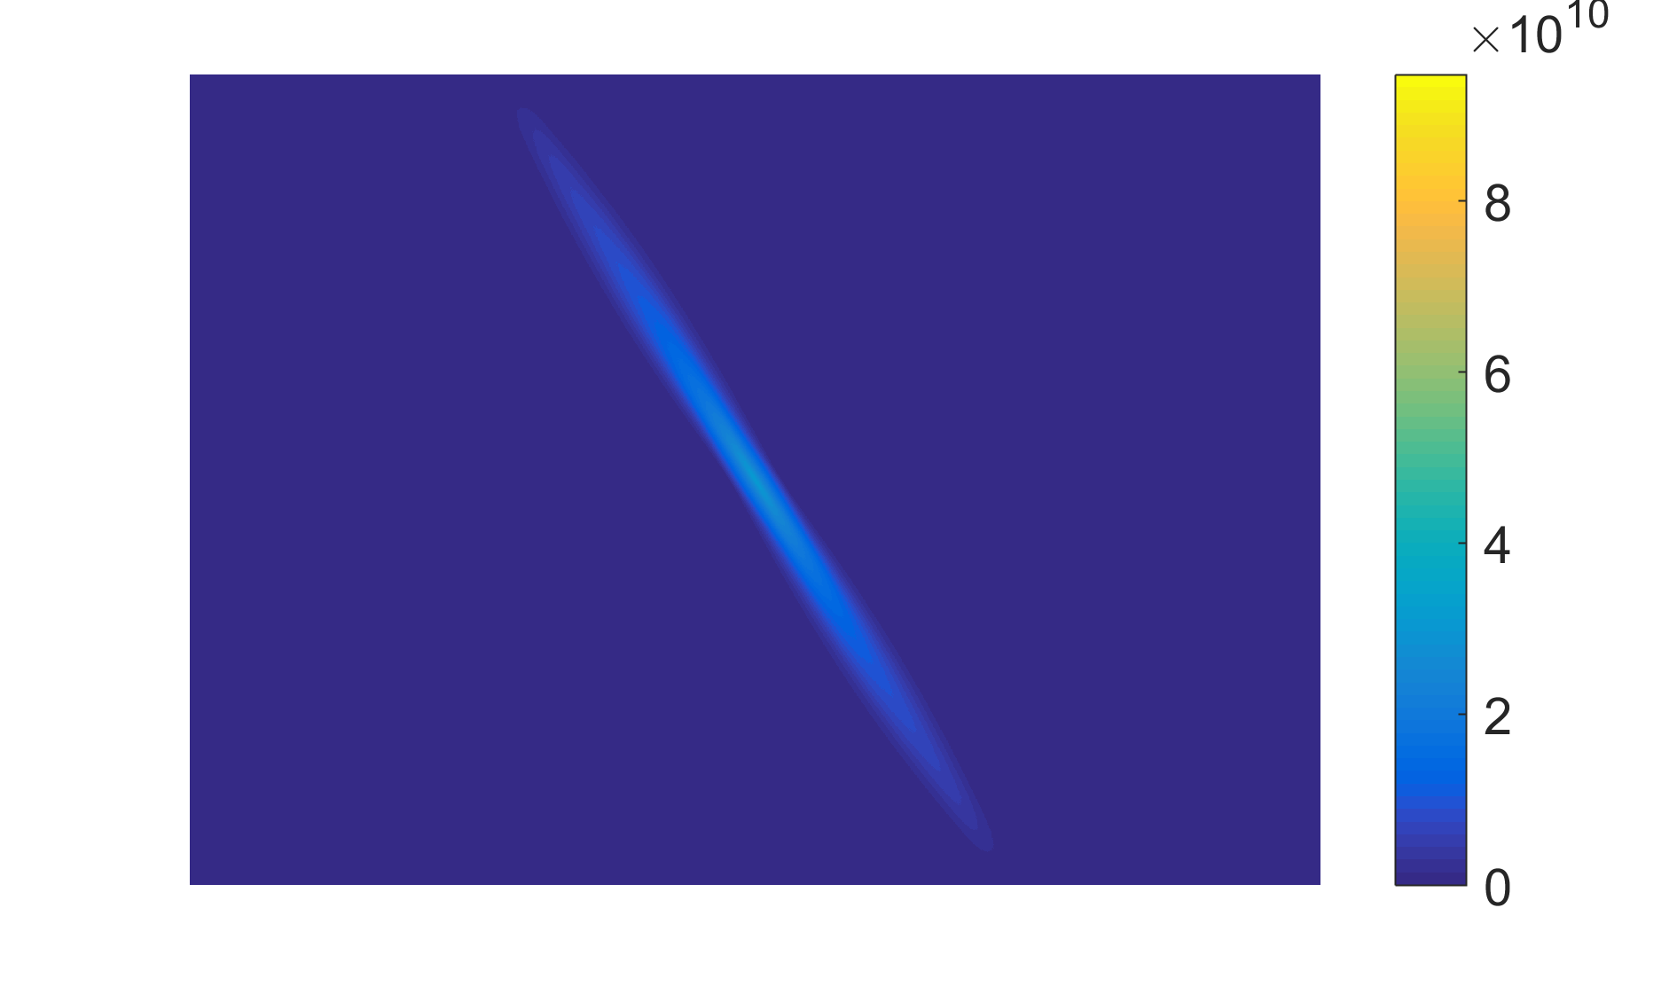
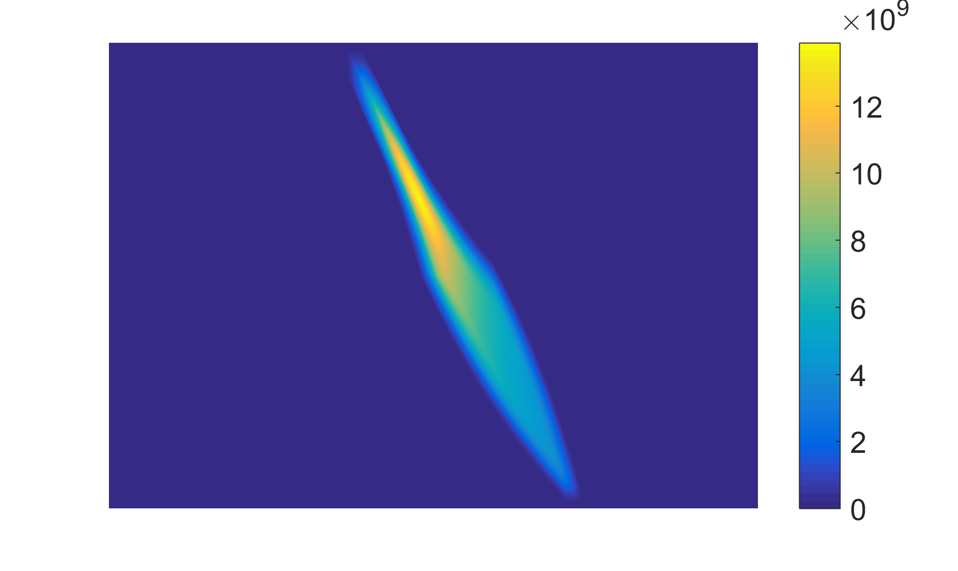
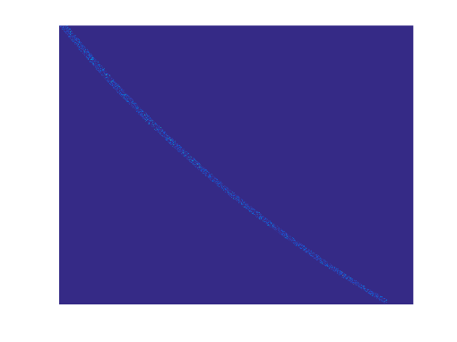


Matched filtering of filter-bank data
Correlate filter-bank data with a dispersed pulse.
Vary pulse width and its shape. Also vary DM value.
Computationally it is very expensive.
PSNR can be used as detection criterion.
correlation function
2d correlation
=
**
a spectrogram
response of matched filter

Slide 10
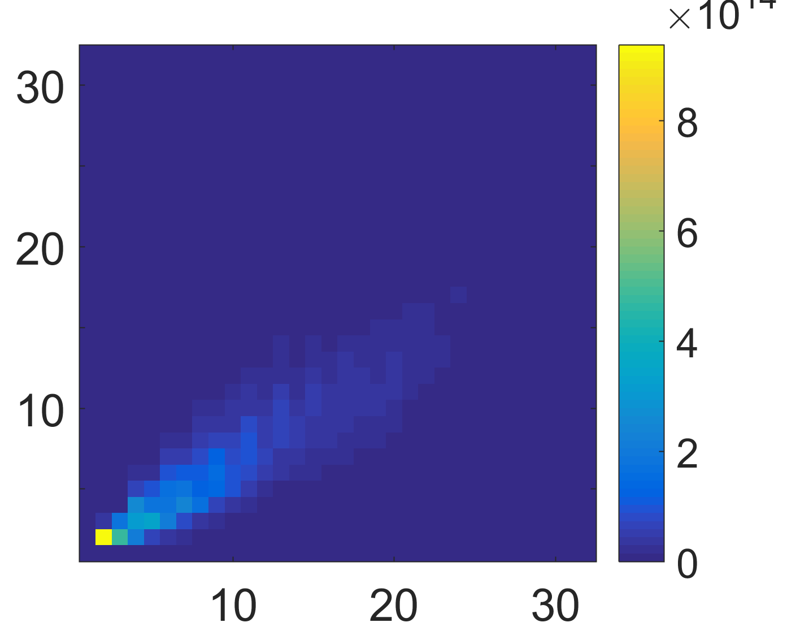
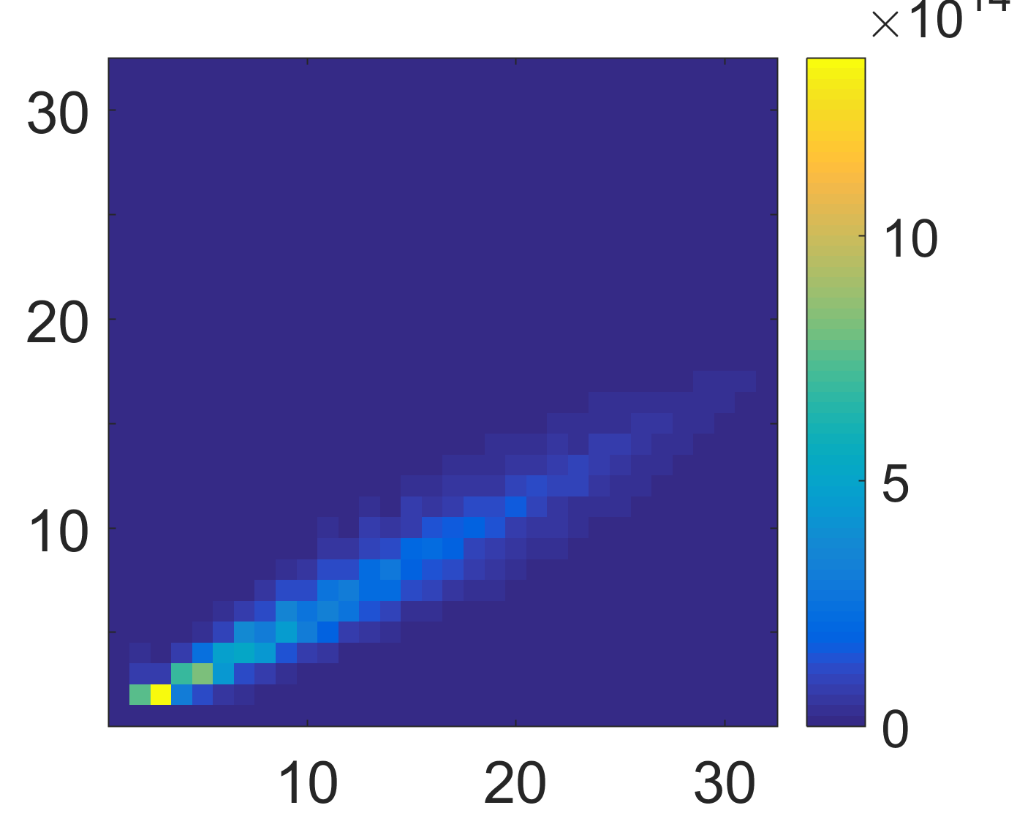
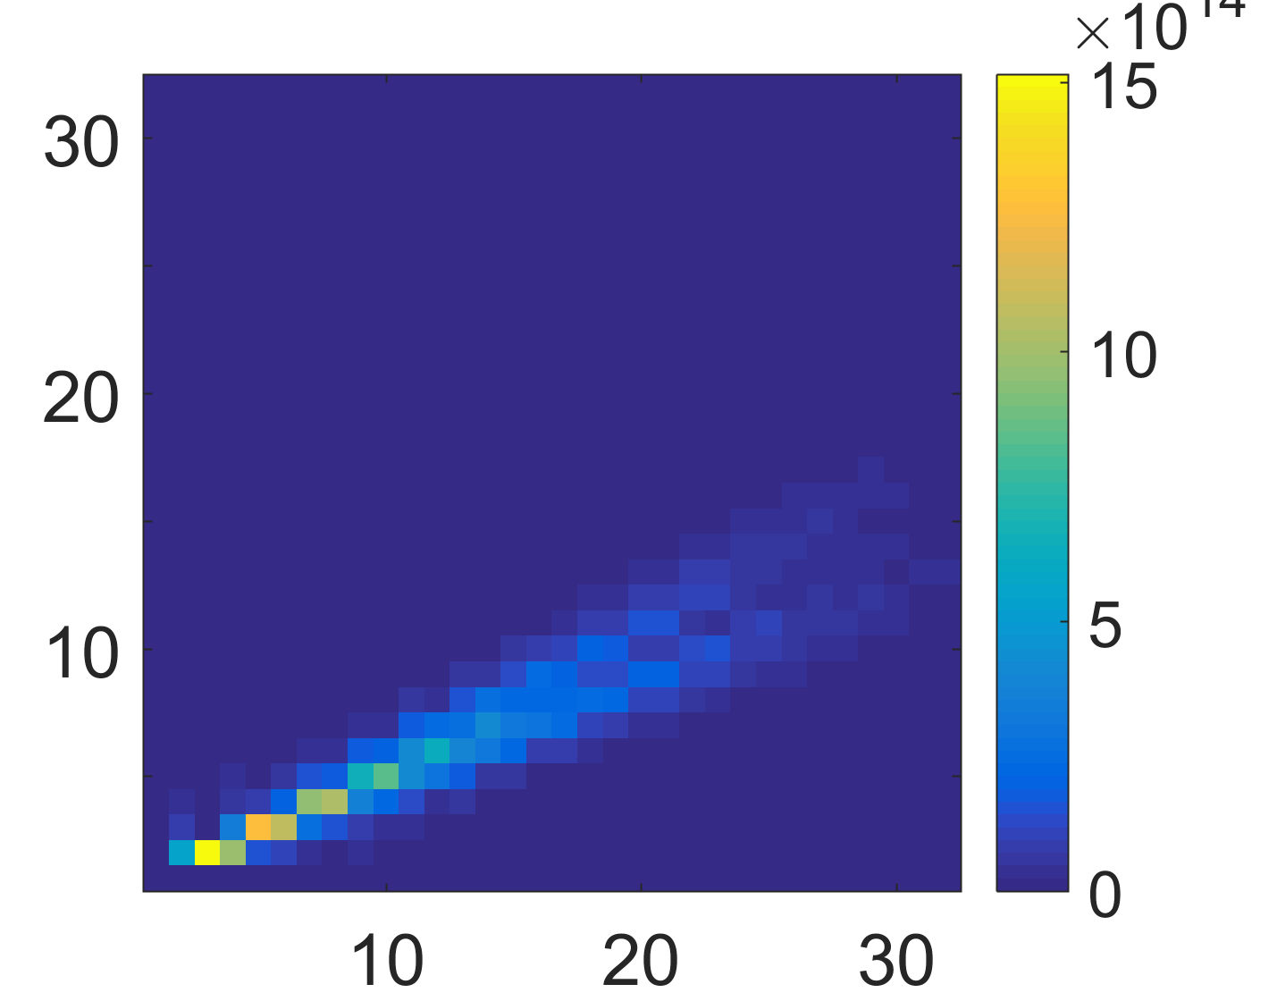
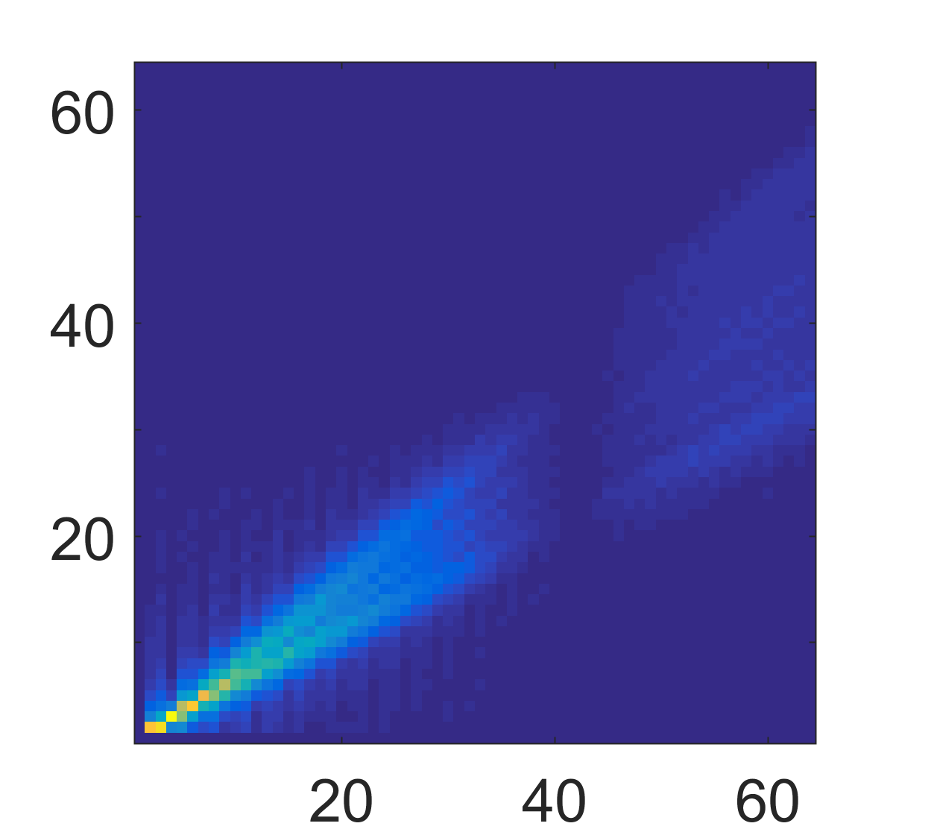
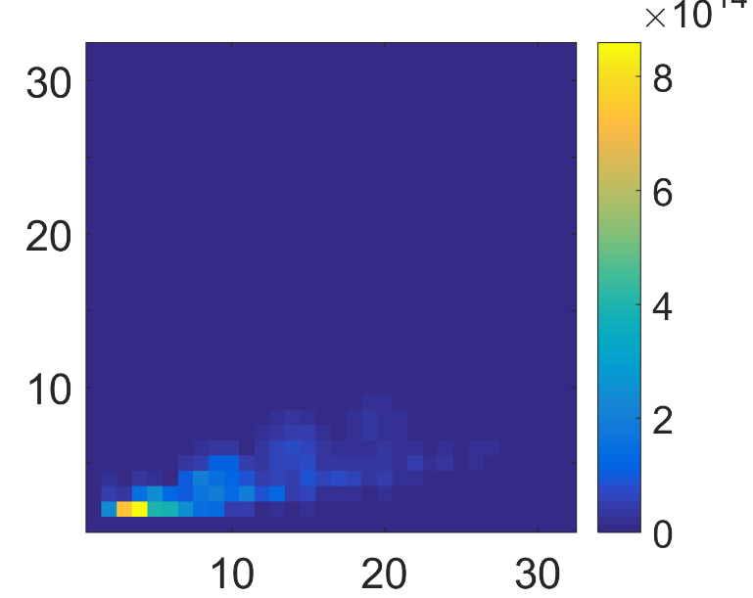
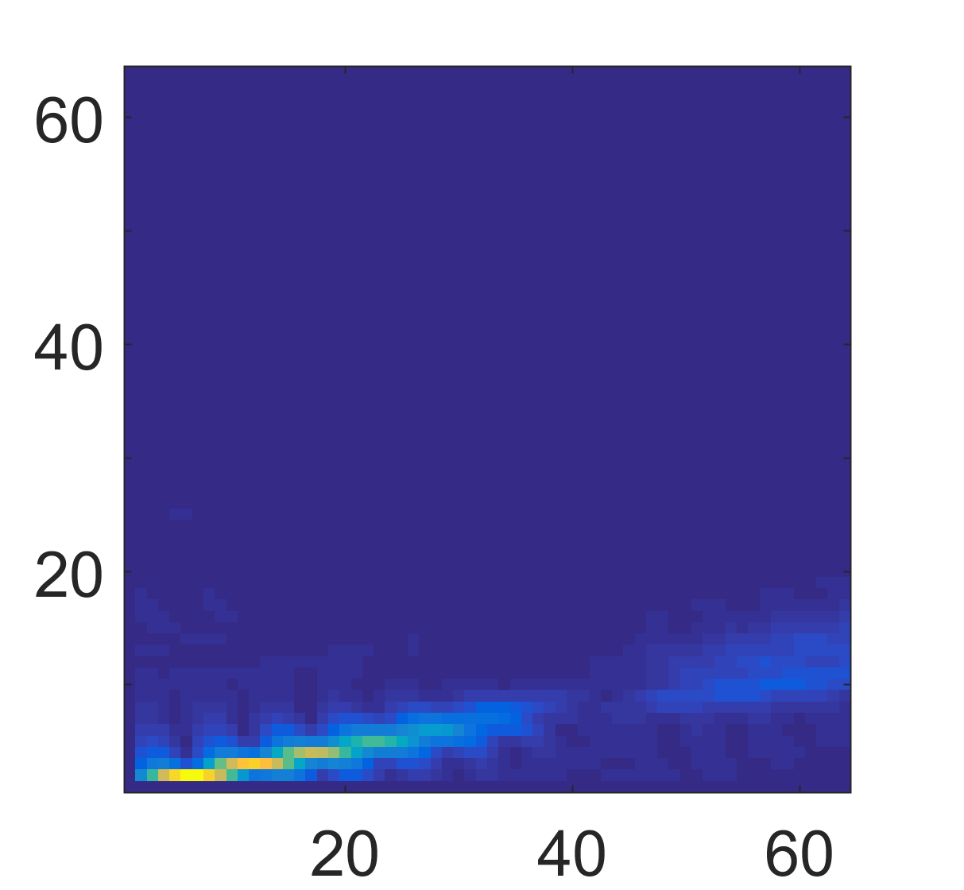
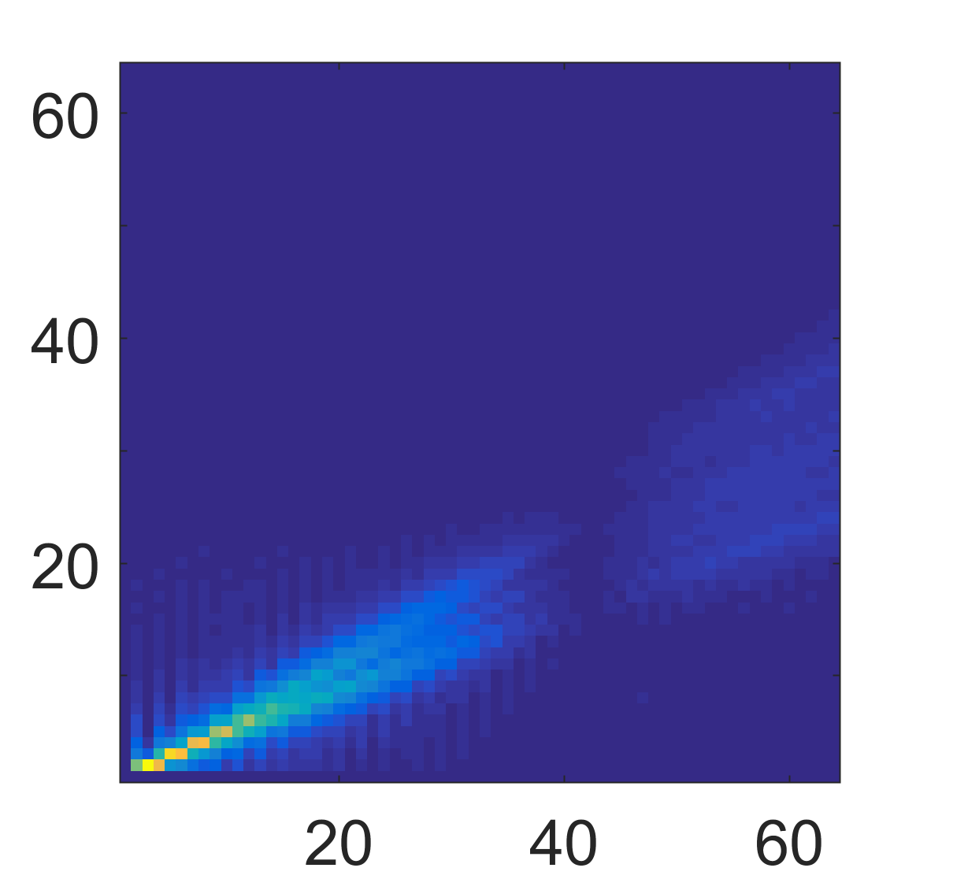
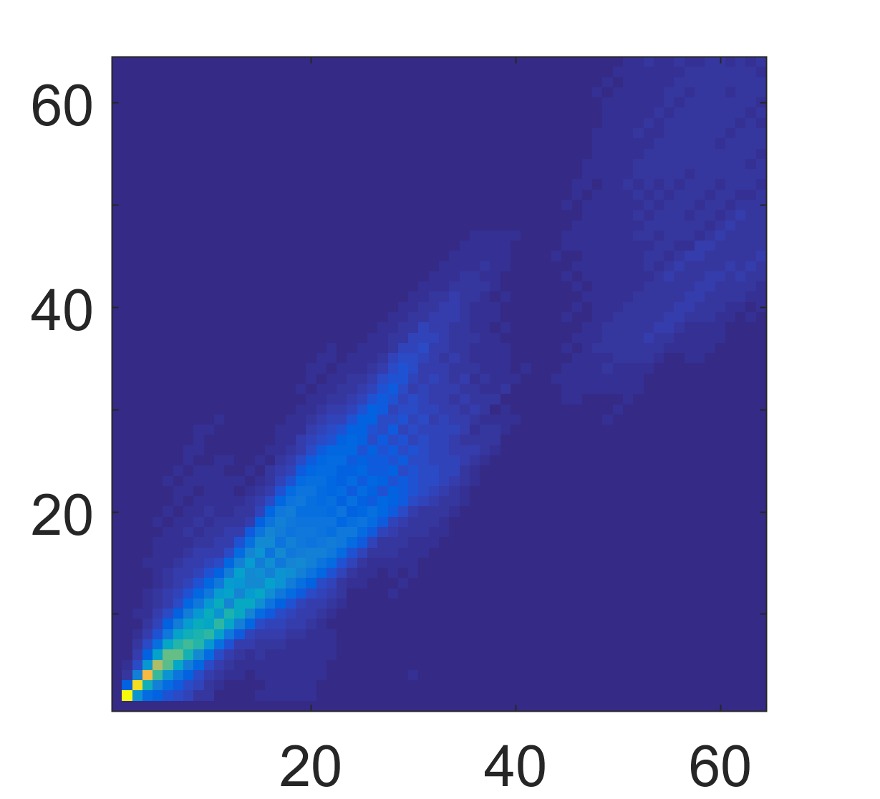

Correlation in 2d FT
2d FT stands for two dimensional Fourier Transform
the result of “correlation”
true pulse
four matched filters
$$×$$
=
DM = 50
DM = 20, 50, 70, 100
Width = 100 (in bins)
Width = 100 (in bins)

