Slide 1
Time and planning observations
Connect the clock to the sky
WVU DSPIRA astronomy
Adapted from lecture material credited to Loren Anderson
Notes:
Adapted from lecture material credited to Loren Anderson.

Slide 2
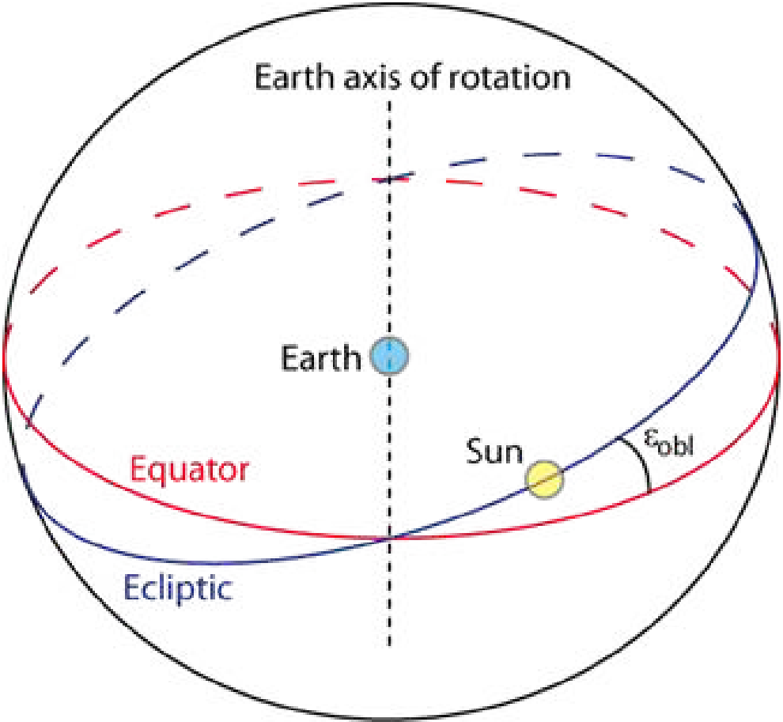
Two reference planes in the sky
The celestial equator extends Earth’s equator onto the sky.
The ecliptic traces the Sun’s apparent annual path.
Earth’s tilted axis separates these planes.
Earth’s equator and the ecliptic define different planes.
Notes:
Adapted from lecture material credited to Loren Anderson.
Source figure: original slide 2. Original figure credits and rights remain in effect.

Slide 3
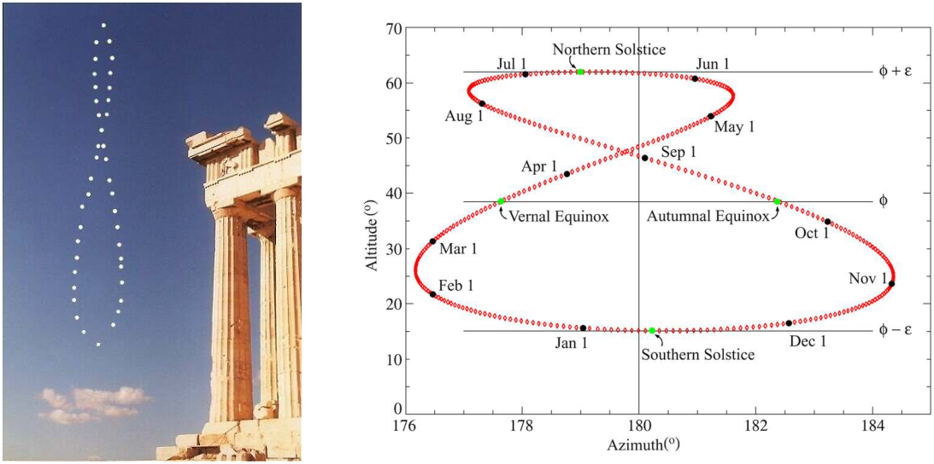
The analemma
Record the Sun from one location at the same mean solar time throughout a year.
Notes:
Adapted from lecture material credited to Loren Anderson.
The figure-eight path reflects changing solar declination and apparent solar time. Original photo and chart retained. https://aa.usno.navy.mil/faq/eqtime
Source figure: original slide 3. Original figure credits and rights remain in effect.

Slide 4
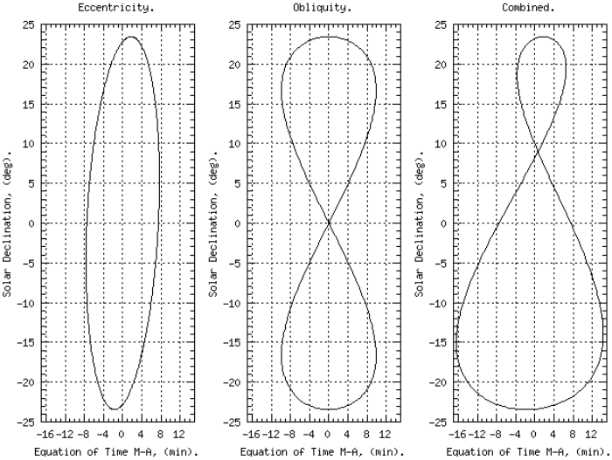
Why the analemma forms
Earth’s orbital speed varies.
Axial tilt changes the projection of solar motion.
Both effects change apparent solar time.
Orbital eccentricity and axial tilt combine to produce the analemma.
Notes:
Adapted from lecture material credited to Loren Anderson.
https://aa.usno.navy.mil/faq/eqtime The relevant projection is the Sun’s motion along the celestial equator.
Source figure: original slide 4. Original figure credits and rights remain in effect.

Slide 5
The equation of time
Apparent solar time
Tracks the real Sun.
Apparent noon occurs when the Sun crosses the local meridian.
Mean solar time
Uses a uniform solar clock.
Equation of time =
apparent solar time
− mean solar time
Notes:
Adapted from lecture material credited to Loren Anderson.
https://aa.usno.navy.mil/faq/eqtime The original plot had an unexplained day-of-year phase offset. It is replaced by an explicit definition; do not use civil time directly without longitude and time-zone corrections.

Slide 6
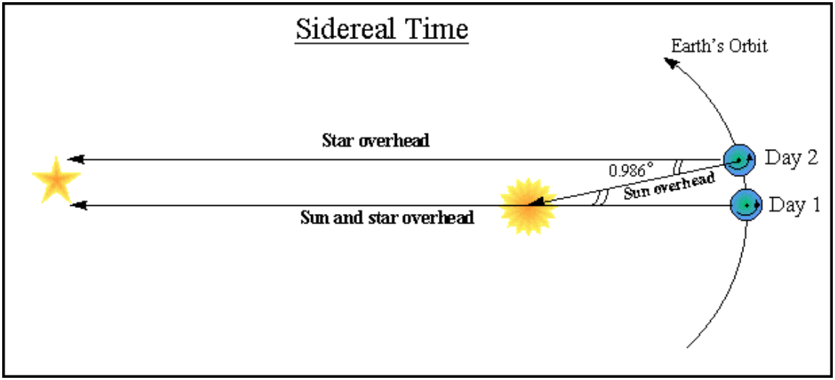
A sidereal day follows the stars
A sidereal day is about 23 hours 56 minutes. A mean solar day is 24 hours.
Notes:
Adapted from lecture material credited to Loren Anderson.
Relative to distant stars, Earth completes a turn in about 23h56m. It then turns farther to bring the Sun back to the meridian because Earth has moved along its orbit. https://aa.usno.navy.mil/faq/eqtime
Source figure: original slide 6. Original figure credits and rights remain in effect.

Slide 7
Local sidereal time
Read the sky clock
Local sidereal time is the right ascension crossing the upper meridian.
It depends on both time and longitude.
Use hour angle
HA = LST − RA
At upper transit, HA = 0.
An object transits when LST equals its RA.
Notes:
Adapted from lecture material credited to Loren Anderson.
Use matching coordinate epochs and mean/apparent conventions for precision work. https://aa.usno.navy.mil/data/siderealtime

Slide 8
Practice with hour angle
Local sidereal time | Target RA | Hour angle
4 hours | 6 hours | −2 hours: east of meridian
6 hours | 6 hours | 0 hours: upper transit
8 hours | 6 hours | +2 hours: west of meridian
Hour angle increases as Earth rotates. Upper transit is usually a useful time to observe a visible target.
Notes:
Adapted from lecture material credited to Loren Anderson.
https://aa.usno.navy.mil/faq/eqtime

Slide 9
Compare the equinoxes
March equinox
The Sun’s RA is approximately 0 hours.
At local apparent noon, LST is approximately 0 hours.
September equinox
The Sun’s RA is approximately 12 hours.
At local apparent noon, LST is approximately 12 hours.
Notes:
Adapted from lecture material credited to Loren Anderson.
Start with Greenwich to remove longitude from the example. Apparent solar noon is not generally 12:00 civil time. These examples do not make sidereal and civil time identical. https://aa.usno.navy.mil/faq/eqtime

Slide 10
Calculate local sidereal time
1. Enter the observing date and UT1 time.
2. Enter longitude using the calculator’s sign convention.
3. Find LST and compare it with your target’s RA.
4. Check altitude and obstructions in Stellarium.
Open the U.S. Naval Observatory sidereal-time calculator
Notes:
Adapted from lecture material credited to Loren Anderson.
https://aa.usno.navy.mil/data/siderealtime The calculator accepts longitude in degrees east; western longitudes are negative. For classroom scheduling UTC approximates UT1 within a second.

Slide 11
Plan an observation
Choose the target and record its coordinates.
Find a time when it is above your local horizon.
Record the site, date, time zone, azimuth, and elevation.
Check that your clock settings match your observing plan.
Notes:
Adapted from lecture material credited to Loren Anderson.
Original lecture credited to Loren Anderson. References: https://aa.usno.navy.mil/data/siderealtime ; https://aa.usno.navy.mil/faq/eqtime ; https://stellarium.org/guide/

Slide 12
Reference tools
U.S. Naval Observatory sidereal-time calculator
U.S. Naval Observatory equation of time guide
Stellarium user guide
Original lecture: Loren Anderson
Notes:
Adapted from lecture material credited to Loren Anderson.
Original photos and scientific diagrams are retained from the source lecture. Existing figure rights remain in effect. Source records: https://github.com/WVURAIL/dspira/blob/main/assets/lessons/lectures/SOURCE-NOTICE.txt

