Slide 1

Galactic Rotation
Notes:
Source edition: assets/lessons/lectures/astronomy/rotation-curves.pdf, page 1. Original author and figure credits remain on the slide. Text is editable; illustrations retain their source artwork.

Slide 2
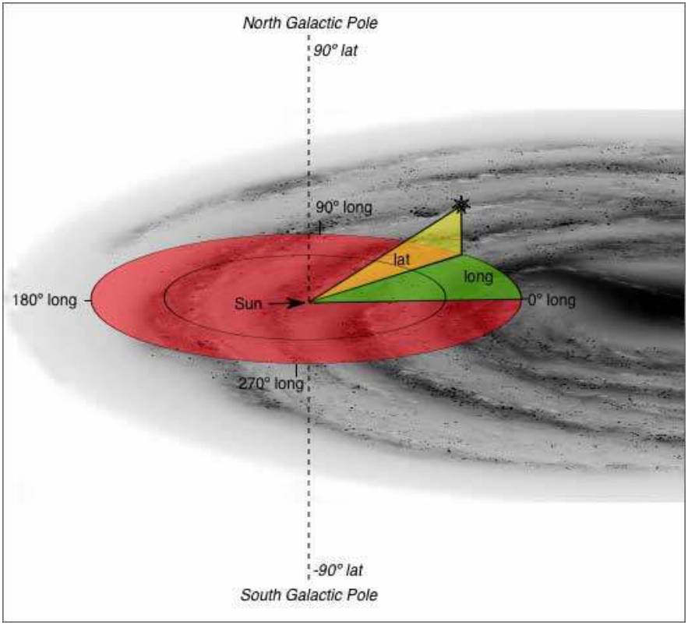
Galactic Coordinates
Notes:
Source edition: assets/lessons/lectures/astronomy/rotation-curves.pdf, page 2. Original author and figure credits remain on the slide. Text is editable; illustrations retain their source artwork.

Slide 3
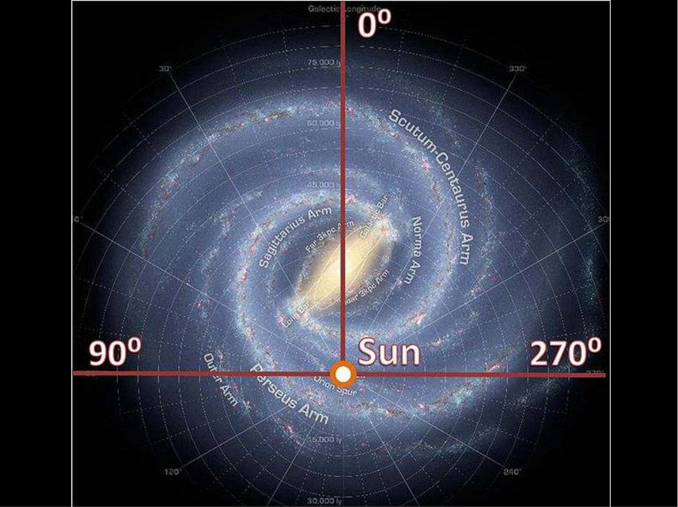
Rotation curves
Notes:
Source edition: assets/lessons/lectures/astronomy/rotation-curves.pdf, page 3. Original author and figure credits remain on the slide. Text is editable; illustrations retain their source artwork.

Slide 4
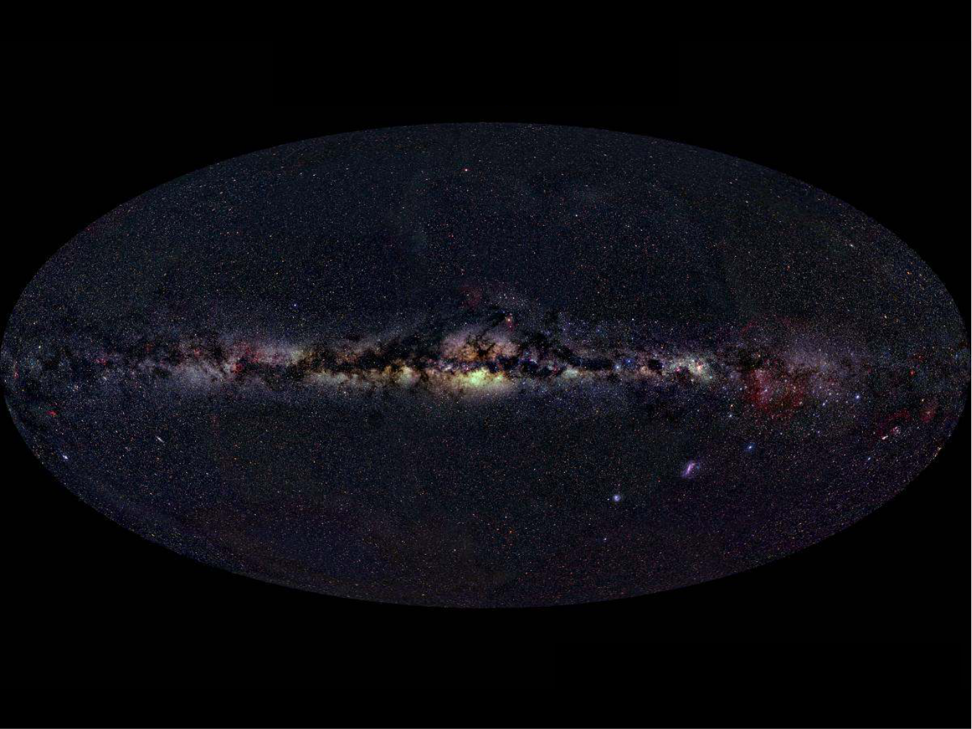
Rotation curves
Notes:
Source edition: assets/lessons/lectures/astronomy/rotation-curves.pdf, page 4. Original author and figure credits remain on the slide. Text is editable; illustrations retain their source artwork.

Slide 5
Rotation curves
Positive Latitudes
180 deg.
180 deg.
Longitude
0 deg. Longitude
Longitude
Negative Latitudes
Notes:
Source edition: assets/lessons/lectures/astronomy/rotation-curves.pdf, page 5. Original author and figure credits remain on the slide. Text is editable; illustrations retain their source artwork.

Slide 6
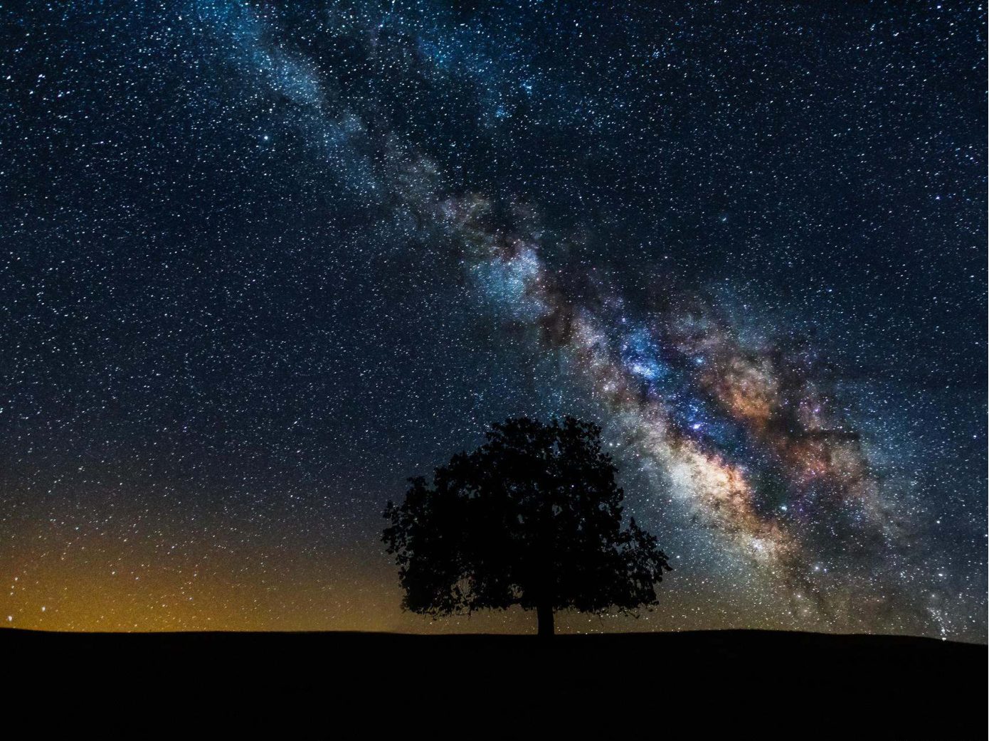
Rotation curves
Positive Latitudes
0 deg. Longitude
Negative Latitudes
Notes:
Source edition: assets/lessons/lectures/astronomy/rotation-curves.pdf, page 6. Original author and figure credits remain on the slide. Text is editable; illustrations retain their source artwork.

Slide 7
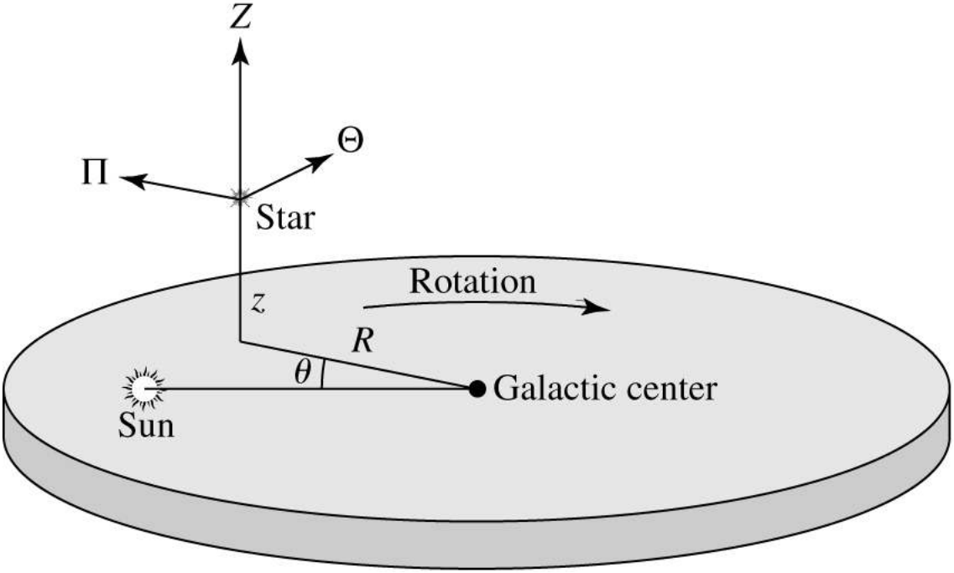
Galactic Center Cylindrical Coordinates
Notes:
Source edition: assets/lessons/lectures/astronomy/rotation-curves.pdf, page 7. Original author and figure credits remain on the slide. Text is editable; illustrations retain their source artwork.

Slide 8
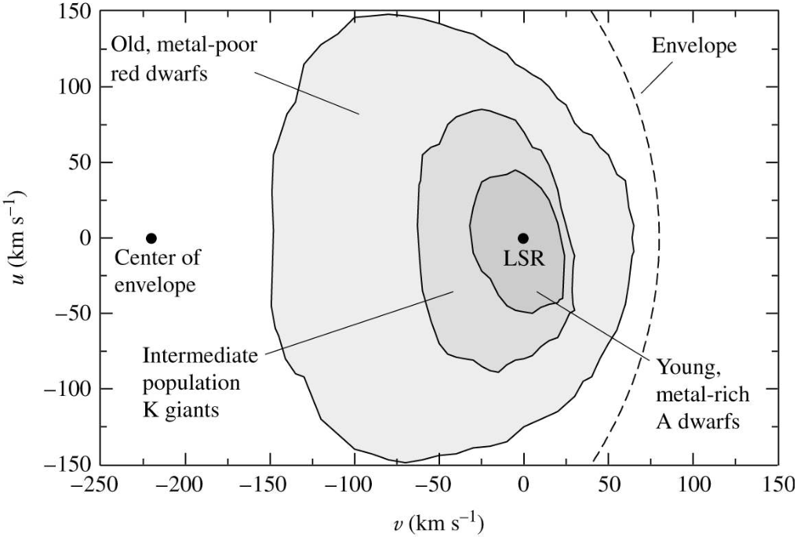
Rotation curves
Observations of Stars Show
Notes:
Source edition: assets/lessons/lectures/astronomy/rotation-curves.pdf, page 8. Original author and figure credits remain on the slide. Text is editable; illustrations retain their source artwork.

Slide 9
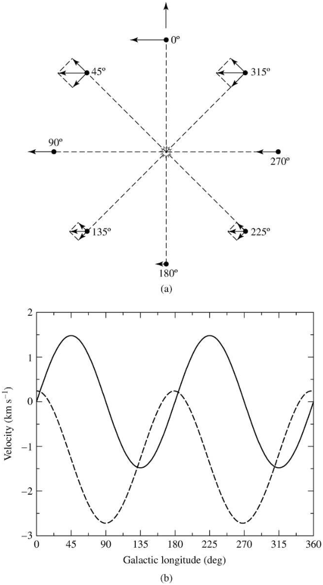
Rotation curves
Radial (solid) and
transverse (dashed)
velocities as a
function of
l.
Dependence is sin (2
l
)
Notes:
Source edition: assets/lessons/lectures/astronomy/rotation-curves.pdf, page 9. Original author and figure credits remain on the slide. Text is editable; illustrations retain their source artwork.

Slide 10
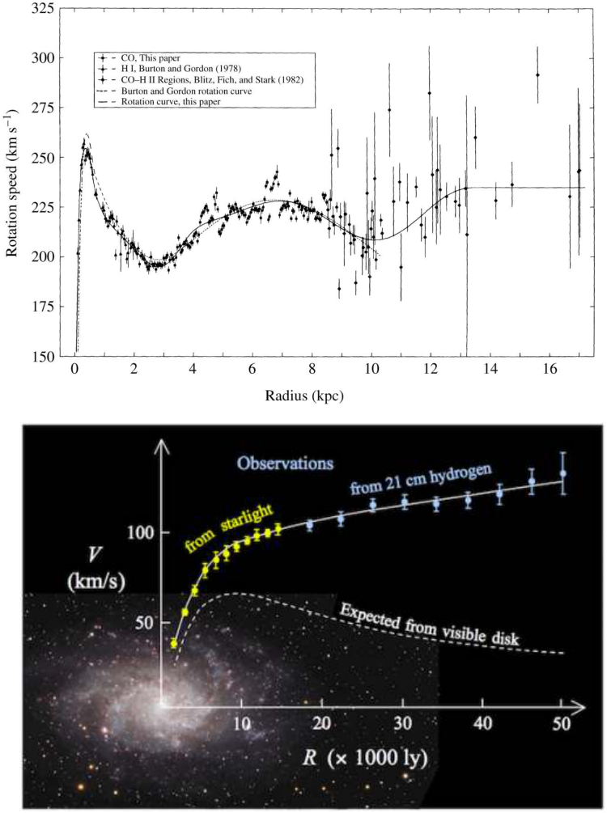
Rotation curves
Milky Way
Other galaxy
Notes:
Source edition: assets/lessons/lectures/astronomy/rotation-curves.pdf, page 10. Original author and figure credits remain on the slide. Text is editable; illustrations retain their source artwork.

Slide 11
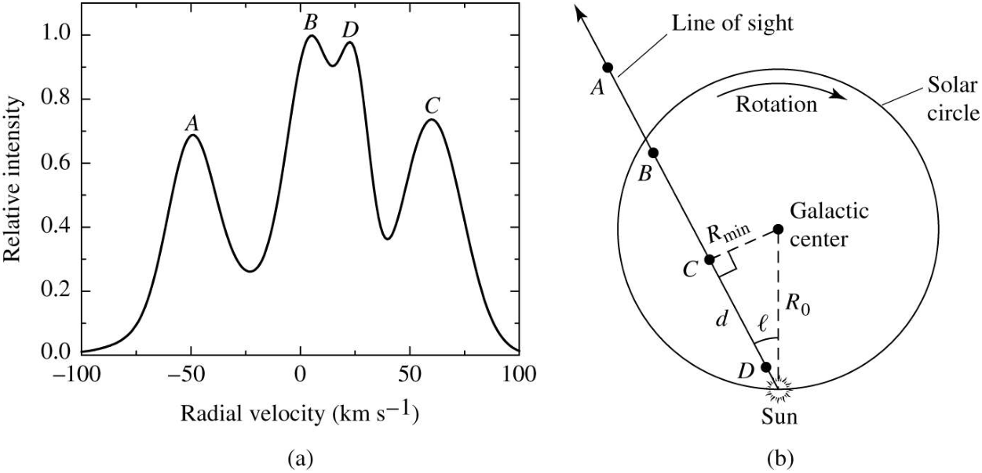
Rotation curves
Notes:
Source edition: assets/lessons/lectures/astronomy/rotation-curves.pdf, page 11. Original author and figure credits remain on the slide. Text is editable; illustrations retain their source artwork.

Slide 12
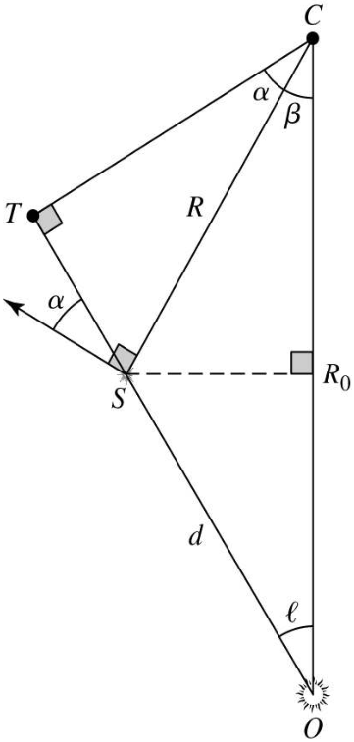
Rotation curves
Notes:
Source edition: assets/lessons/lectures/astronomy/rotation-curves.pdf, page 12. Original author and figure credits remain on the slide. Text is editable; illustrations retain their source artwork.

