Slide 1

Galaxy Interactions Dark Matter
D.J. Pisano
July 14, 2017
Notes:
Source edition: assets/lessons/lectures/astronomy/galaxy-interactions-and-dark-matter.pdf, page 1. Original author and figure credits remain on the slide. Text is editable; illustrations retain their source artwork.

Slide 2
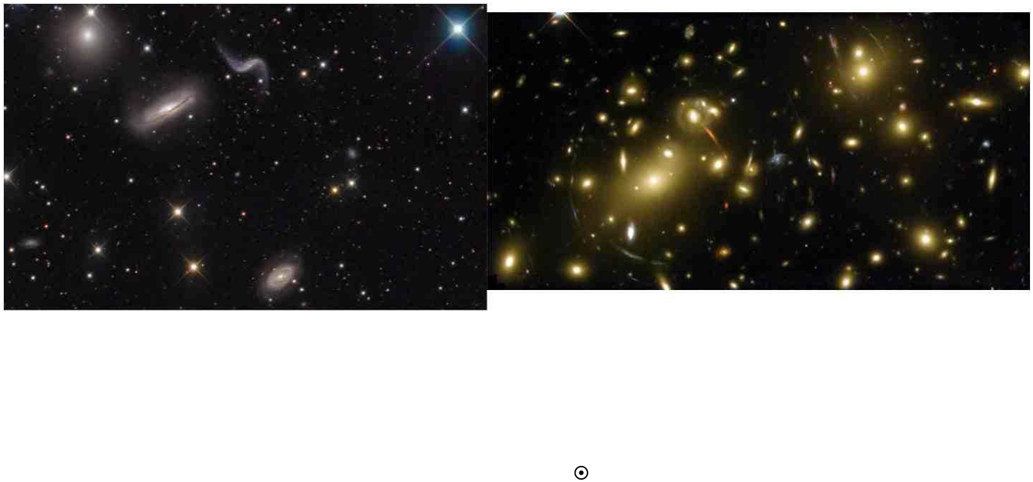
Groups and Clusters
•
Galaxies are very social and typically reside in small groups or large
clusters.
•
Galaxies may be separated by only a couple times their size.
•
Large clusters have masses ≥ 10
14
M
, large enough to bend light
(
gravitational lensing
). Groups and clusters span about 1 million
parsecs (1 Mpc).
•
The Milky Way resides in the Local Group, a collection of ~ 50
galaxies.
Notes:
Source edition: assets/lessons/lectures/astronomy/galaxy-interactions-and-dark-matter.pdf, page 2. Original author and figure credits remain on the slide. Text is editable; illustrations retain their source artwork.

Slide 3
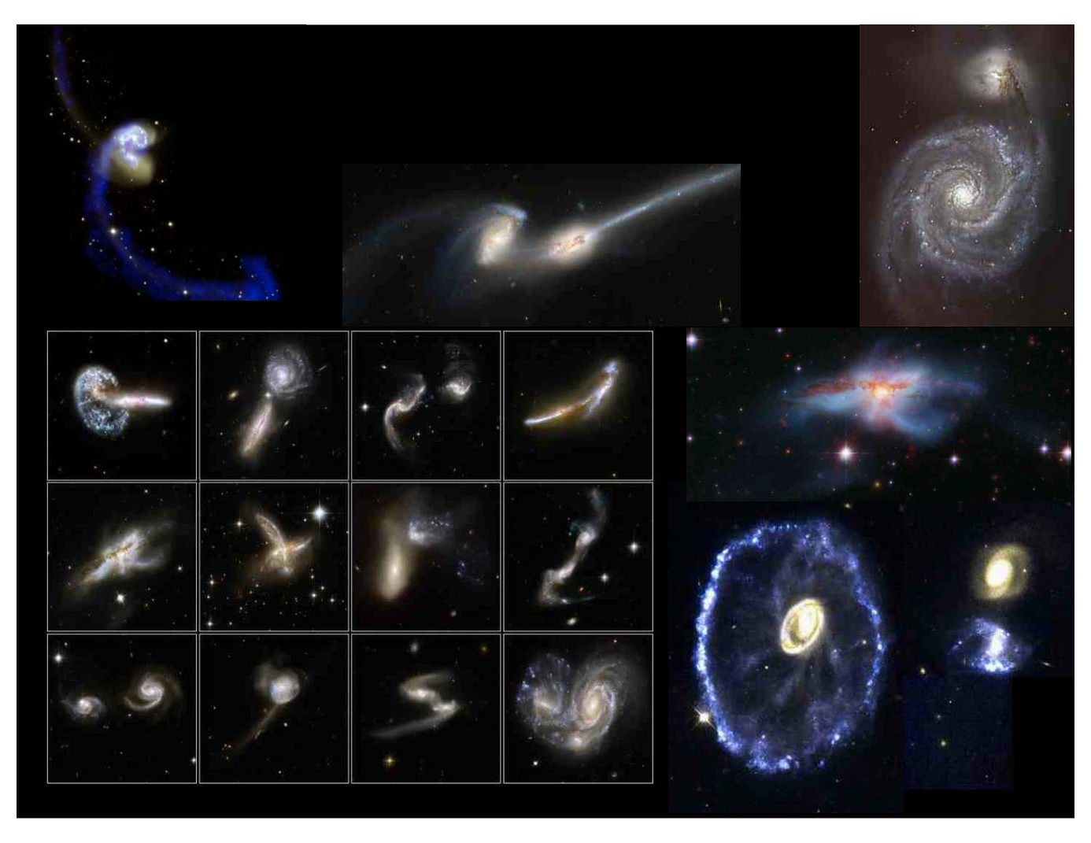
Interacting Galaxies
GalCrash
Notes:
Source edition: assets/lessons/lectures/astronomy/galaxy-interactions-and-dark-matter.pdf, page 3. Original author and figure credits remain on the slide. Text is editable; illustrations retain their source artwork.

Slide 4
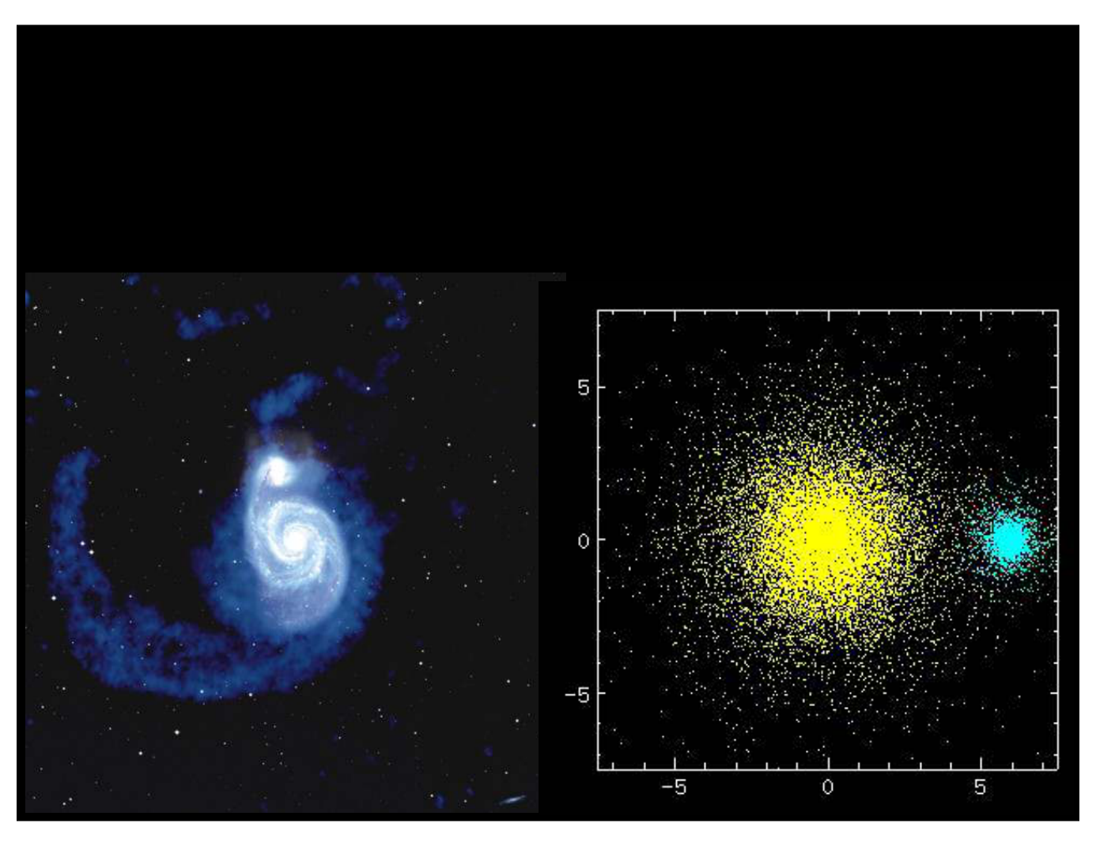
Minor Mergers: Making bigger spiral galaxies
Notes:
Source edition: assets/lessons/lectures/astronomy/galaxy-interactions-and-dark-matter.pdf, page 4. Original author and figure credits remain on the slide. Text is editable; illustrations retain their source artwork.

Slide 5
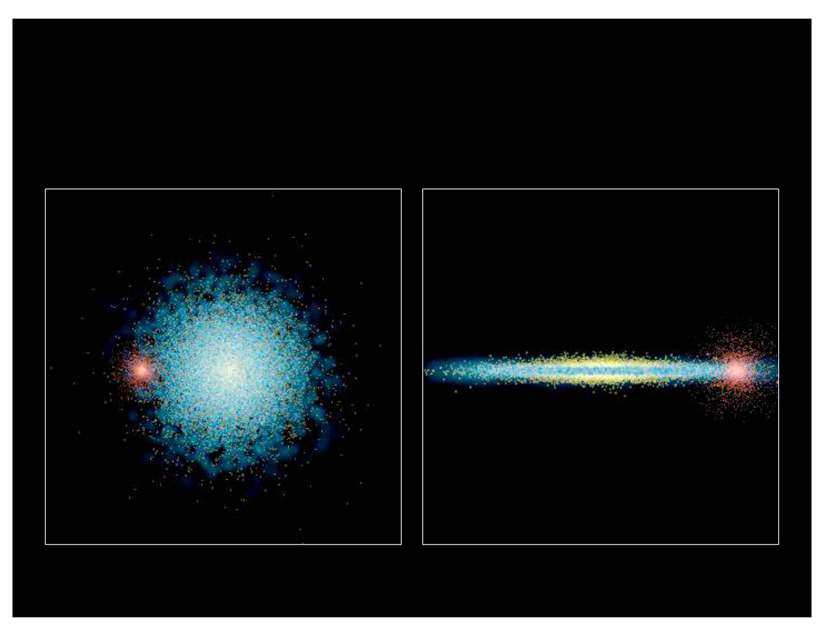
Another simulation of a minor merger:
Notes:
Source edition: assets/lessons/lectures/astronomy/galaxy-interactions-and-dark-matter.pdf, page 5. Original author and figure credits remain on the slide. Text is editable; illustrations retain their source artwork.

Slide 6
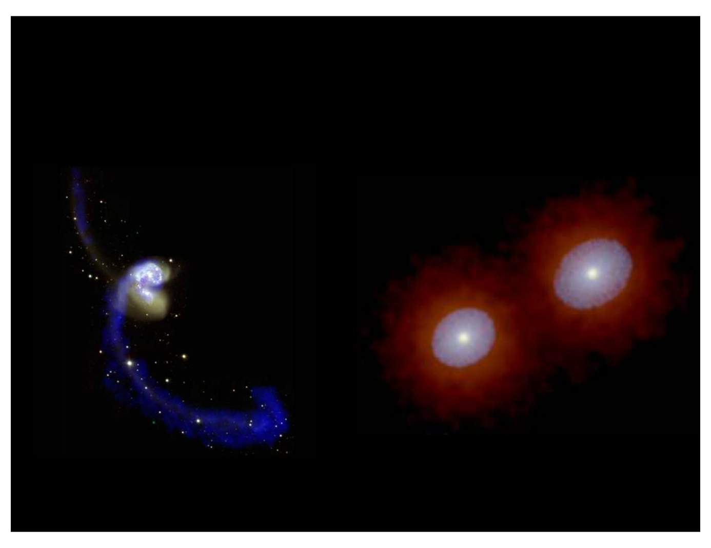
Major Mergers: Forming Elliptical Galaxies
Notes:
Source edition: assets/lessons/lectures/astronomy/galaxy-interactions-and-dark-matter.pdf, page 6. Original author and figure credits remain on the slide. Text is editable; illustrations retain their source artwork.

Slide 7
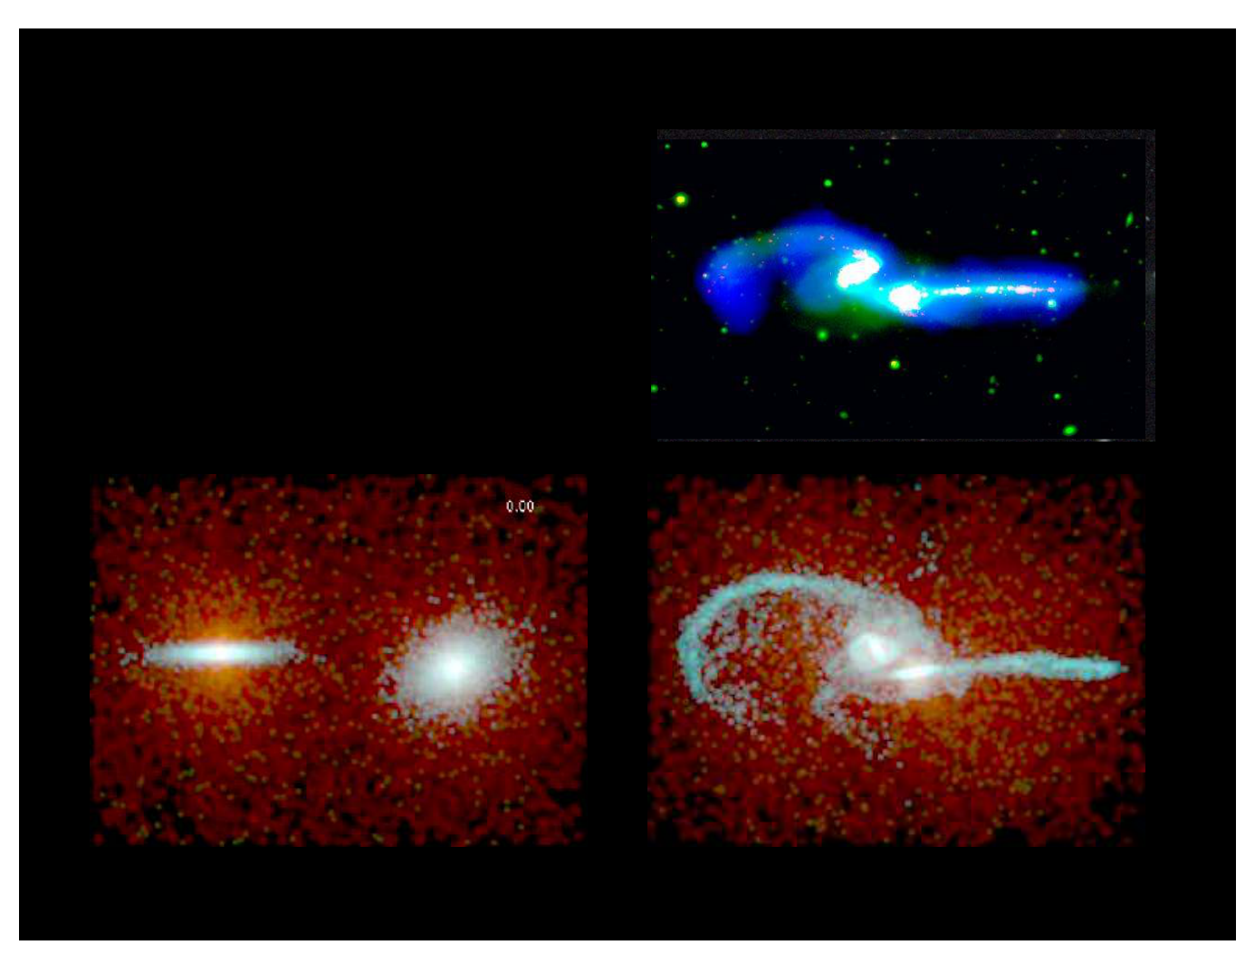
Simulating galaxy interactions
N-body simulation of NGC 4676 “The Mice”
Hibbard & Barnes, in preparation
N-body simulations
provide past/future
evolution and 3-D
geometry
Notes:
Source edition: assets/lessons/lectures/astronomy/galaxy-interactions-and-dark-matter.pdf, page 7. Original author and figure credits remain on the slide. Text is editable; illustrations retain their source artwork.

Slide 8
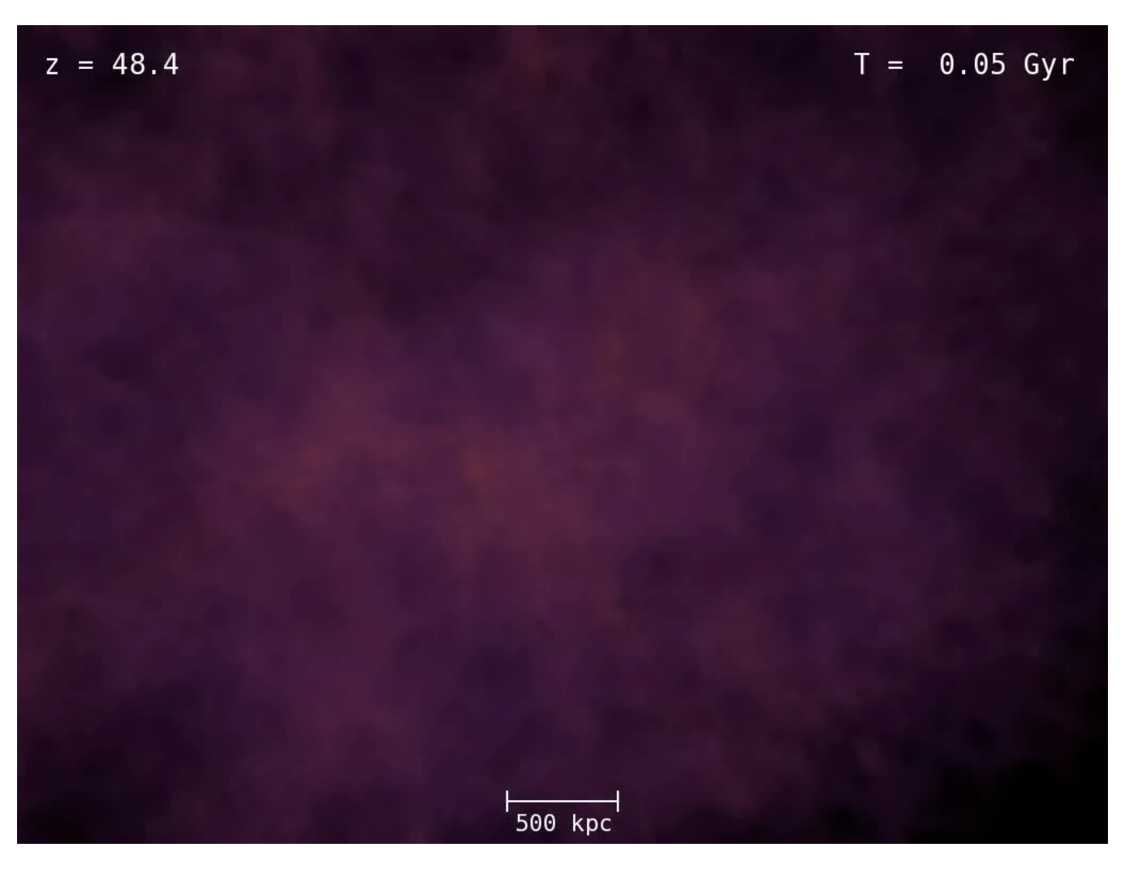
Galaxy Formation occurs via mergers (dark matter)
Notes:
Source edition: assets/lessons/lectures/astronomy/galaxy-interactions-and-dark-matter.pdf, page 8. Original author and figure credits remain on the slide. Text is editable; illustrations retain their source artwork.

Slide 9

Galaxy Formation occurs via mergers (dark matter and gas)
Notes:
Source edition: assets/lessons/lectures/astronomy/galaxy-interactions-and-dark-matter.pdf, page 9. Original author and figure credits remain on the slide. Text is editable; illustrations retain their source artwork.

Slide 10
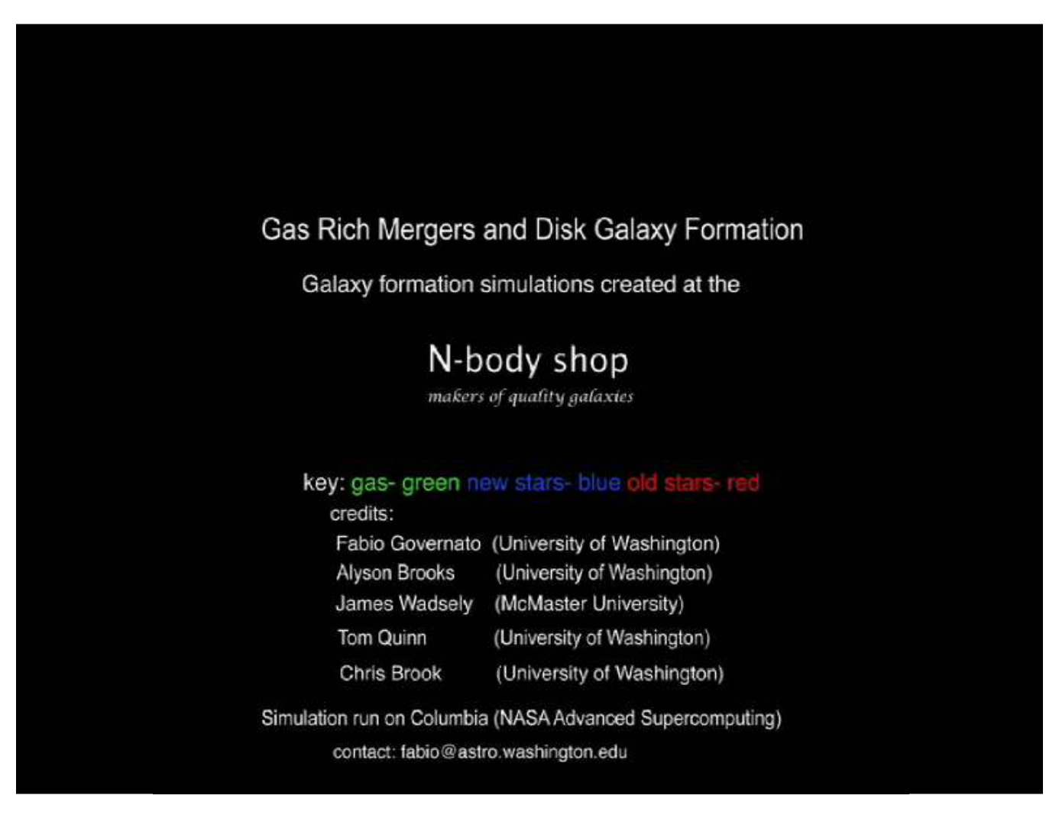
Galaxy Formation occurs via mergers (one galaxy)
Notes:
Source edition: assets/lessons/lectures/astronomy/galaxy-interactions-and-dark-matter.pdf, page 10. Original author and figure credits remain on the slide. Text is editable; illustrations retain their source artwork.

Slide 11
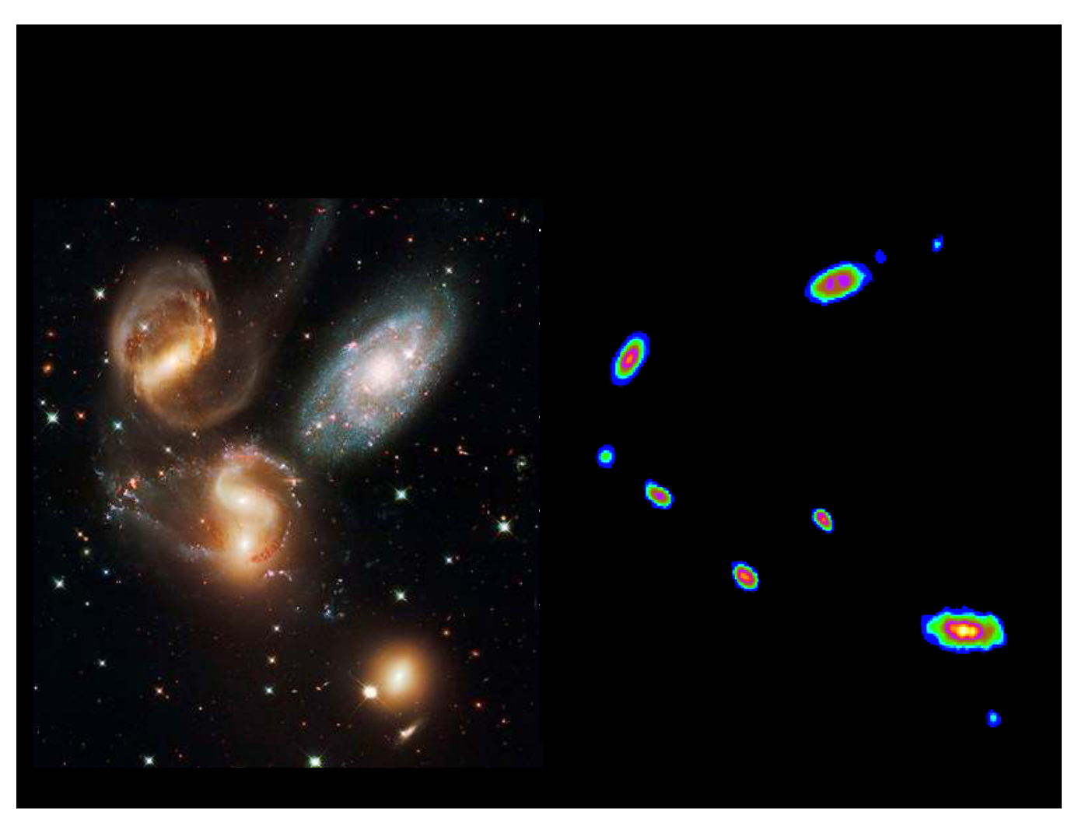
Where do interactions occur? Groups of Galaxies
Notes:
Source edition: assets/lessons/lectures/astronomy/galaxy-interactions-and-dark-matter.pdf, page 11. Original author and figure credits remain on the slide. Text is editable; illustrations retain their source artwork.

Slide 12
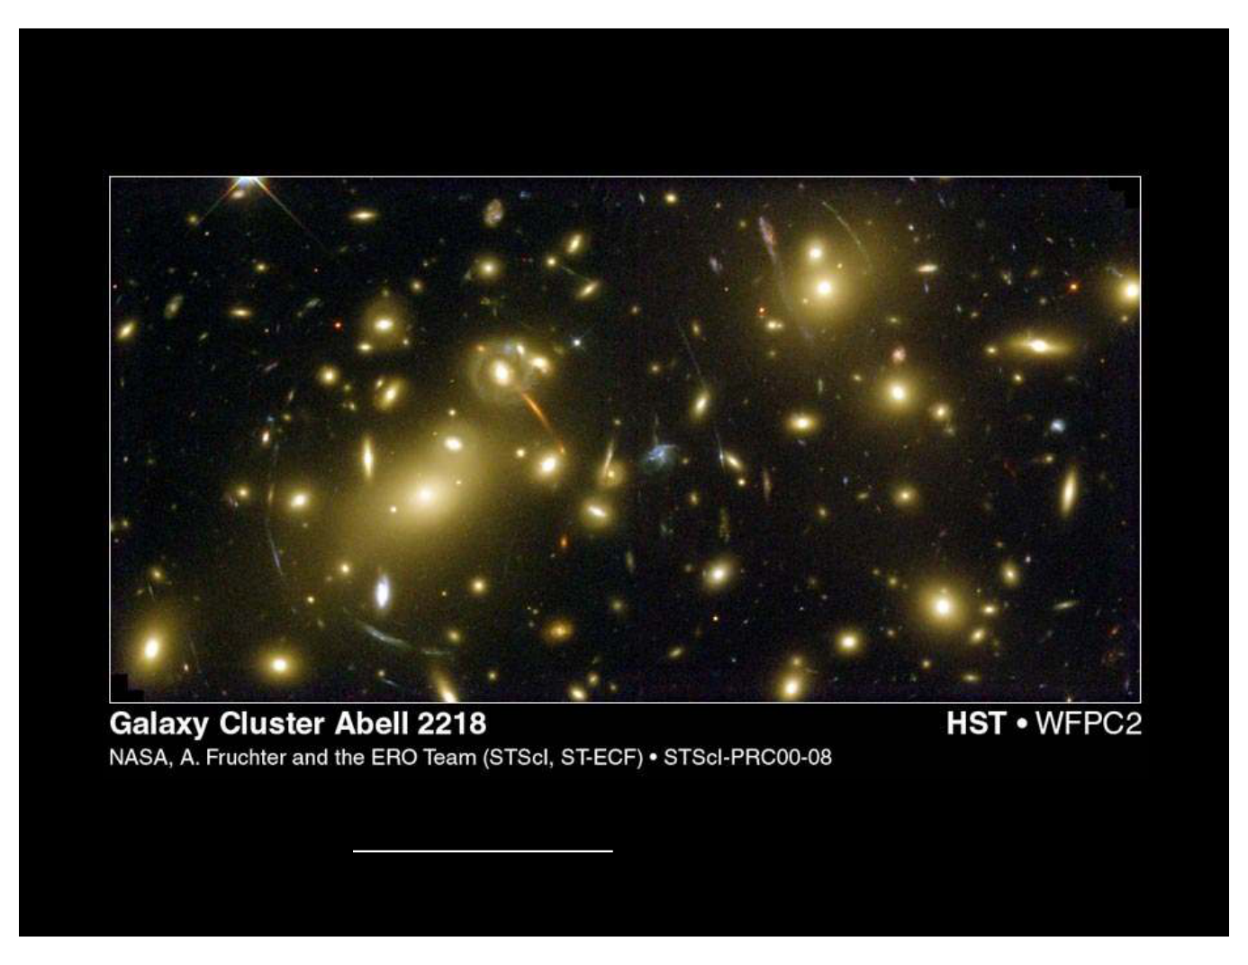
Clusters of Galaxies
See the arcs of light?
Those are gravitational lensed images of background galaxies
Their shape is due to the dark matter in the cluster.
Notes:
Source edition: assets/lessons/lectures/astronomy/galaxy-interactions-and-dark-matter.pdf, page 12. Original author and figure credits remain on the slide. Text is editable; illustrations retain their source artwork.

Slide 13
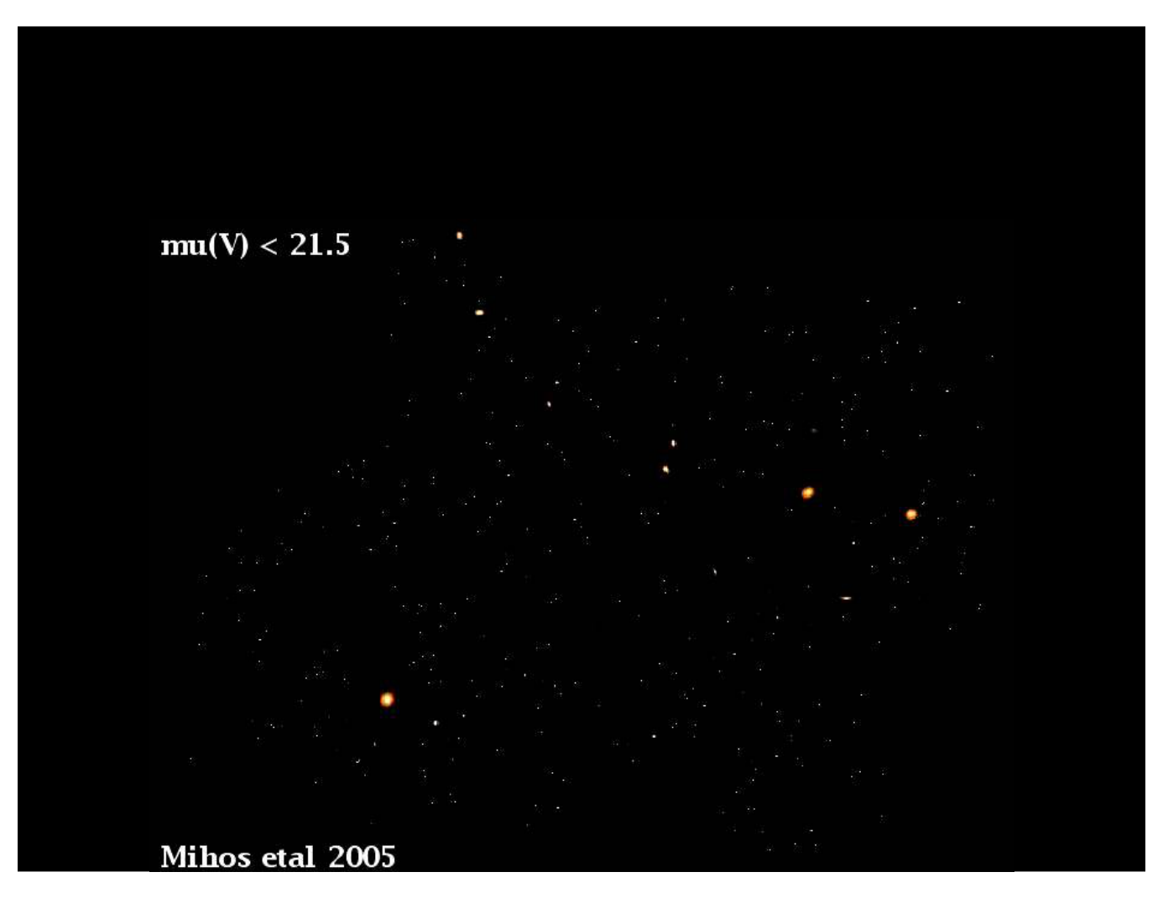
Galaxy Interactions in Clusters
Notes:
Source edition: assets/lessons/lectures/astronomy/galaxy-interactions-and-dark-matter.pdf, page 13. Original author and figure credits remain on the slide. Text is editable; illustrations retain their source artwork.

Slide 14
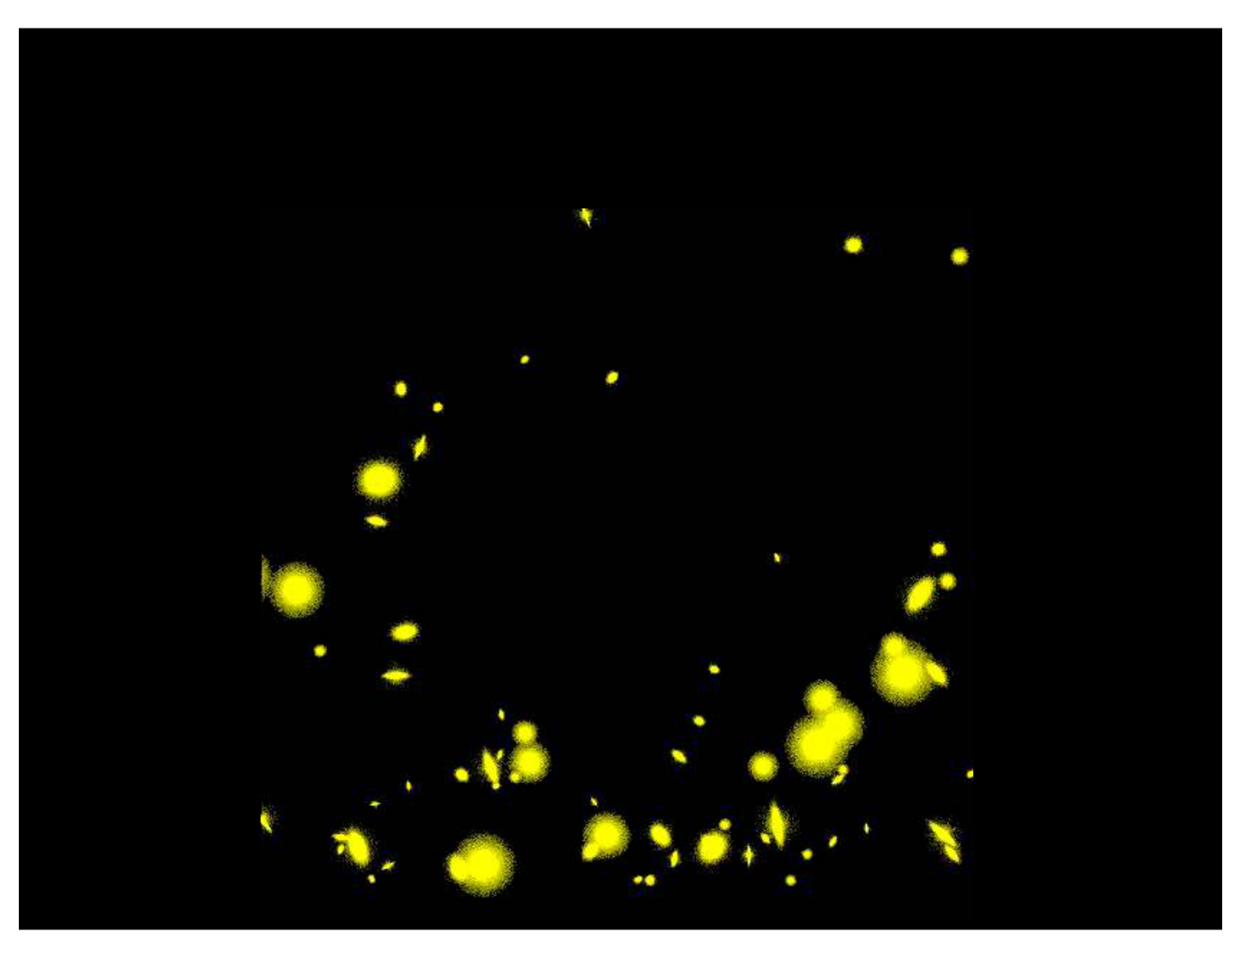
The Future: Forming Even Larger Galaxies?
Notes:
Source edition: assets/lessons/lectures/astronomy/galaxy-interactions-and-dark-matter.pdf, page 14. Original author and figure credits remain on the slide. Text is editable; illustrations retain their source artwork.

Slide 15
Starburst Galaxies
•
Galaxy interactions can compress gas
clouds in a galaxy triggering star formation
(particularly in the center of a galaxy).
•
It can also fuel a black hole in the center of
a galaxy.
•
Major mergers may also form elliptical
galaxies.
Notes:
Source edition: assets/lessons/lectures/astronomy/galaxy-interactions-and-dark-matter.pdf, page 15. Original author and figure credits remain on the slide. Text is editable; illustrations retain their source artwork.

Slide 16
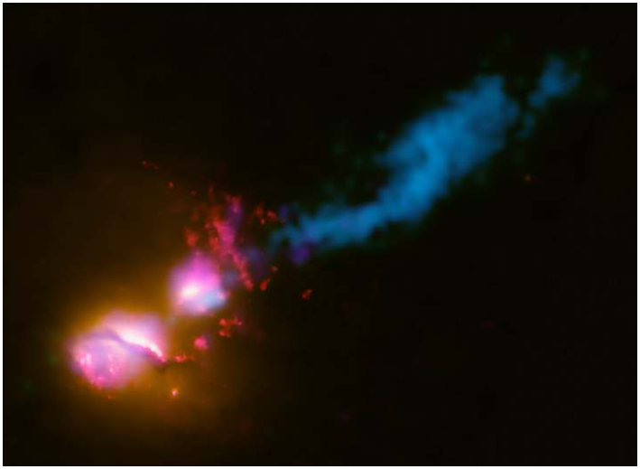
Active Galaxies
•
Often referred to as Active Galactic Nuclei
(AGN)
•
Otherwise normal galaxies with an active black
hole in their center that is producing jets (often
seen in radio light).
•
May be triggered by
interactions
•
Jets can affect the
surrounding galaxies.
Notes:
Source edition: assets/lessons/lectures/astronomy/galaxy-interactions-and-dark-matter.pdf, page 16. Original author and figure credits remain on the slide. Text is editable; illustrations retain their source artwork.

Slide 17
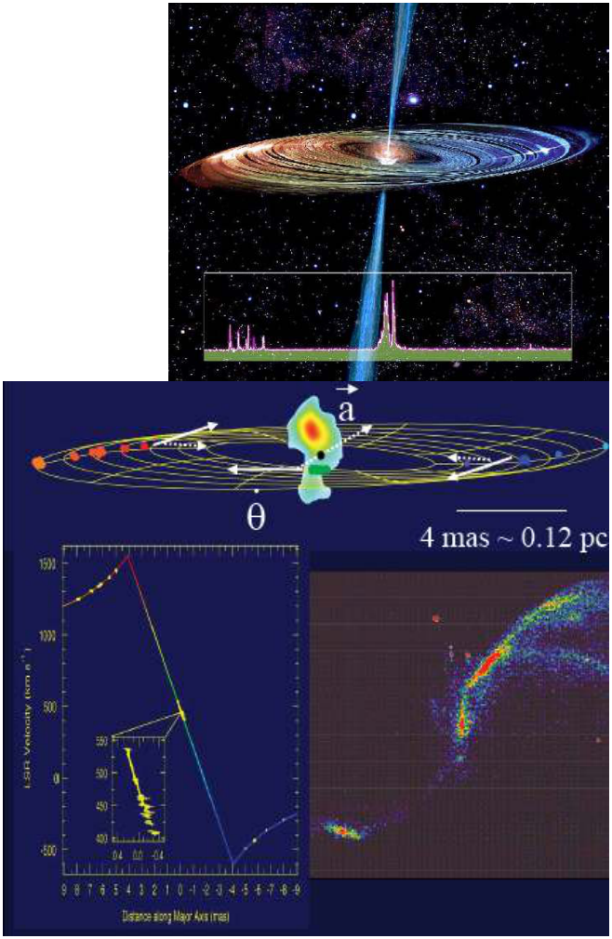
Supermassive Black Holes
•
Astronomers use widely
separated radio telescopes to
trace the motion of objects in
the center of other galaxies.
•
We can measure both the
apparent motion of these
objects and their velocities.
•
Combined, these data allow
us to measure the mass of
the black hole
•
We also see radio jet coming
from near the black hole.
•
Supermassive Black holes
are found in all galaxies
with spheroids (ellipticals
and early-type spirals)
Notes:
Source edition: assets/lessons/lectures/astronomy/galaxy-interactions-and-dark-matter.pdf, page 17. Original author and figure credits remain on the slide. Text is editable; illustrations retain their source artwork.

Slide 18
Black holes: review question
Which type of galaxy is
most
likely to contain a supermassive
black hole?
A.
Dwarf irregular
B.
Elliptical
C. Irregular
D. A spiral galaxy with a small bulge.
Notes:
Source edition: assets/lessons/lectures/astronomy/galaxy-interactions-and-dark-matter.pdf, page 18. Original author and figure credits remain on the slide. Text is editable; illustrations retain their source artwork.

Slide 19
How do we measure the mass of a galaxy?
•
We need to know the mass of a galaxy in
order to determine its nature and how it
formed.
•
Different physics are involved in forming a
single star as opposed to a cluster of stars
and in contrast to an entire galaxy.
•
There are a couple methods.
Notes:
Source edition: assets/lessons/lectures/astronomy/galaxy-interactions-and-dark-matter.pdf, page 19. Original author and figure credits remain on the slide. Text is editable; illustrations retain their source artwork.

Slide 20
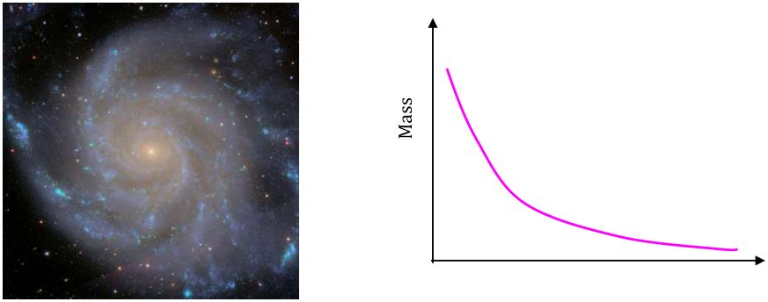
How do we measure the mass of a galaxy?
Method 1:Count all the stars and gas in a galaxy and add
up all their masses.
Pros: It is a relatively straight-forward measurement.
Getting the total gas mass is fairly easy and robust.
Cons: It is pretty hard to actually count all the individual
stars in a galaxy so you have to assume you know what
types of stars are in the galaxy.
Distance
Notes:
Source edition: assets/lessons/lectures/astronomy/galaxy-interactions-and-dark-matter.pdf, page 20. Original author and figure credits remain on the slide. Text is editable; illustrations retain their source artwork.

Slide 21
How do we measure the mass of a galaxy?
Method 2:Use the motions of objects in the
galaxy to determine the mass.
Pros: Simple measurement that gives you
all
the mass of a galaxy.
Cons: Need to have an object emitting light
in order to measure mass at that position.
Notes:
Source edition: assets/lessons/lectures/astronomy/galaxy-interactions-and-dark-matter.pdf, page 21. Original author and figure credits remain on the slide. Text is editable; illustrations retain their source artwork.

Slide 22
Mass of the Solar System
•
What is the mass of the solar system?
– about 1 solar mass
•
Where is most of the mass in the solar
system?
– in the center
•
We can use the velocity of the planets
versus their position to measure the mass
of the solar system.
Notes:
Source edition: assets/lessons/lectures/astronomy/galaxy-interactions-and-dark-matter.pdf, page 22. Original author and figure credits remain on the slide. Text is editable; illustrations retain their source artwork.

Slide 23
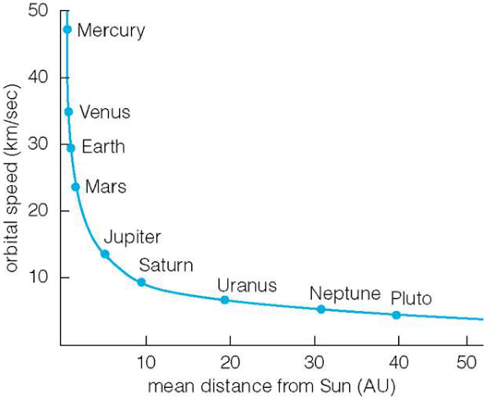
Mass of the Solar System
•
This is what the
rotation curve
of the Solar System looks like.
•
As the semi-major axis of a
planet is increased, its velocity
decreases.
•
This curve is called a
Keplerian rotation curve.
•
It implies that all the mass is
in the center of the system.
•
This is the same rotation
curve as is seen for objects
around black holes.
Notes:
Source edition: assets/lessons/lectures/astronomy/galaxy-interactions-and-dark-matter.pdf, page 23. Original author and figure credits remain on the slide. Text is editable; illustrations retain their source artwork.

Slide 24
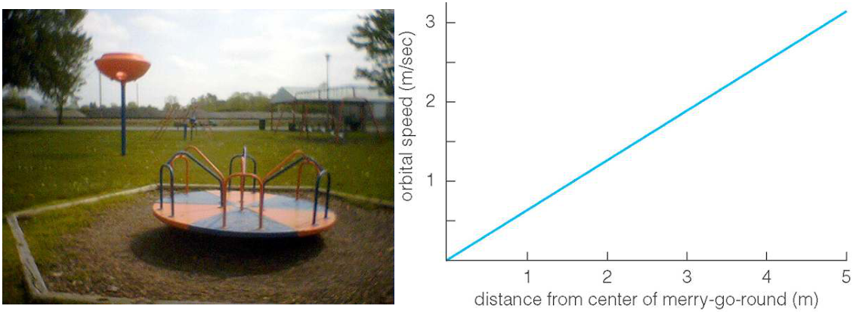
Mass of a merry-go-round
•
As you move from the center to the edge, you go faster
and faster since each part of the merry-go-round needs
to complete a circle in the same amount of time.
•
As you move to the edge, more of the mass of the
merry-go-round is between you and the center.
•
This curve implies that mass is
increasing
with radius.
Notes:
Source edition: assets/lessons/lectures/astronomy/galaxy-interactions-and-dark-matter.pdf, page 24. Original author and figure credits remain on the slide. Text is editable; illustrations retain their source artwork.

Slide 25
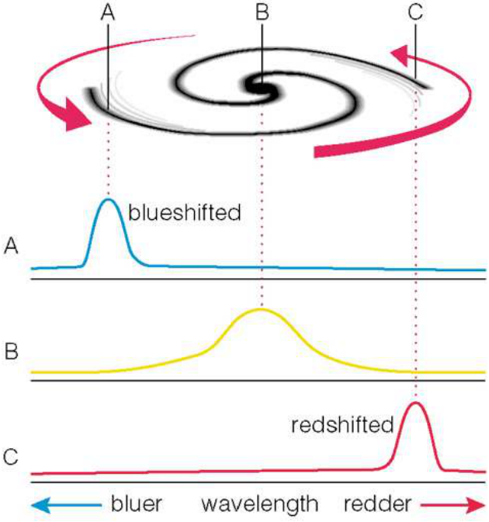
Mass of a Galaxy
•
Using the Doppler effect
we can measure the
rotation of a spiral galaxy.
•
One side is blue-shifted,
one side is red-shifted
with respect to the center.
•
The total shift
corresponds to the
rotation velocity of the
galaxy
Notes:
Source edition: assets/lessons/lectures/astronomy/galaxy-interactions-and-dark-matter.pdf, page 25. Original author and figure credits remain on the slide. Text is editable; illustrations retain their source artwork.

Slide 26
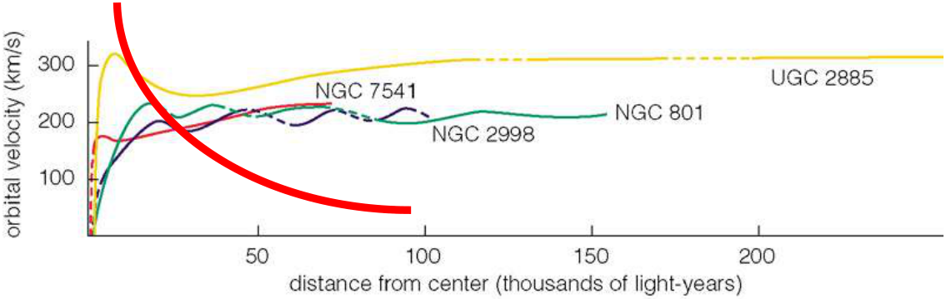
Mass of a Galaxy
•
For
all
spiral galaxies, we see a rotation curve like those above.
•
The center parts look like a merry-go-round (solid body)
•
The outer parts are flat.
•
The height and extent of the curve give you the total mass.
–
higher and longer curves = larger total mass
•
No
galaxy has a
declining, Keplerian
rotation curve.
•
This implies that the mass of a galaxy continues to increase
with radius.
Notes:
Source edition: assets/lessons/lectures/astronomy/galaxy-interactions-and-dark-matter.pdf, page 26. Original author and figure credits remain on the slide. Text is editable; illustrations retain their source artwork.

Slide 27
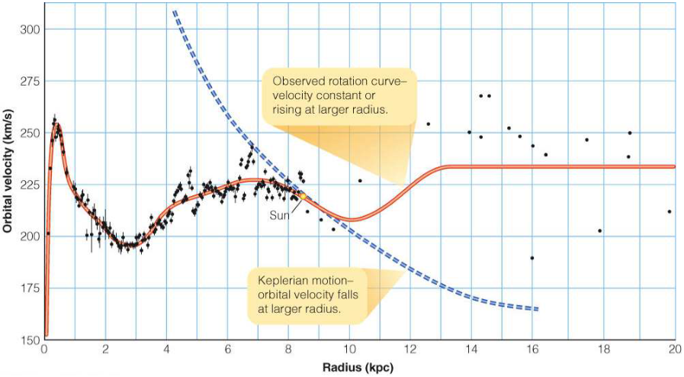
Mass of the Milky Way
•
Same rotation curve seen for the Milky Way.
•
The mass continue to increase beyond the edge of the
disk of stars and gas out to the very edge of the halo.
•
What is this missing mass???
Notes:
Source edition: assets/lessons/lectures/astronomy/galaxy-interactions-and-dark-matter.pdf, page 27. Original author and figure credits remain on the slide. Text is editable; illustrations retain their source artwork.

Slide 28
Masses of other galaxies
•
While not all galaxies rotate, the motions
of their stars and gas
all
indicate some
missing mass.
•
The motions of galaxies in pairs, in
groups, and in clusters also provide
evidence for missing mass.
•
As does gravitational lensing by clusters.
Notes:
Source edition: assets/lessons/lectures/astronomy/galaxy-interactions-and-dark-matter.pdf, page 28. Original author and figure credits remain on the slide. Text is editable; illustrations retain their source artwork.

Slide 29
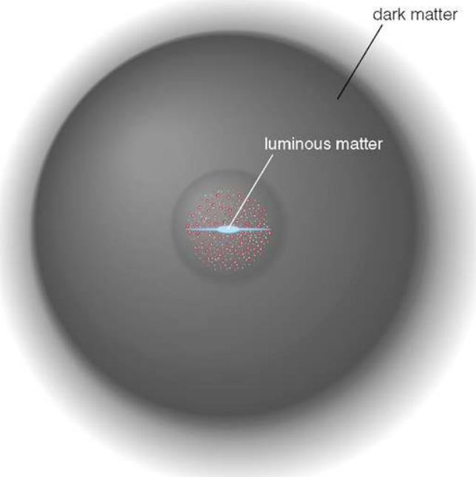
Mass in stars versus Total Mass
•
Most of the missing
mass is in the
outskirts of
galaxies.
•
Can only account
for about 10% of
the total mass of
galaxies in stars
and gas.
Notes:
Source edition: assets/lessons/lectures/astronomy/galaxy-interactions-and-dark-matter.pdf, page 29. Original author and figure credits remain on the slide. Text is editable; illustrations retain their source artwork.

Slide 30
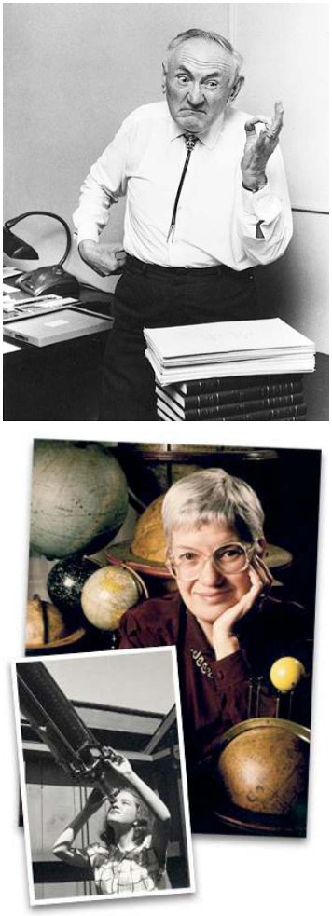
Dark Matter
•
This missing mass is called
dark
matter
. It is matter that does not emit
light, or at least can’t be seen.
•
You are a form of dark matter.
•
It is
not
the same as a dark nebula or
black holes.
•
First suggested to exist by Fritz
Zwicky in the 1930s!
•
Observational evidence first provided
in the 1970s by Vera Rubin.
•
We still don’t know what it is only that
it is seen almost everywhere.
Notes:
Source edition: assets/lessons/lectures/astronomy/galaxy-interactions-and-dark-matter.pdf, page 30. Original author and figure credits remain on the slide. Text is editable; illustrations retain their source artwork.

Slide 31
Dark matter: review question
Which of the following does not provide
evidence for the existence of dark
matter?
A.
Rotation Curves of galaxies
B.
The orbits of the planets
C. Gravitational lenses
D. Motions of galaxies in groups
E.
They all provide evidence
Notes:
Source edition: assets/lessons/lectures/astronomy/galaxy-interactions-and-dark-matter.pdf, page 31. Original author and figure credits remain on the slide. Text is editable; illustrations retain their source artwork.

Slide 32
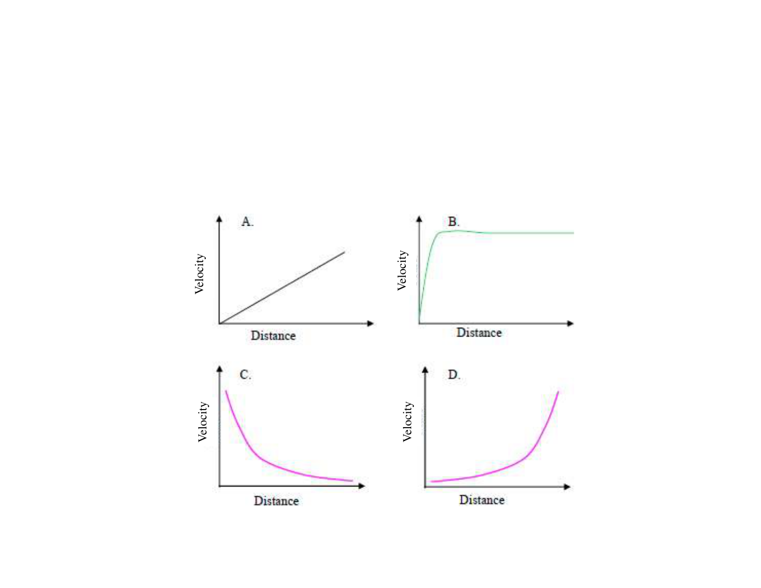
Which of the following could be a rotation curve for the solar system?
Notes:
Source edition: assets/lessons/lectures/astronomy/galaxy-interactions-and-dark-matter.pdf, page 32. Original author and figure credits remain on the slide. Text is editable; illustrations retain their source artwork.

Slide 33
Rotation curves: review question
Which of the following could be a
rotation curve for stars around a
supermassive black hole?
Notes:
Source edition: assets/lessons/lectures/astronomy/galaxy-interactions-and-dark-matter.pdf, page 33. Original author and figure credits remain on the slide. Text is editable; illustrations retain their source artwork.

Slide 34
Which of the following rotation curves would be for a galaxy?
Notes:
Source edition: assets/lessons/lectures/astronomy/galaxy-interactions-and-dark-matter.pdf, page 34. Original author and figure credits remain on the slide. Text is editable; illustrations retain their source artwork.

