Slide 1

Discovery of the Milky Way
D.J. Pisano
July 12, 2017
Notes:
Source edition: assets/lessons/lectures/astronomy/discovery-of-the-milky-way.pdf, page 1. Original author and figure credits remain on the slide. Text is editable; illustrations retain their source artwork.

Slide 2

Discovery of the milky way
On to galaxies...
Monty Python’s “Galaxy Song”
Notes:
Source edition: assets/lessons/lectures/astronomy/discovery-of-the-milky-way.pdf, page 2. Original author and figure credits remain on the slide. Text is editable; illustrations retain their source artwork.

Slide 3
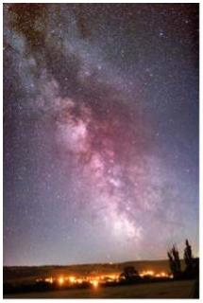
Discovery of the Milky Way
Before the 20
th
century, we
thought that the Milky Way
was the entire Universe.
How did we figure out that it
wasn’t?
Statistics!
Notes:
Source edition: assets/lessons/lectures/astronomy/discovery-of-the-milky-way.pdf, page 3. Original author and figure credits remain on the slide. Text is editable; illustrations retain their source artwork.

Slide 4
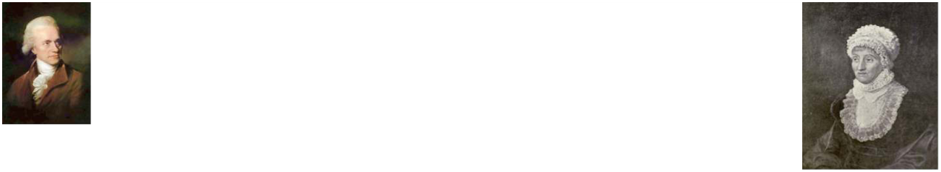
William and Caroline Herschel
•
Brother and sister German/English astronomers in the
1700 and 1800s.
•
William was also a musician, and discovered Uranus
as well as moons in the solar system.
•
Caroline worked with him and discovered many
comets.
•
They cataloged many nebulae in the night sky. A
version of their catalog (from William’s son) is still
used today.
•
They made the first attempt to determine the size and
shape of the Milky Way by counting stars in 1785.
•
How did this work?
Notes:
Source edition: assets/lessons/lectures/astronomy/discovery-of-the-milky-way.pdf, page 4. Original author and figure credits remain on the slide. Text is editable; illustrations retain their source artwork.

Slide 5
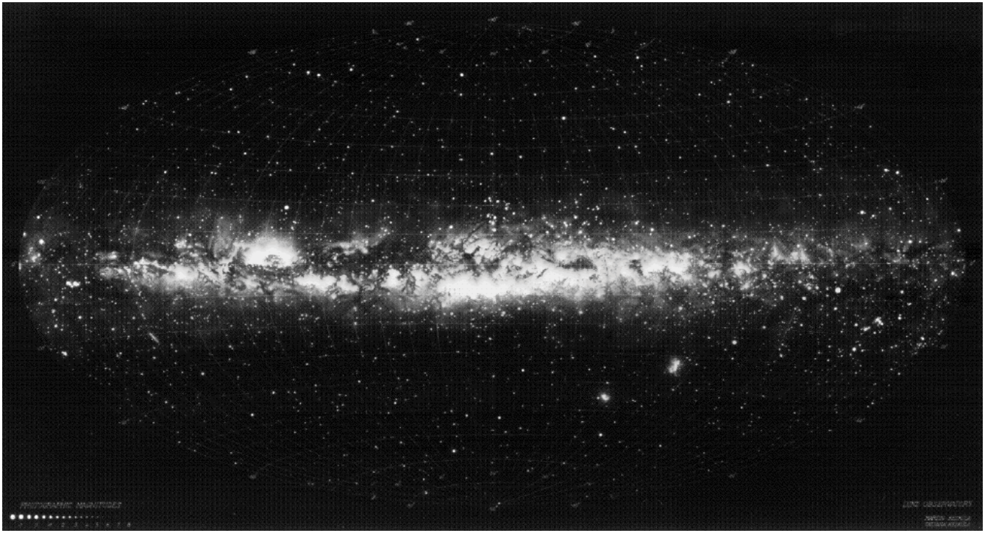
An all-sky view of the Milky Way
Notes:
Source edition: assets/lessons/lectures/astronomy/discovery-of-the-milky-way.pdf, page 5. Original author and figure credits remain on the slide. Text is editable; illustrations retain their source artwork.

Slide 6
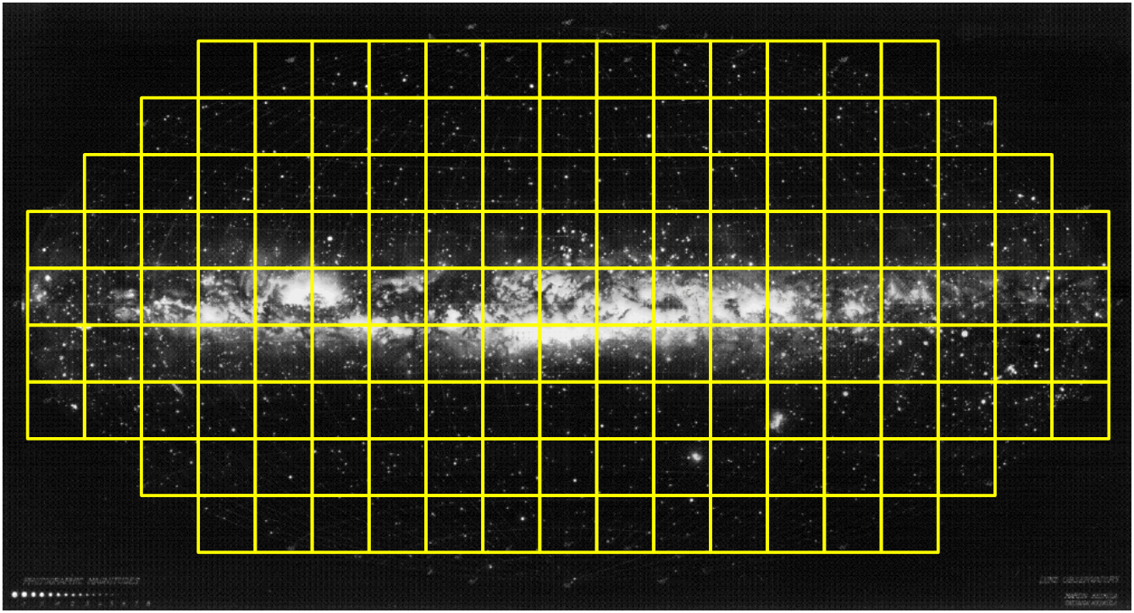
Count the stars in different directions.
Brighter = More stars = Larger distance to edge of Galaxy
Notes:
Source edition: assets/lessons/lectures/astronomy/discovery-of-the-milky-way.pdf, page 6. Original author and figure credits remain on the slide. Text is editable; illustrations retain their source artwork.

Slide 7
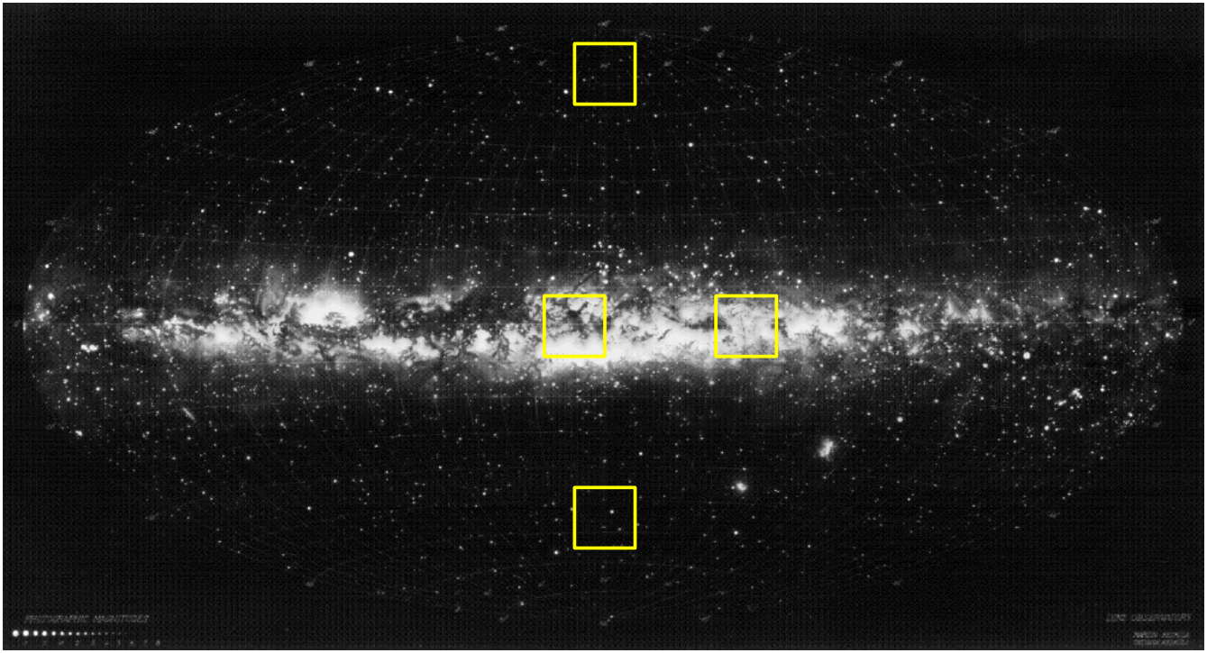
Which direction has more stars?
A
C
B
D
Notes:
Source edition: assets/lessons/lectures/astronomy/discovery-of-the-milky-way.pdf, page 7. Original author and figure credits remain on the slide. Text is editable; illustrations retain their source artwork.

Slide 8
Star counts
•
How can you tell if two regions have
significantly
different numbers of stars?
•
Need to understand statistics.
•
Let’s do an experiment: coin flipping.
Notes:
Source edition: assets/lessons/lectures/astronomy/discovery-of-the-milky-way.pdf, page 8. Original author and figure credits remain on the slide. Text is editable; illustrations retain their source artwork.

Slide 9
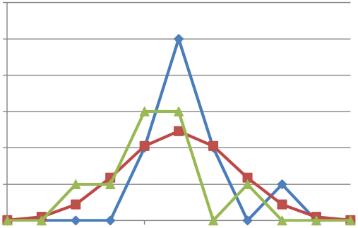
Coin Flip results
•
The results of your coin flips are shown below (green)
along with a simulation (blue) and the prediction (red).
•
Pretty good agreement?
6
5
4
3
2
1
0
0
2
4
6
8
10
•
A total of XX heads were flipped during 100 coin flips
(XX%). Were the coins fair?
Notes:
Source edition: assets/lessons/lectures/astronomy/discovery-of-the-milky-way.pdf, page 9. Original author and figure credits remain on the slide. Text is editable; illustrations retain their source artwork.

Slide 10
How can you tell if two regions have significantly different numbers of stars?
• Consider boxes A, B, C, and D.
• Let’s assume that A has 9 stars in it, B has 55
stars, C has 49 stars, and D has 12.
• B and C are consistent with each having the
same number of stars, while A and D are
significantly
less (deviate by more than √N).
Therefore, the galaxy is larger in the direction
of B and C than it is toward A or D.
This same principle is how polls and surveys
determine margin of error.
Notes:
Source edition: assets/lessons/lectures/astronomy/discovery-of-the-milky-way.pdf, page 10. Original author and figure credits remain on the slide. Text is editable; illustrations retain their source artwork.

Slide 11
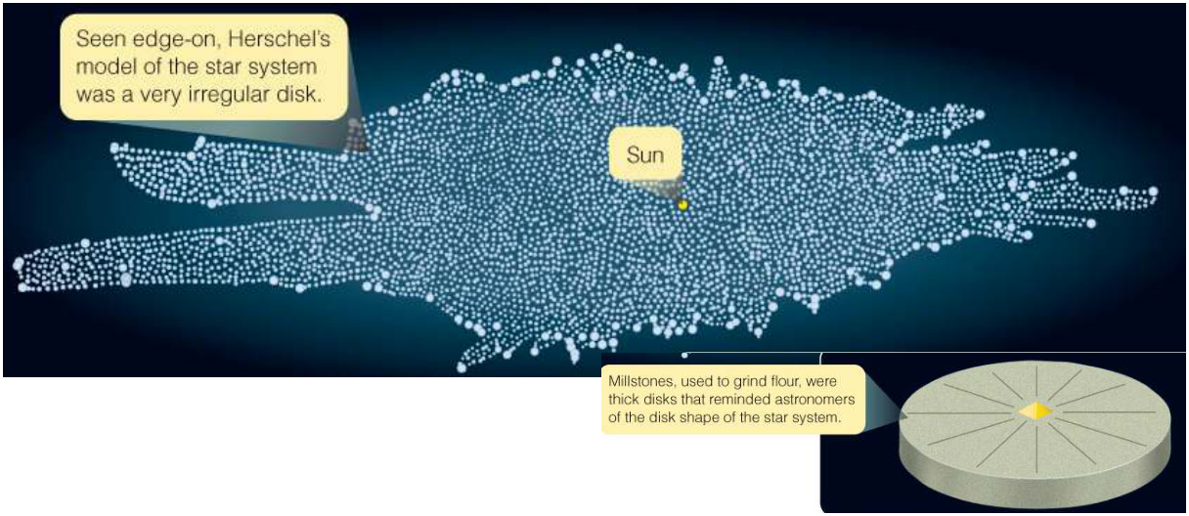
The Herschels’ results
•
They found that the Milky Way
was shaped something like a grindstone
(or frisbee) 15,000 light-years across with the Sun in the
center.
•
Irregular edge due to lack of observed stars in certain
directions.
•
Problem: Stars cluster in space and dust absorbs light
from distant stars.
Notes:
Source edition: assets/lessons/lectures/astronomy/discovery-of-the-milky-way.pdf, page 11. Original author and figure credits remain on the slide. Text is editable; illustrations retain their source artwork.

Slide 12
Size of the Milky Way
•
A better way to determine the size of the
Milky Way and the location of our Sun in it
is by measuring distances to objects in the
Galaxy.
•
Parallax only works for relatively close
objects (within 100s of parsecs).
•
Need to observe bright objects that can be
seen across the entire Milky Way.
Notes:
Source edition: assets/lessons/lectures/astronomy/discovery-of-the-milky-way.pdf, page 12. Original author and figure credits remain on the slide. Text is editable; illustrations retain their source artwork.

Slide 13
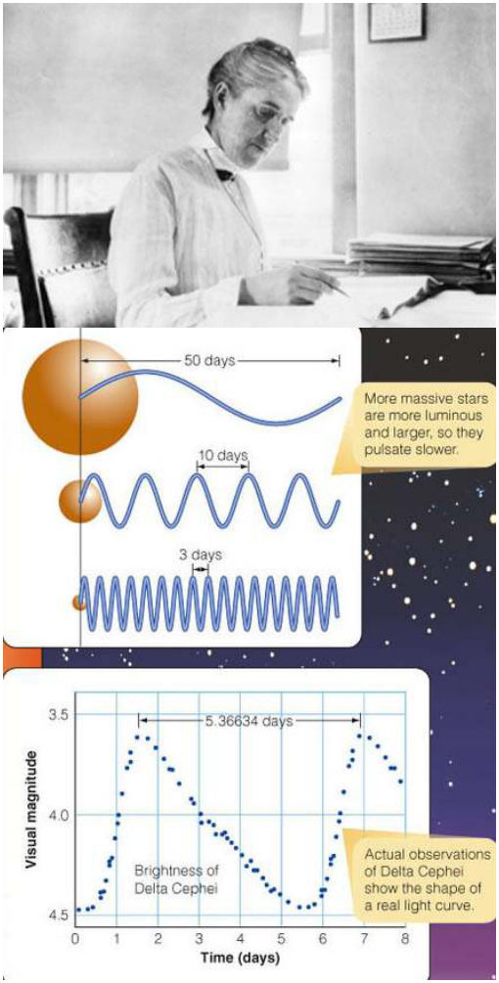
Cepheids
•
Henrietta Leavitt (1868-1921)
discovered a relation between the
period
and
luminosity
(or
absolute magnitude
) of Cepheid
stars.
•
Cepheids are stars that vary in
luminosity (by growing and
shrinking) over periods of days to
months.
•
The
longer
the period the
brighter
the star.
Notes:
Source edition: assets/lessons/lectures/astronomy/discovery-of-the-milky-way.pdf, page 13. Original author and figure credits remain on the slide. Text is editable; illustrations retain their source artwork.

Slide 14
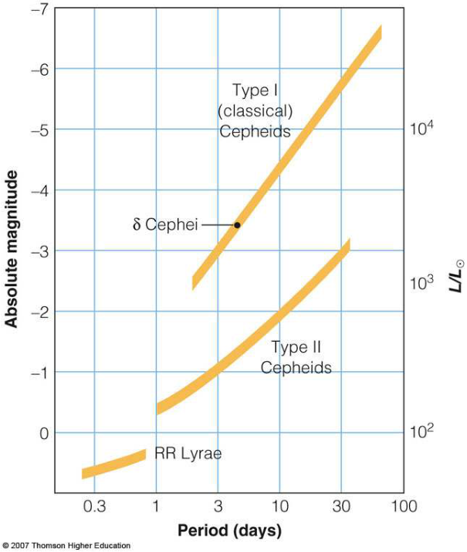
Distances from the Period-Luminosity Relation
•
Measure the period of a
Cepheid
•
This gives you the absolute
magnitude of the star.
•
Measure the apparent
magnitude of the star
•
You can use these two
magnitudes to calculate the
distance to the Cepheid.
•
You can do this with other
types of variable stars too.
Notes:
Source edition: assets/lessons/lectures/astronomy/discovery-of-the-milky-way.pdf, page 14. Original author and figure credits remain on the slide. Text is editable; illustrations retain their source artwork.

Slide 15

Harlow Shapley (1885-1972)
•
Calibrated Leavitt’s period-luminosity
relation by measuring distances to nearby
Cepheids.
•
Used this relation to measure distances to
globular clusters.
•
Found that globular clusters are not
centered on the Sun.
Therefore, the Sun
is not at the center of the Milky way!
Notes:
Source edition: assets/lessons/lectures/astronomy/discovery-of-the-milky-way.pdf, page 15. Original author and figure credits remain on the slide. Text is editable; illustrations retain their source artwork.

Slide 16
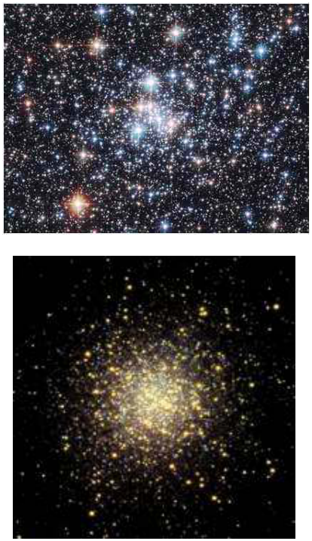
Using star clusters to measure the size of the Milky Way
•
Open Clusters
–
young clusters of recently formed
stars located in the disk of the
Milky Way (with lots of dust).
•
Globular Clusters
–
old (about 10 billion years)
centrally-concentrated clusters of
stars located in the halo of the
Milky Way (away from obscuring
dust).
Notes:
Source edition: assets/lessons/lectures/astronomy/discovery-of-the-milky-way.pdf, page 16. Original author and figure credits remain on the slide. Text is editable; illustrations retain their source artwork.

Slide 17
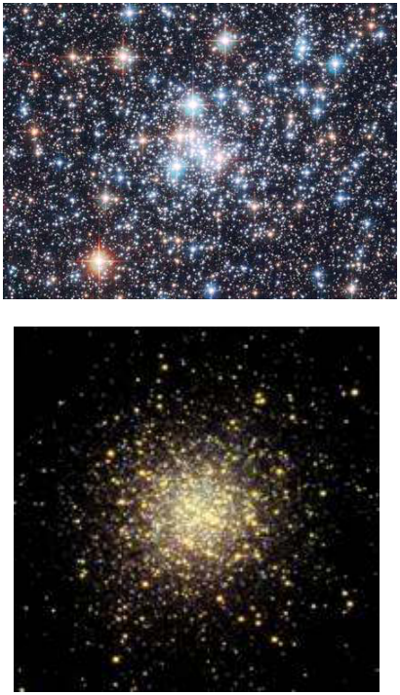
Using star clusters to measure the size of the Milky Way
You will be repeating the work
of Shapley by locating the
center of the Milky Way using
open and globular clusters.
Notes:
Source edition: assets/lessons/lectures/astronomy/discovery-of-the-milky-way.pdf, page 17. Original author and figure credits remain on the slide. Text is editable; illustrations retain their source artwork.

Slide 18
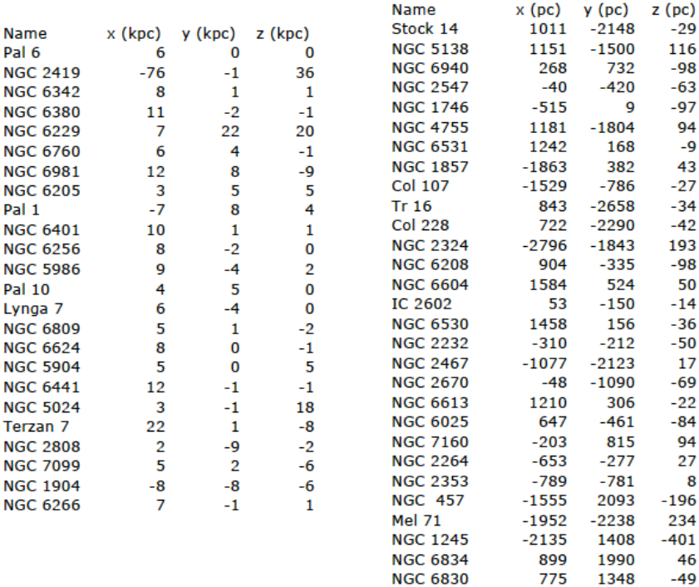
Star clusters
Globular Clusters
Open Clusters
Plot x vs. y and x vs. z for both populations
Notes:
Source edition: assets/lessons/lectures/astronomy/discovery-of-the-milky-way.pdf, page 18. Original author and figure credits remain on the slide. Text is editable; illustrations retain their source artwork.

Slide 19
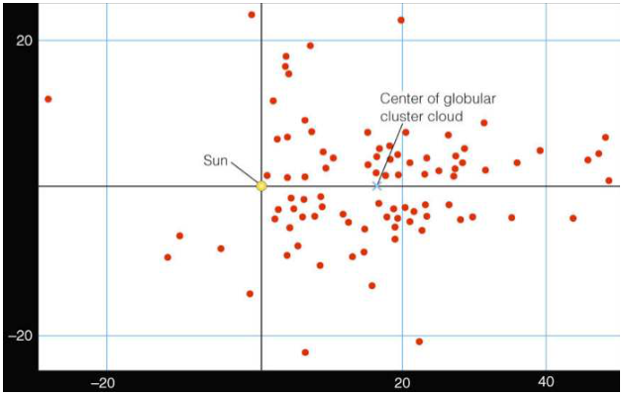
Shapley’s results
•
Shapley found that
Y
globular clusters were
clumped around a point
about 20,000 parsecs
from Sun.
•
Shapley’s result showed
X
that the Milky Way was much, much bigger than
previously thought!
•
This value turns out to be about twice as far as the
currently accepted value of the distance from the Sun to
the Galactic Center (8500 parsecs).
Notes:
Source edition: assets/lessons/lectures/astronomy/discovery-of-the-milky-way.pdf, page 19. Original author and figure credits remain on the slide. Text is editable; illustrations retain their source artwork.

Slide 20
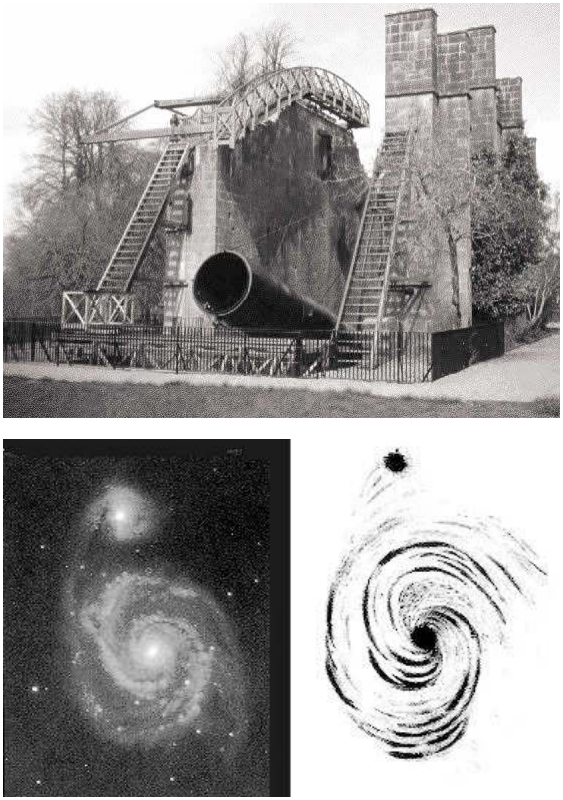
Discovery of Spiral Nebulae
•
In 1845, Lord Rosse used
his 72-inch telescope to
discover the first nebula
with spiral structure.
•
Were these “spiral
nebulae” distant versions
of our galaxy?
•
This was a matter of
debate for almost 80 years.
Notes:
Source edition: assets/lessons/lectures/astronomy/discovery-of-the-milky-way.pdf, page 20. Original author and figure credits remain on the slide. Text is editable; illustrations retain their source artwork.

Slide 21
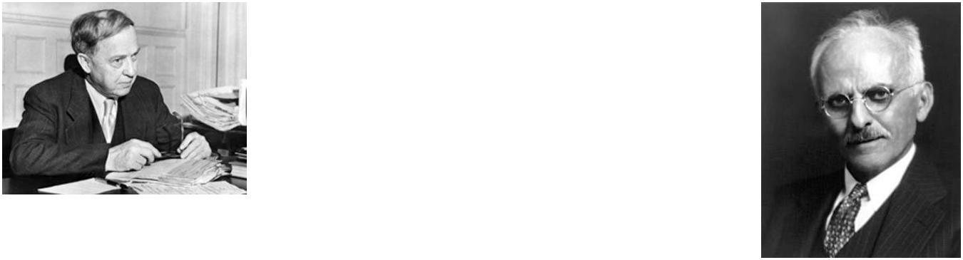
The Great Debate (1921)
•
Shapley versus Heber Curtis
•
Shapley argued that the Milky Way was the
entire universe, but that the Sun was not in the
center.
•
Curtis said the Sun was at the center of the
Milky Way, but that our galaxy was one of many.
•
They were both partially correct.
Notes:
Source edition: assets/lessons/lectures/astronomy/discovery-of-the-milky-way.pdf, page 21. Original author and figure credits remain on the slide. Text is editable; illustrations retain their source artwork.

Slide 22
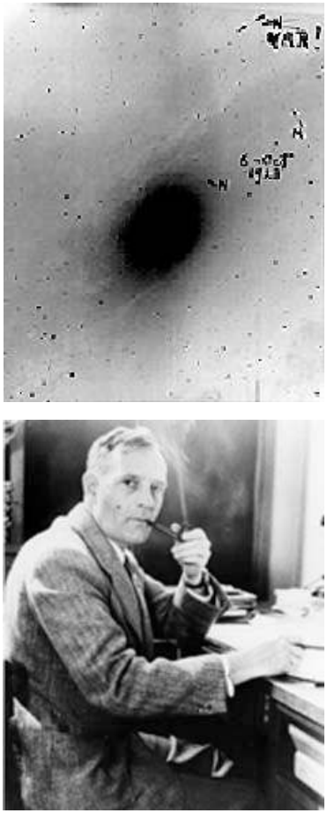
Edwin Hubble
•
In 1923, Hubble found a Cepheid
variable in Andromeda using the
largest telescope of the day, the
100-inch reflector on Mt. Wilson
near Los Angeles.
•
The distance he measured proved
that Andromeda was clearly beyond
the Milky Way.
•
Current distance to Andromeda is
780 kiloparsecs.
Notes:
Source edition: assets/lessons/lectures/astronomy/discovery-of-the-milky-way.pdf, page 22. Original author and figure credits remain on the slide. Text is editable; illustrations retain their source artwork.

Slide 23
Discovery of the milky way
The structure of the Milky Way
Notes:
Source edition: assets/lessons/lectures/astronomy/discovery-of-the-milky-way.pdf, page 23. Original author and figure credits remain on the slide. Text is editable; illustrations retain their source artwork.

Slide 24
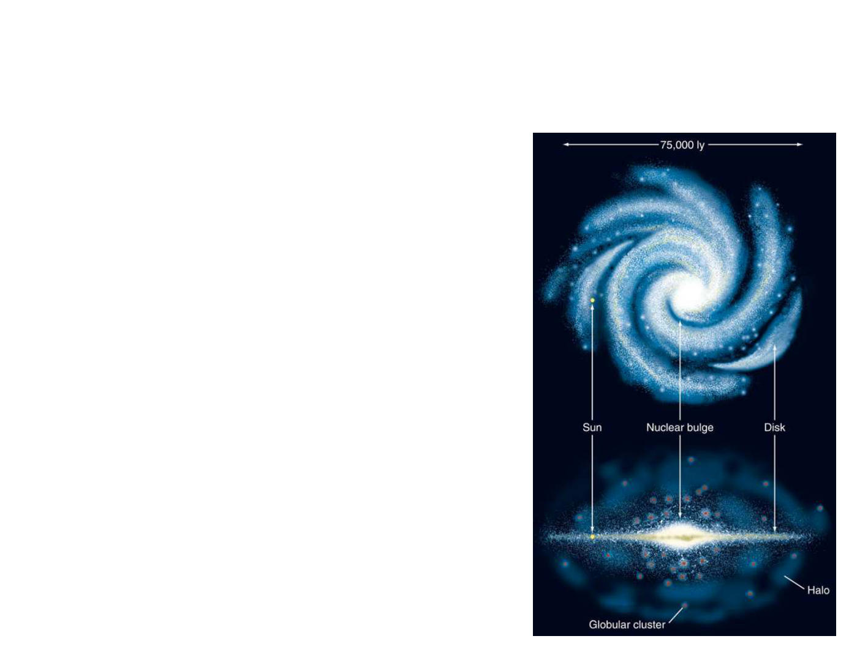
The structure of Milky Way
•
The
disk
contains stars, open
clusters, and lots of gas and
dust
.
It is characterized by its spiral arms
and lots of star formation.
•
The disk is about 30 kiloparsecs
(kpc) across and less than 1 kpc
thick near the Sun.
•
The Sun is in the disk, 8.5
kiloparsecs from the Galactic
Center.
Notes:
Source edition: assets/lessons/lectures/astronomy/discovery-of-the-milky-way.pdf, page 24. Original author and figure credits remain on the slide. Text is editable; illustrations retain their source artwork.

Slide 25
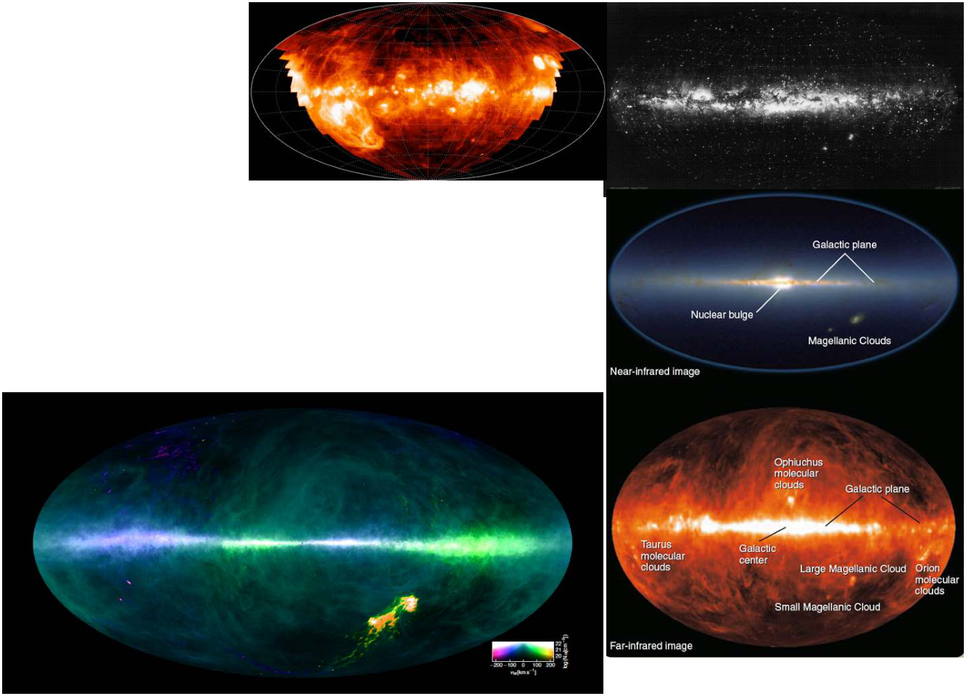
The Milky Way disk
The disk is visible in (clockwise
from above) forming stars,
young stars, old stars, dust and
molecular gas, and cool gas.
Notes:
Source edition: assets/lessons/lectures/astronomy/discovery-of-the-milky-way.pdf, page 25. Original author and figure credits remain on the slide. Text is editable; illustrations retain their source artwork.

Slide 26
The structure of Milky Way
•
The
halo
is spherical. It contains
globular clusters, hot gas, very few
stars, very little cool gas, and lots of
dark matter
. The halo only has 2%
of the stars as the disk and bulge.
•
The halo extends beyond the disk
out to, perhaps, 100 or more kpc.
•
There is little star formation in the
halo.
Notes:
Source edition: assets/lessons/lectures/astronomy/discovery-of-the-milky-way.pdf, page 26. Original author and figure credits remain on the slide. Text is editable; illustrations retain their source artwork.

Slide 27
The structure of Milky Way
•
The
bulge
is spherical, but is
concentrated in the center of the
galaxy.
•
The bulge is mostly stars. It has a
diameter of 4 kpc.
•
There is a bar (not shown)
composed of stars, gas, and dust
that extends 6 kpc through the
center of the galaxy
•
In the center of the Galaxy, the
nucleus,
there is a
supermassive
black hole
, about 4 million solar
masses.
Notes:
Source edition: assets/lessons/lectures/astronomy/discovery-of-the-milky-way.pdf, page 27. Original author and figure credits remain on the slide. Text is editable; illustrations retain their source artwork.

Slide 28
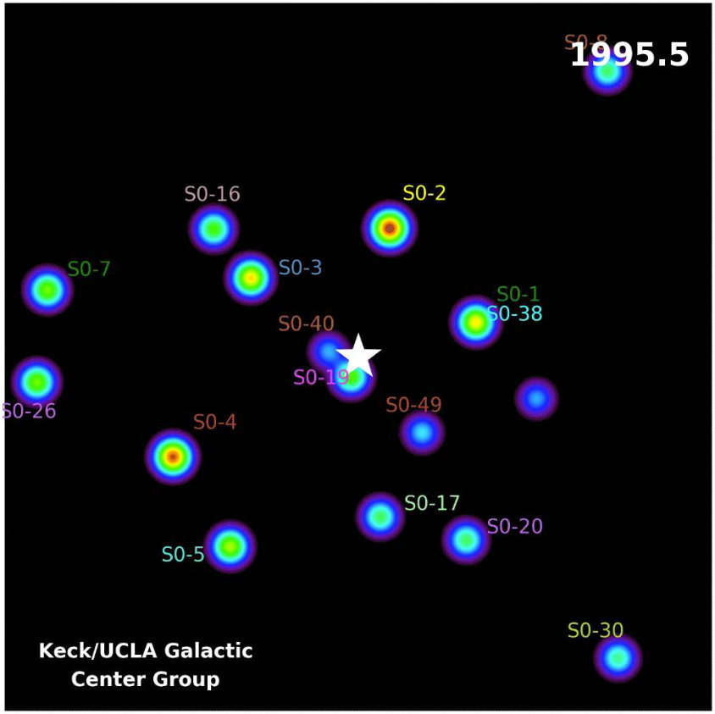
What’s at the center of the Milky Way?
Notes:
Source edition: assets/lessons/lectures/astronomy/discovery-of-the-milky-way.pdf, page 28. Original author and figure credits remain on the slide. Text is editable; illustrations retain their source artwork.

Slide 29
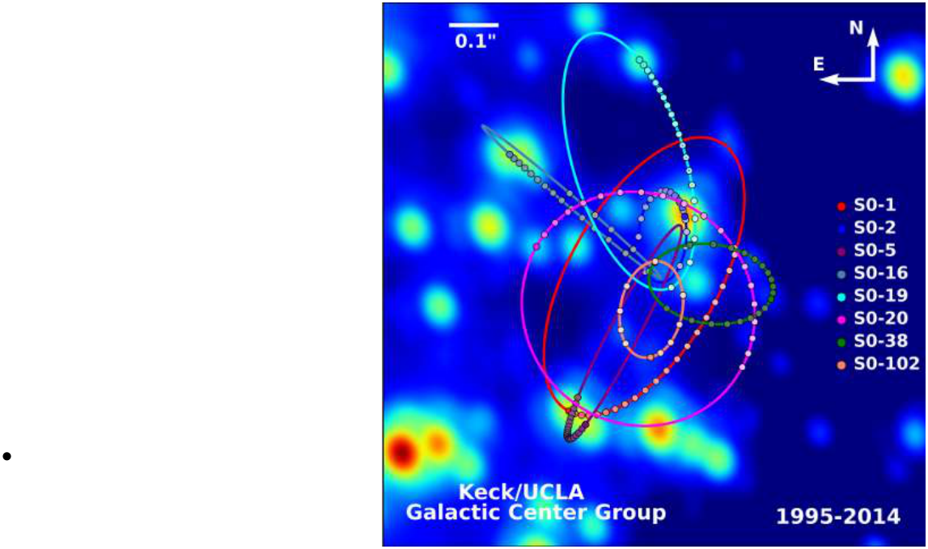
The Black Hole at the center of the Milky Way
Using Kepler’s and
Newton’s laws, we can
relate the size and the
period of the stellar
orbits to derive the
mass of the Milky Way’s
black hole.
M
~ 4 million solar
masses
Notes:
Source edition: assets/lessons/lectures/astronomy/discovery-of-the-milky-way.pdf, page 29. Original author and figure credits remain on the slide. Text is editable; illustrations retain their source artwork.

Slide 30
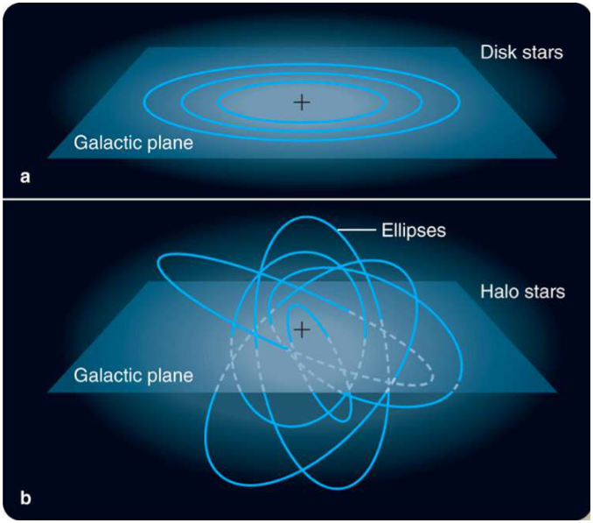
Disk vs. Halo and Bulge
•
Stars and gas in the
disk are all rotating
together in the same
general direction in
the plane of the disk
•
Stars in the halo and
bulge orbit in different
planes with no general
sense of rotation.
Notes:
Source edition: assets/lessons/lectures/astronomy/discovery-of-the-milky-way.pdf, page 30. Original author and figure credits remain on the slide. Text is editable; illustrations retain their source artwork.

Slide 31
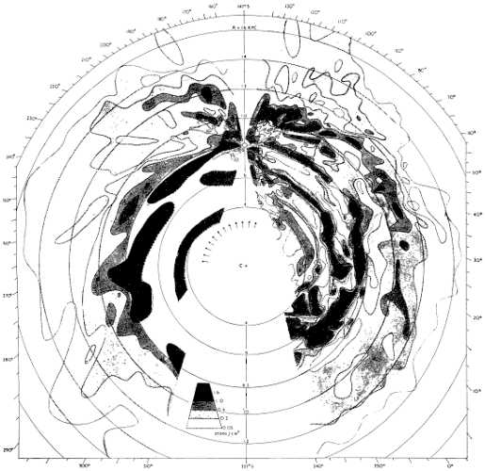
Spiral Arms
•
If you measure the
amount of gas as a
function of distance at
different positions, you
can make a map of the
spiral arms of the Milky
Way.
•
This is an early map in
neutral hydrogen.
Notes:
Source edition: assets/lessons/lectures/astronomy/discovery-of-the-milky-way.pdf, page 31. Original author and figure credits remain on the slide. Text is editable; illustrations retain their source artwork.

Slide 32
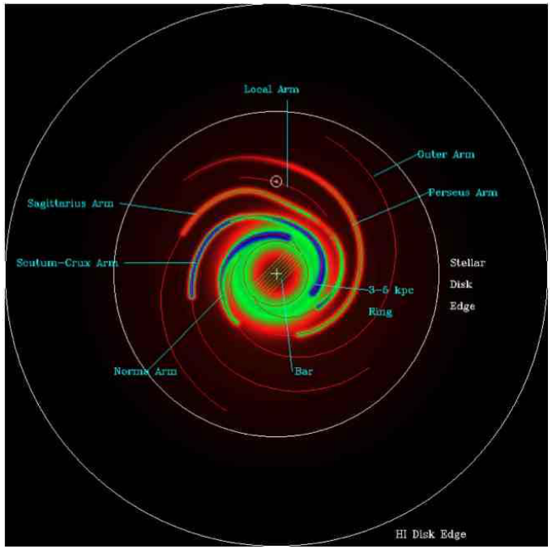
Spiral Arms
This is a more recent
map using just
electrons with various
features labeled.
Notes:
Source edition: assets/lessons/lectures/astronomy/discovery-of-the-milky-way.pdf, page 32. Original author and figure credits remain on the slide. Text is editable; illustrations retain their source artwork.

Slide 33

Spiral Arms
The same map as
before, but with
additional fictional
labels.
Notes:
Source edition: assets/lessons/lectures/astronomy/discovery-of-the-milky-way.pdf, page 33. Original author and figure credits remain on the slide. Text is editable; illustrations retain their source artwork.

Slide 34
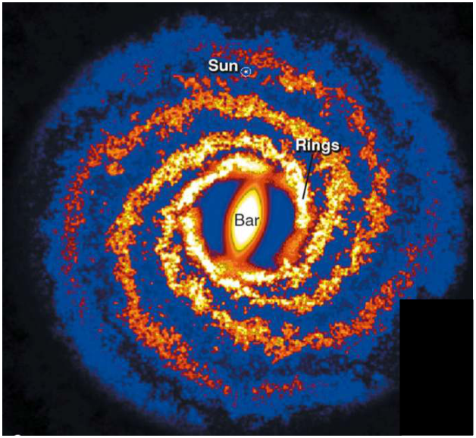
Spiral Arms
Another recent map
using the distribution of
dust to trace the spiral
arms.
Notice that this is the
first map that shows
the bar.
Notes:
Source edition: assets/lessons/lectures/astronomy/discovery-of-the-milky-way.pdf, page 34. Original author and figure credits remain on the slide. Text is editable; illustrations retain their source artwork.

Slide 35
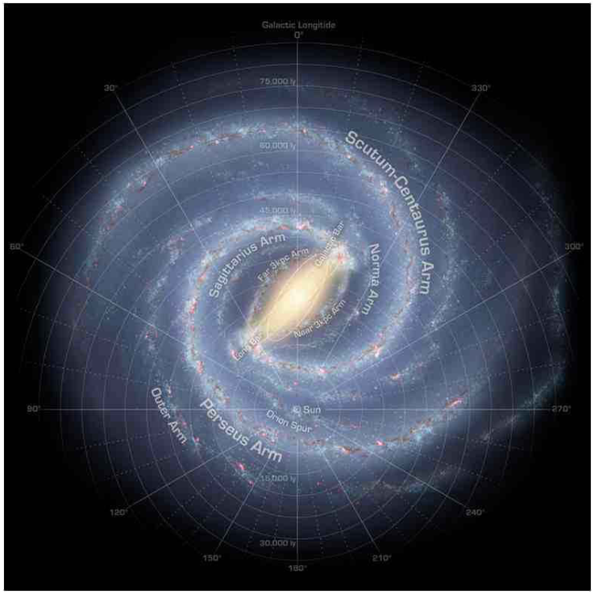
Spiral Arms
Artist’s conception
based on recent
measurements of
stellar distances in
the infrared
Notes:
Source edition: assets/lessons/lectures/astronomy/discovery-of-the-milky-way.pdf, page 35. Original author and figure credits remain on the slide. Text is editable; illustrations retain their source artwork.

Slide 36
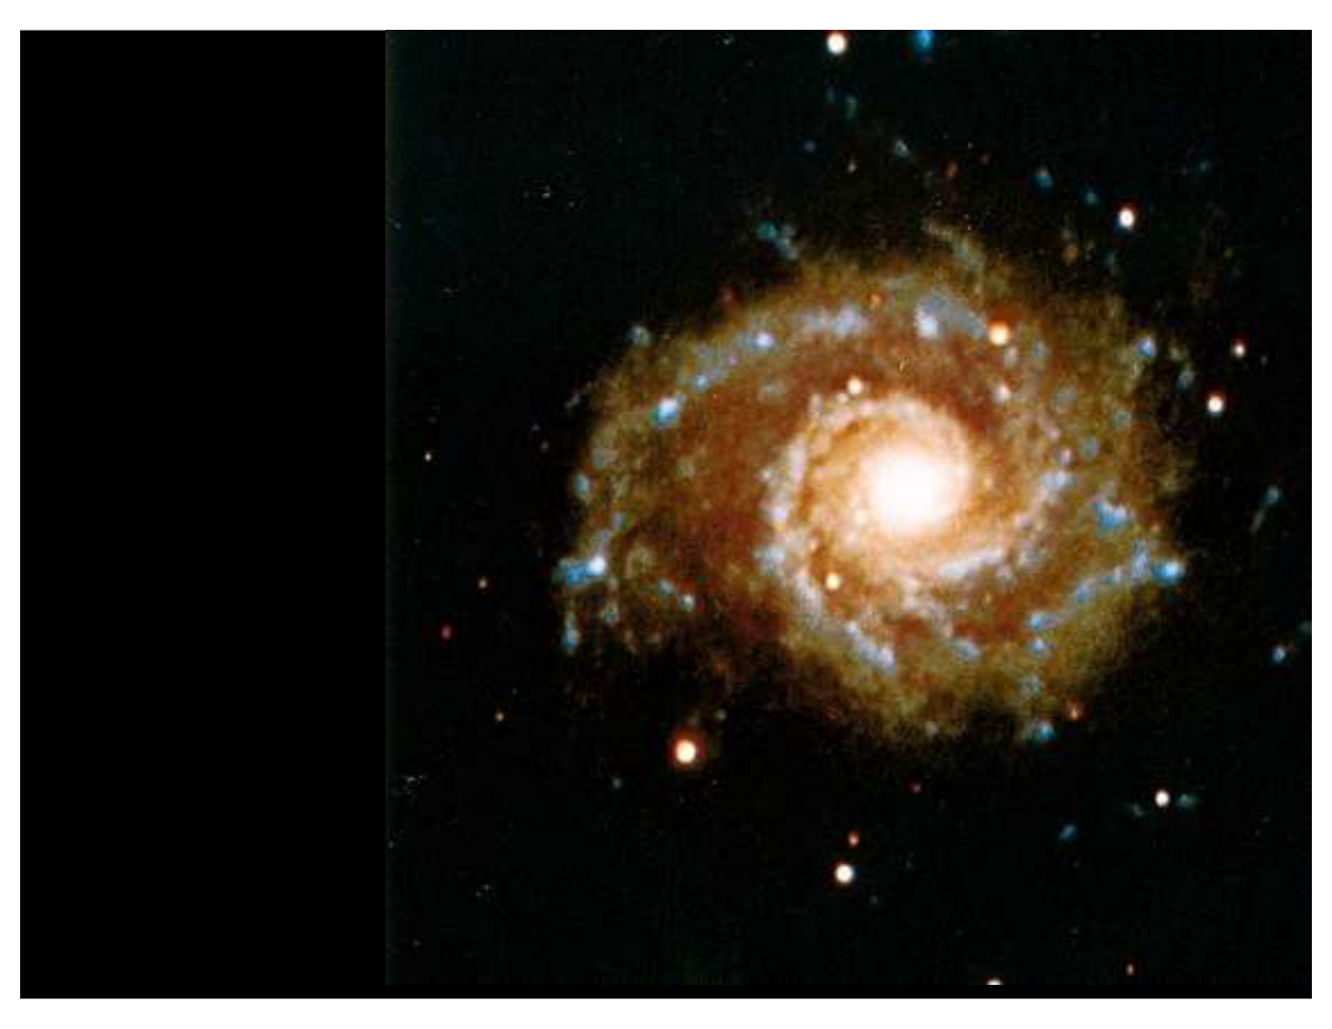
Colors in spiral arms
What do you
notice about
the colors of
the stars in the
spiral arms of
this galaxy?
Notes:
Source edition: assets/lessons/lectures/astronomy/discovery-of-the-milky-way.pdf, page 36. Original author and figure credits remain on the slide. Text is editable; illustrations retain their source artwork.

Slide 37
Stars in spiral arms
The arms of
spiral galaxies
contain most of
the bright, blue
O and B type
stars.
Notes:
Source edition: assets/lessons/lectures/astronomy/discovery-of-the-milky-way.pdf, page 37. Original author and figure credits remain on the slide. Text is editable; illustrations retain their source artwork.

Slide 38
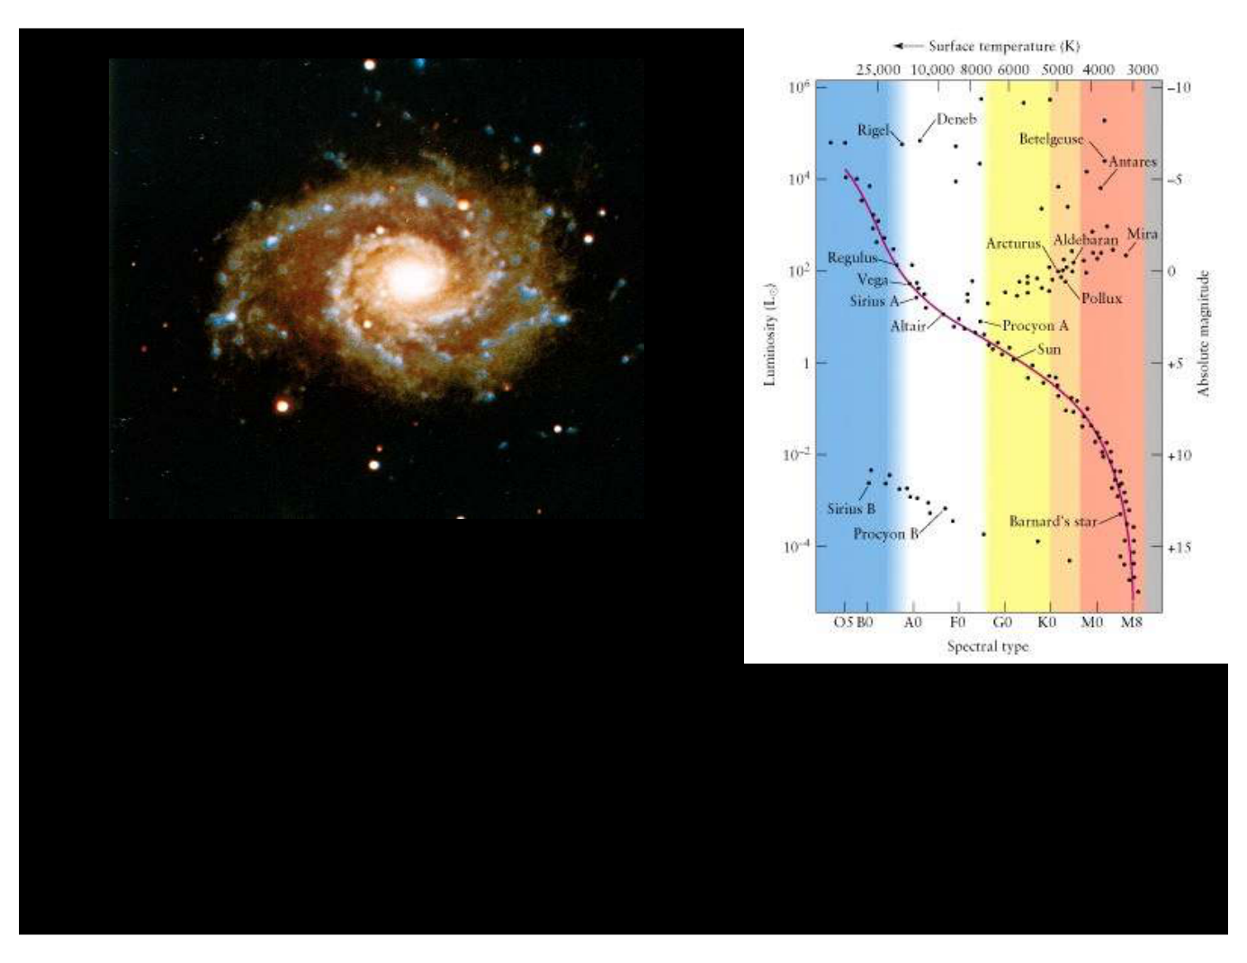
Discovery of the milky way
Stellar Lifetimes
•
Which live longer,
Red or Blue stars?
Notes:
Source edition: assets/lessons/lectures/astronomy/discovery-of-the-milky-way.pdf, page 38. Original author and figure credits remain on the slide. Text is editable; illustrations retain their source artwork.

Slide 39
Discovery of the milky way
Stellar Lifetimes
•
So the stars in the spiral arms are
mostly
bright, hot, and young stars
!
Notes:
Source edition: assets/lessons/lectures/astronomy/discovery-of-the-milky-way.pdf, page 39. Original author and figure credits remain on the slide. Text is editable; illustrations retain their source artwork.

Slide 40
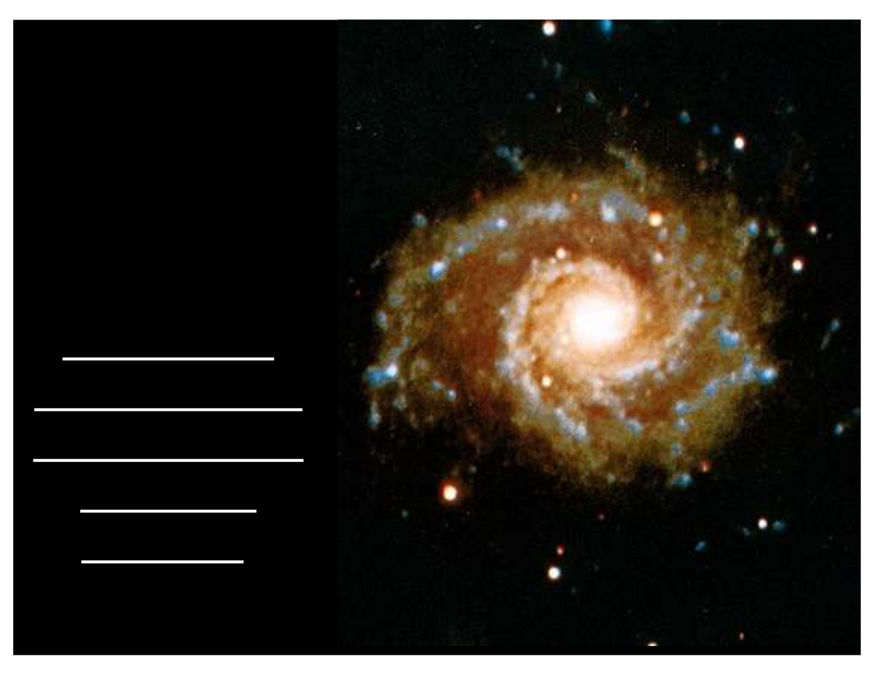
O stars and star formation
Since
O stars
have such a
short lifetime, it
must be that:
the arms of
spiral galaxies
are where star
formation
happens!
Notes:
Source edition: assets/lessons/lectures/astronomy/discovery-of-the-milky-way.pdf, page 40. Original author and figure credits remain on the slide. Text is editable; illustrations retain their source artwork.

Slide 41
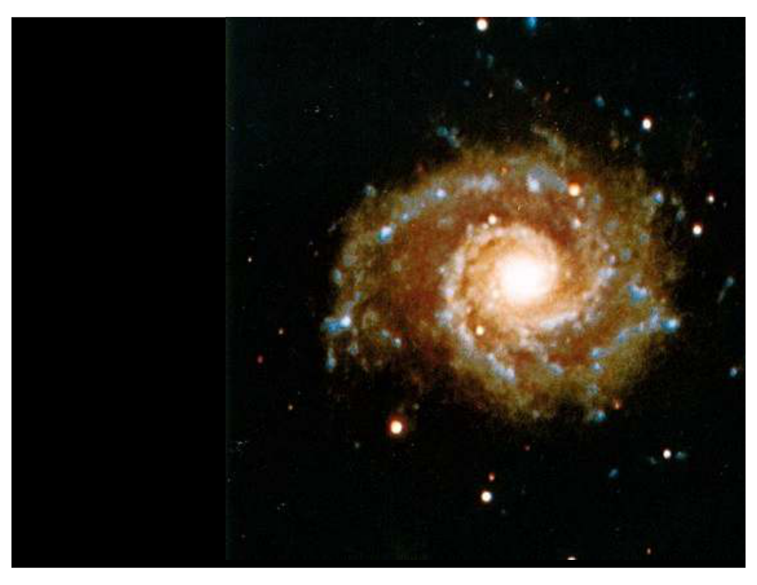
The structure of spiral arms
If stars form in the spiral
arms, how do they end
up getting spread out
over the whole disk?
Spiral arms are
not
permanent structures,
rather they are
locations
where stars are
forming
.
Notes:
Source edition: assets/lessons/lectures/astronomy/discovery-of-the-milky-way.pdf, page 41. Original author and figure credits remain on the slide. Text is editable; illustrations retain their source artwork.

Slide 42
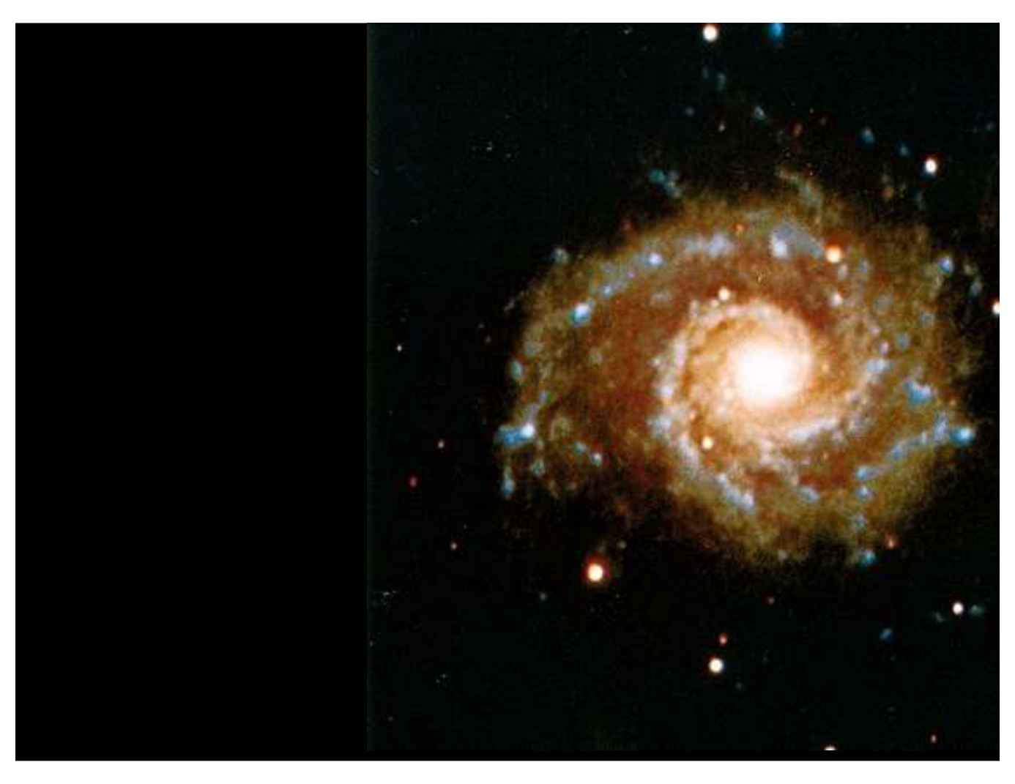
Spiral density waves
If spiral arms are
not
permanent structures,
then
what is making these locations
become active star forming
regions?
Spiral arms are caused by
spiral density waves –
a spiral
shaped disturbances traveling
through the disk of the galaxy
that compressed gas and
.
triggers star formation.
Notes:
Source edition: assets/lessons/lectures/astronomy/discovery-of-the-milky-way.pdf, page 42. Original author and figure credits remain on the slide. Text is editable; illustrations retain their source artwork.

Slide 43
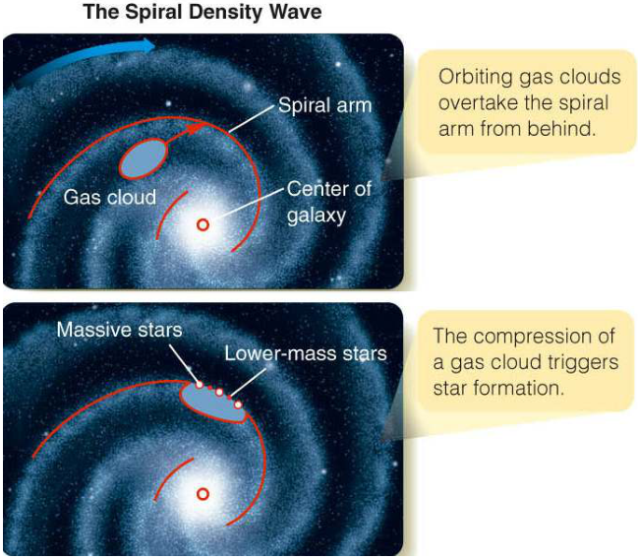
Spiral Density Waves
•
Spiral arms are like
traffic jams: stars and
gas bunch up as they
move through them.
•
As the gas
compresses, star
formation is triggered.
Notes:
Source edition: assets/lessons/lectures/astronomy/discovery-of-the-milky-way.pdf, page 43. Original author and figure credits remain on the slide. Text is editable; illustrations retain their source artwork.

Slide 44
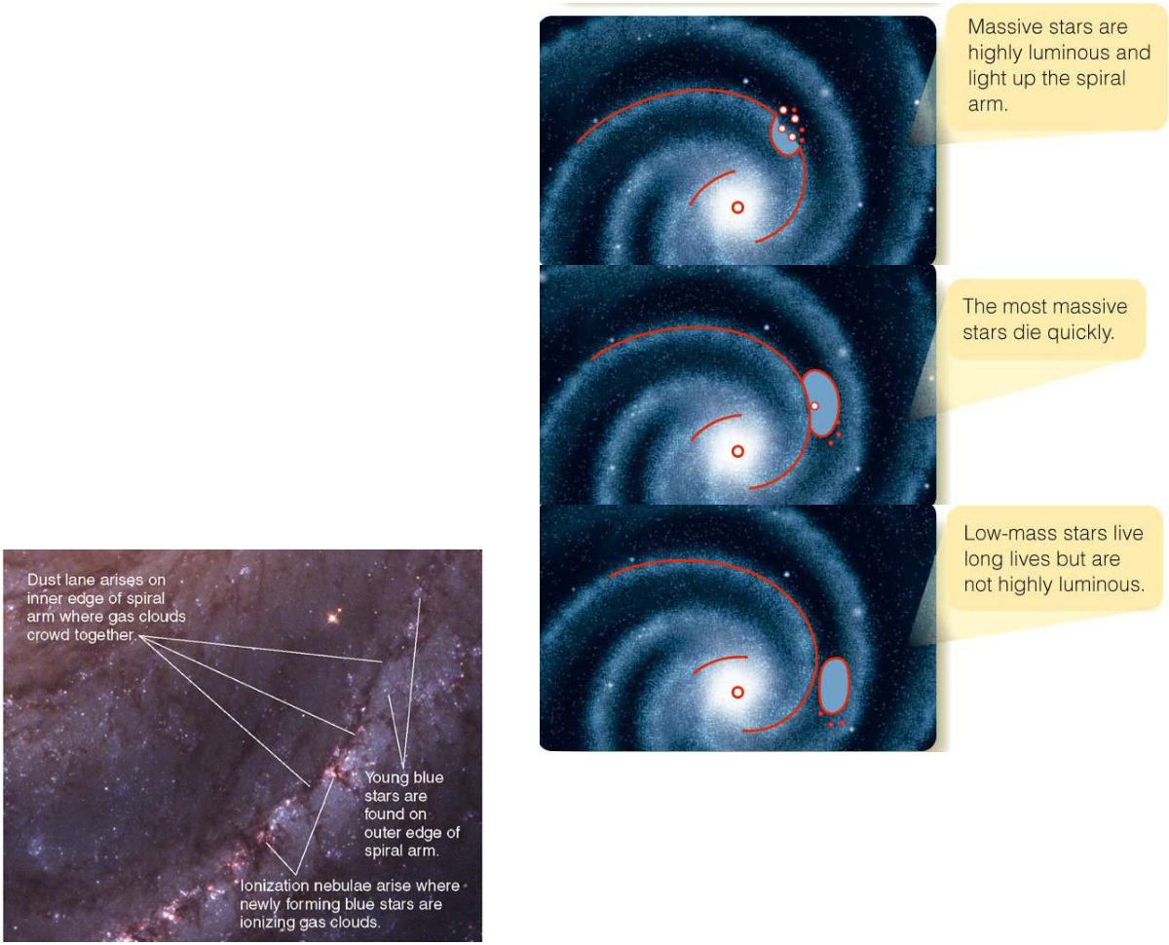
Stars crossing spiral arms
•
Massive, luminous, blue
stars are only seen
close to the spiral arm.
•
Longer-lived, fainter,
low-mass stars (like our
Sun) continue on
through many spiral
arms.
Notes:
Source edition: assets/lessons/lectures/astronomy/discovery-of-the-milky-way.pdf, page 44. Original author and figure credits remain on the slide. Text is editable; illustrations retain their source artwork.

Slide 45
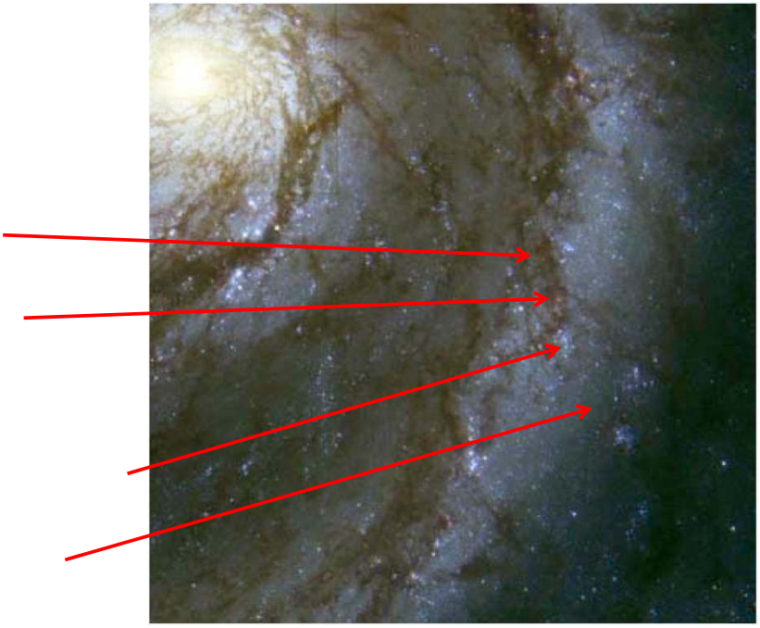
Star Formation across spiral arms
•
We can see many of the
stages of star formation
across a spiral arm.
•
Molecular clouds
•
ionization nebulae
(reddish; associated
with protostars)
•
Main Sequence O Stars
(blue)
•
lower mass main
sequence stars (red)
Notes:
Source edition: assets/lessons/lectures/astronomy/discovery-of-the-milky-way.pdf, page 45. Original author and figure credits remain on the slide. Text is editable; illustrations retain their source artwork.

Slide 46
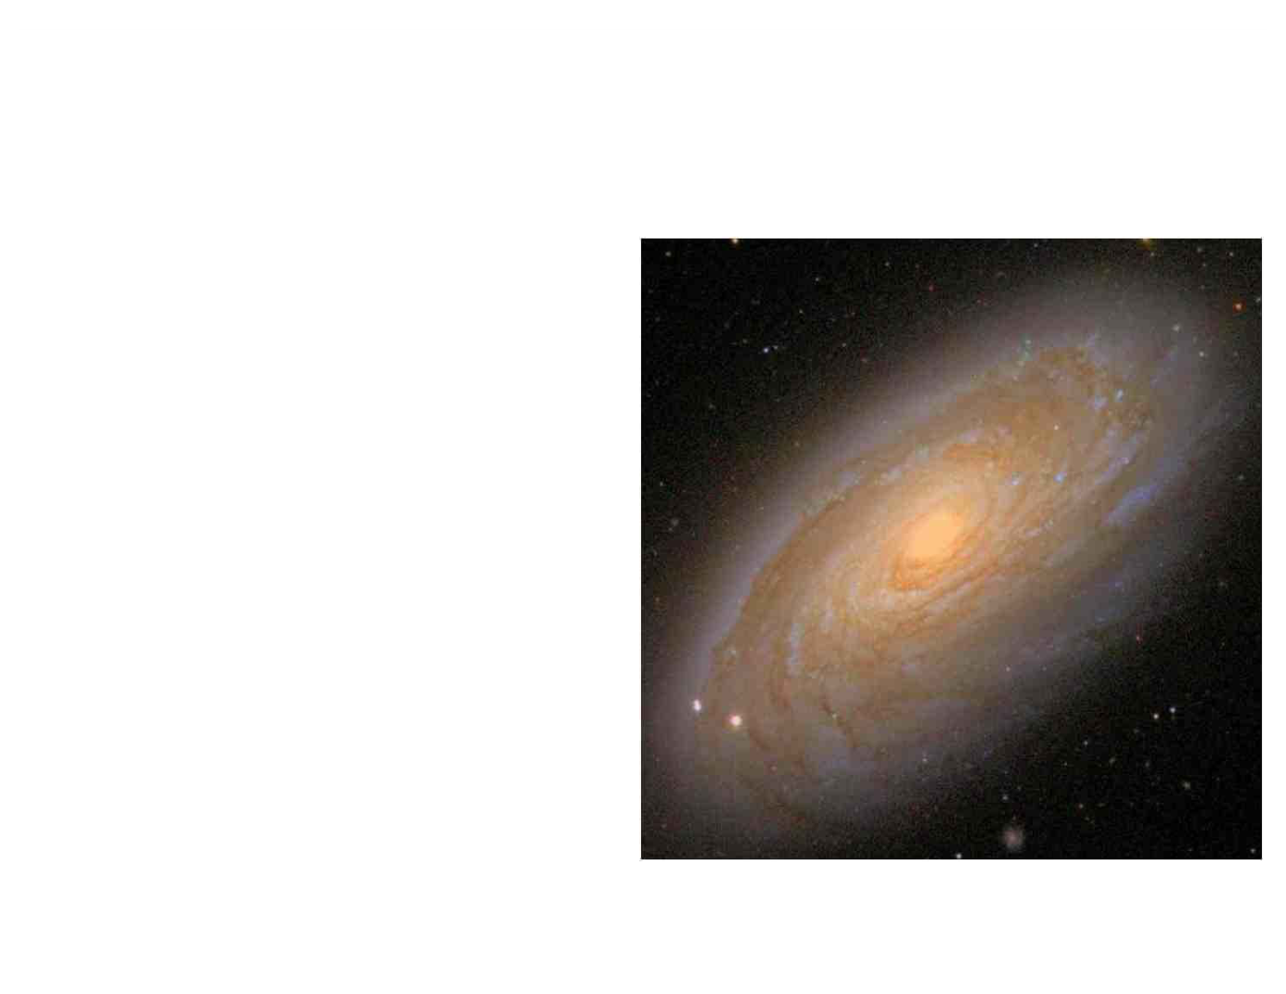
Stars in the bulge
What color is the
center of the galaxy?
Notes:
Source edition: assets/lessons/lectures/astronomy/discovery-of-the-milky-way.pdf, page 46. Original author and figure credits remain on the slide. Text is editable; illustrations retain their source artwork.

Slide 47
Stars in the bulge
•
Stars in the bulge
of our galaxy are
redder
than stars in
the disk.
•
Are they low or high
mass stars?
•
Are they younger or
older?
Notes:
Source edition: assets/lessons/lectures/astronomy/discovery-of-the-milky-way.pdf, page 47. Original author and figure credits remain on the slide. Text is editable; illustrations retain their source artwork.

Slide 48
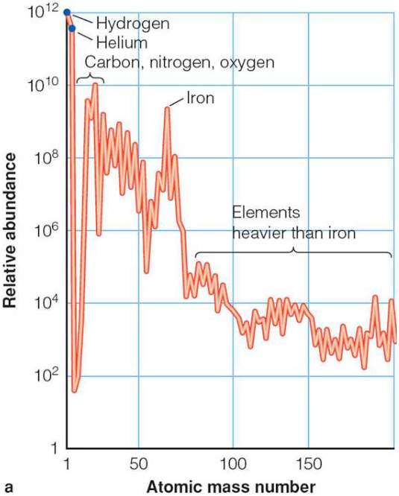
Metals (astronomically speaking)
•
Any element more massive than
hydrogen and helium is called a
metal
(but only by astronomers).
•
“Metals” are elements that can
only be formed in stars.
•
Hydrogen and Helium were
produced when the Universe
formed.
•
The more metals in a star, the
more generations of stars that
formed before it.
•
The amount of metals in a star
serves as clock for star
formation
Notes:
Source edition: assets/lessons/lectures/astronomy/discovery-of-the-milky-way.pdf, page 48. Original author and figure credits remain on the slide. Text is editable; illustrations retain their source artwork.

Slide 49
Populations of stars
Stars in galaxies can be divided into two
populations:
• Population I
• Population II
Population I stars are in the
disk.
They are
younger, bluer and contain more
metals.
Population II stars are in the
halo
and
bulge
.
They are older, redder, and contain fewer
metals.
Notes:
Source edition: assets/lessons/lectures/astronomy/discovery-of-the-milky-way.pdf, page 49. Original author and figure credits remain on the slide. Text is editable; illustrations retain their source artwork.

Slide 50
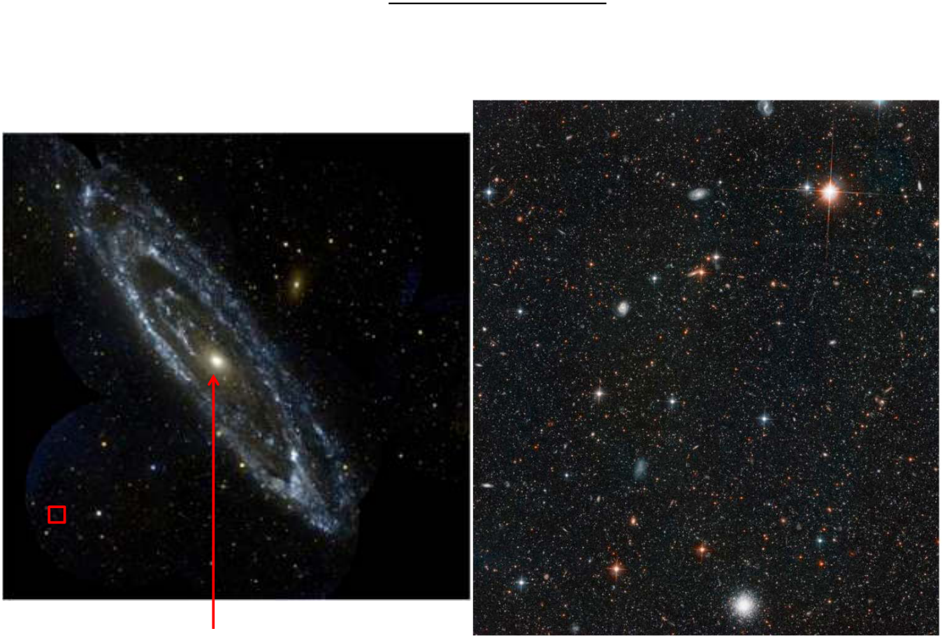
Discovery of the milky way
For the bulge & halo:
Are they red or blue?
Are the stars lower or higher mass than the disk?
Are the stars younger or older than the disk stars?
Bulge
Halo stars
Notes:
Source edition: assets/lessons/lectures/astronomy/discovery-of-the-milky-way.pdf, page 50. Original author and figure credits remain on the slide. Text is editable; illustrations retain their source artwork.

Slide 51
Milky Way Structure
•
Disk
–
diameter of 30 kpc and 1 kpc thick near the Sun
–
Sun is located 8.5 kpc from center of Milky Way in the disk
–
active star formation in disk
•
Bulge
–
diameter of 4 kpc located at the center of the galaxy
–
more spherical than disk
–
supermassive black hole at the center (in nucleus)
•
Bar
–
seen in stars and dust, extends 6 kpc through center of galaxy
•
Halo
–
100s of kpc in diameter, only contains 2% of stars in galaxy
–
includes globular clusters and
dark matter
composing most of
the mass of galaxy.
Notes:
Source edition: assets/lessons/lectures/astronomy/discovery-of-the-milky-way.pdf, page 51. Original author and figure credits remain on the slide. Text is editable; illustrations retain their source artwork.

Slide 52
Ages of stars in the Milky Way
•
Disk stars: 0-10 billion years old, metal-rich
(Population I)
–
Spiral arms have stars < 100 million years old
–
stars in the rest of the disk, 0.2-10 billion years old
•
Bulge stars: 2-10 billion years old, metal-poor
(Population II)
•
Halo stars: 10-13 billion years old, very metal-
poor (Population II)
Notes:
Source edition: assets/lessons/lectures/astronomy/discovery-of-the-milky-way.pdf, page 52. Original author and figure credits remain on the slide. Text is editable; illustrations retain their source artwork.

Slide 53
Discovery of the milky way
So what about other galaxies?
Notes:
Source edition: assets/lessons/lectures/astronomy/discovery-of-the-milky-way.pdf, page 53. Original author and figure credits remain on the slide. Text is editable; illustrations retain their source artwork.

